Slide 1

THE MAGIC R IN GRRMHD
Debora Lančová
Silesian University in Opava
X-Ray Data Modelling of Accreting Black Holes
July 23, 2021
Hradec nad Moravicí

Slide 2

Simulation of accretion processes in the vicinity of BH and NS
GRRMHD simulations of Puffy disk (Maciek Wielgus, David Abarca, Marek Abramowicz, Wlodek Kluzniak, Aleksandr Sądowski, Ramesh Narayan, Gabriel Török, …)
Influence of radiation on behaviour of particles orbiting a BH (Pavel Bakala, Maurizio Falanga, Luigi Stella, Vittorio de Falco, …)
Simulation of QPOs sources and it’s observation (Gabriel Török, Kateřina Klimovičová, Martin Urbanec and other students from Opava University)
Organizing workshops and conferences ☺
5 minute student session

Slide 3
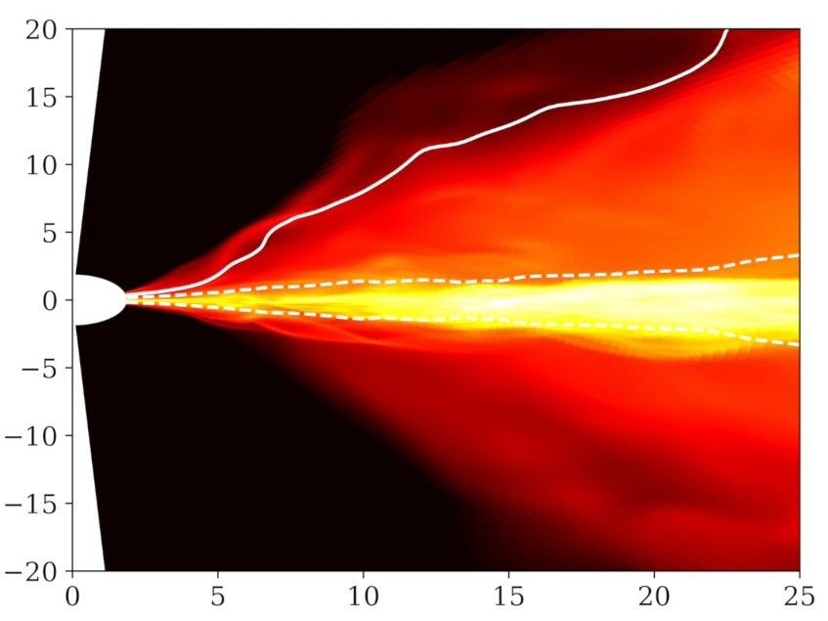
PUFFY DISK
0.6 Eddington
Not thin nor slim… Puffy!
Follows work done of Sądowski 2016
Radiation pressure dominated but stable due to magnetic field
Thin high-density core
Thick photosphere, turbulent hot puffy region
Thicker than Slim disk model, different vertical structure

Slide 4
PUFFY DISK
Ray-traced images and spectra obtained by the HEROIC code (Narayan+ 2016)
Inner part is obscured on high inclination angle
M. Wielgus
M. Wielgus

Slide 5
PUFFY DISK
M. Wielgus

Slide 6
THE MAGIC R

Slide 7
GENERAL RELATIVISTIC RADIATIVE MAGNETOHYDRODYNAMIC
Notes:
csvukrs

Slide 8
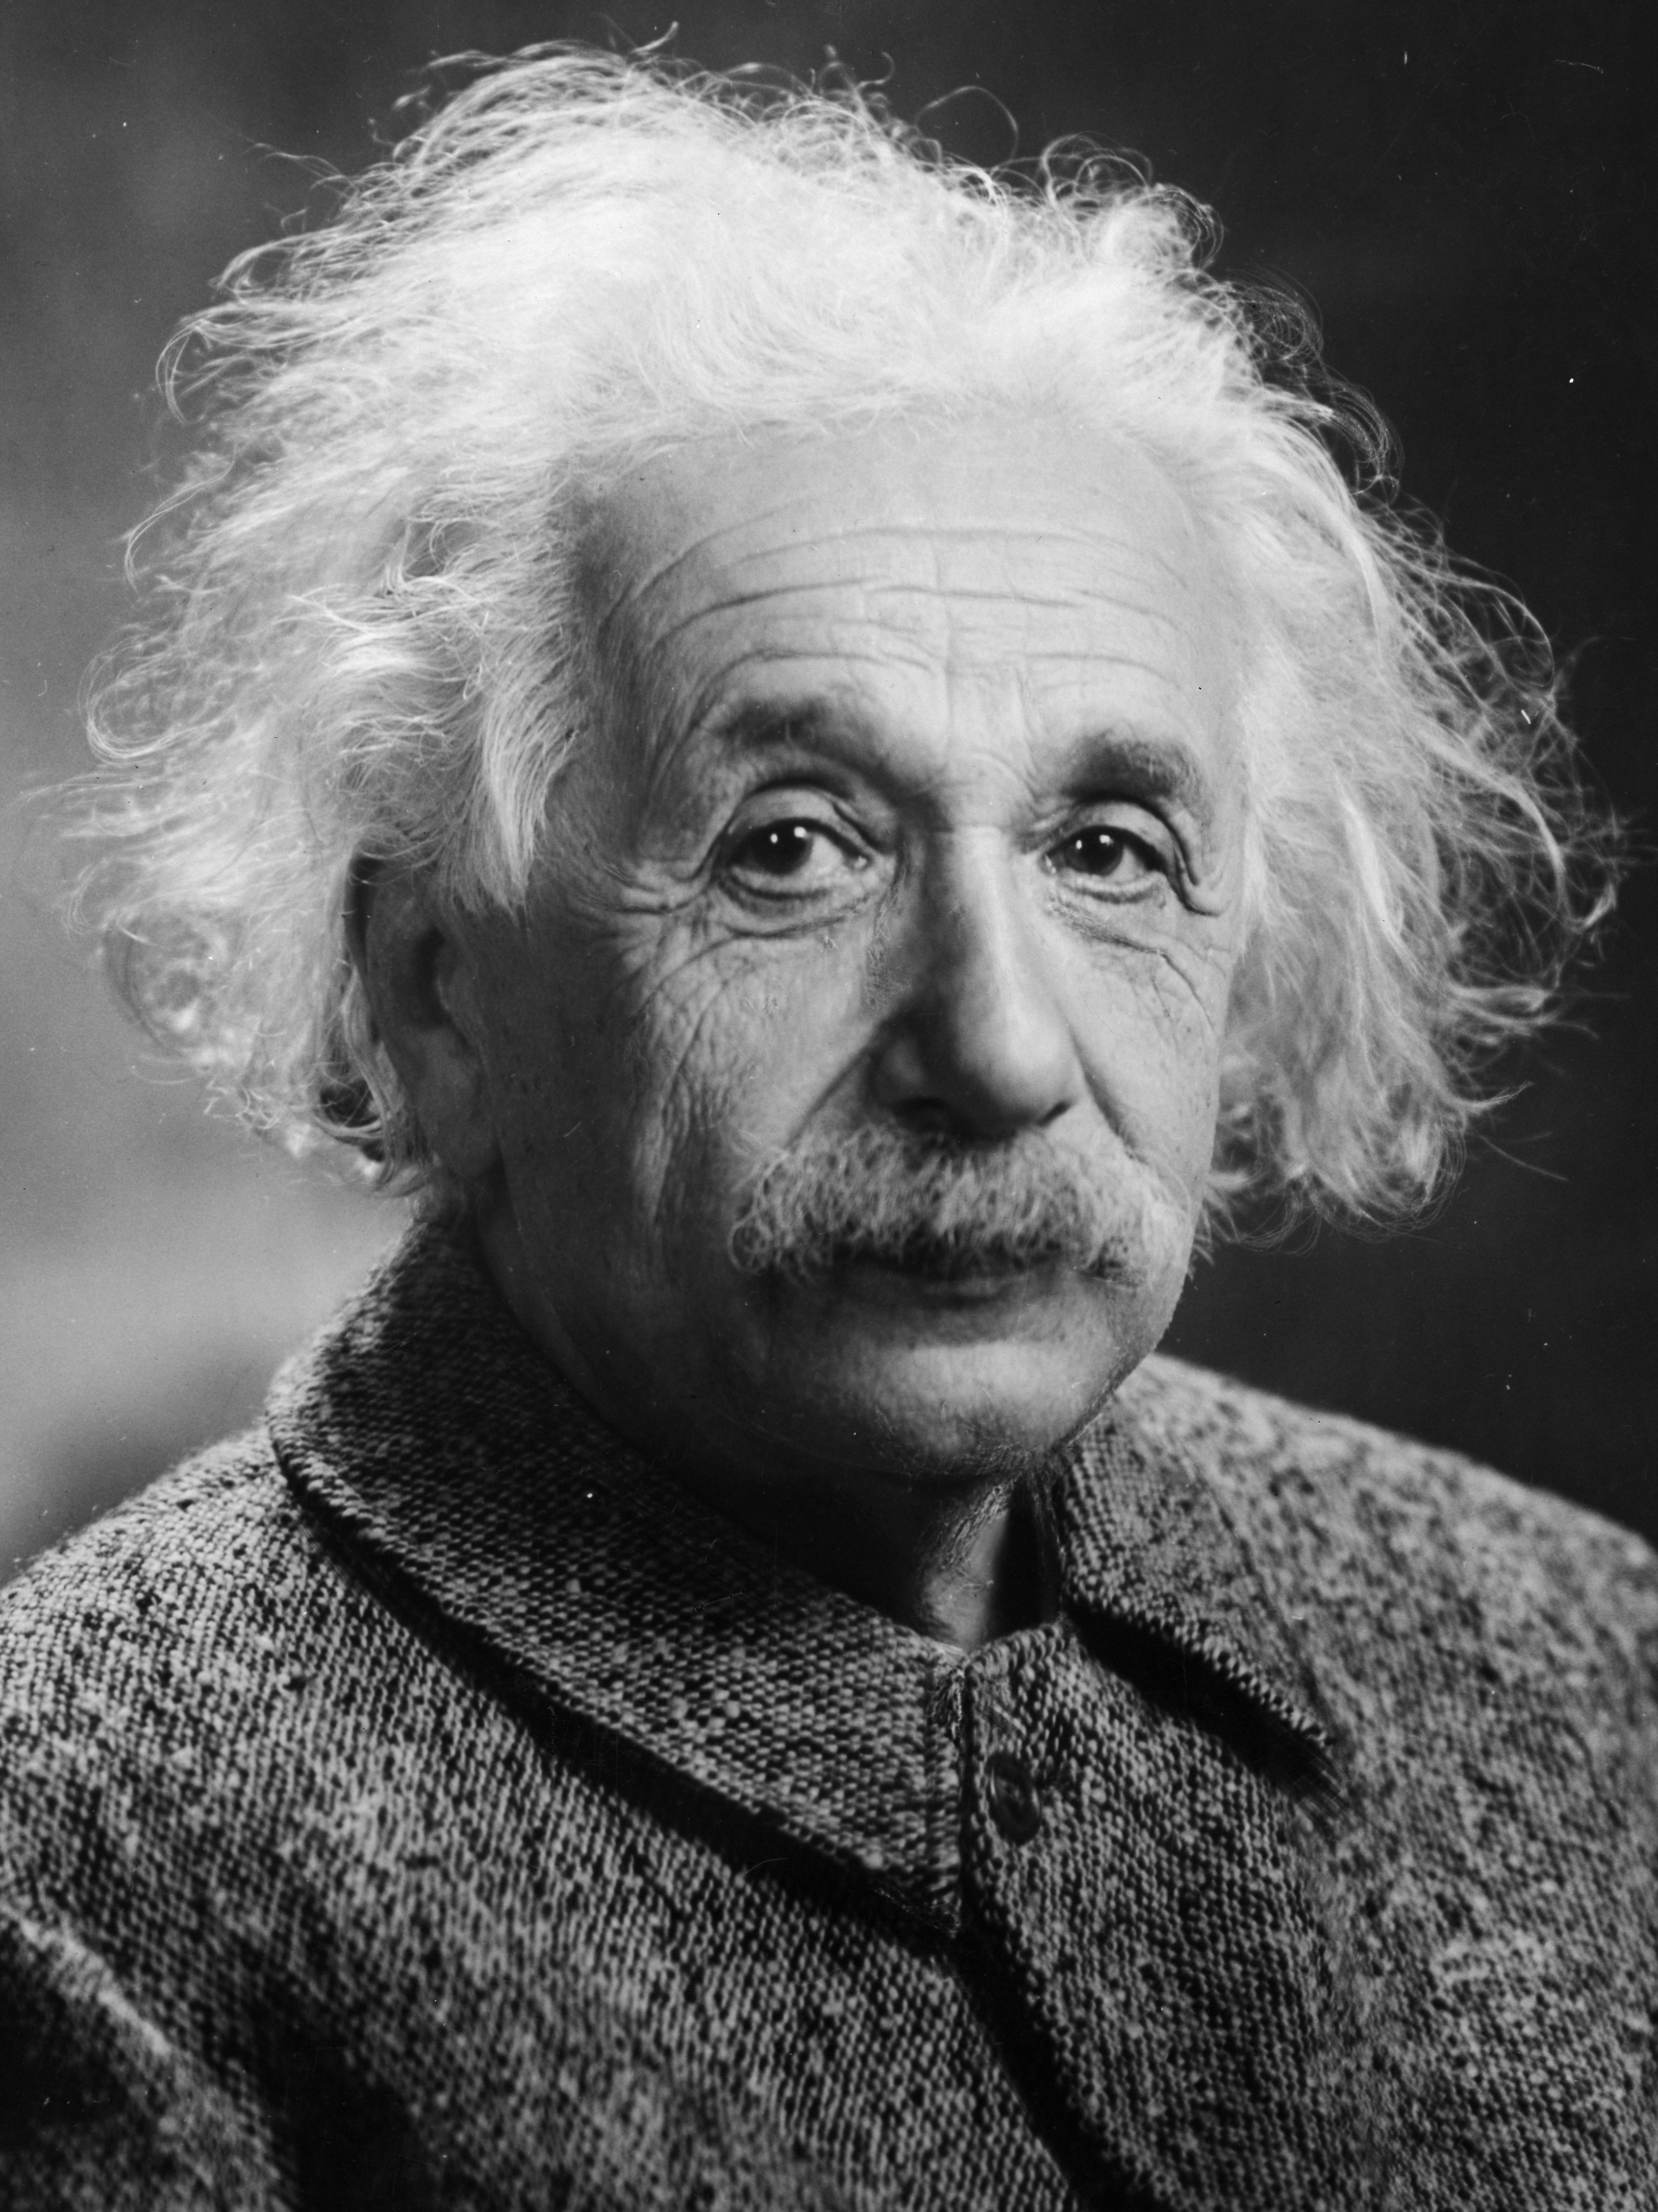
GENERAL RELATIVISTIC RADIATIVE MAGNETOHYDRODYNAMIC
Notes:
csvukrs

Slide 9

GENERAL RELATIVISTIC RADIATIVE MAGNETOHYDRODYNAMIC
Notes:
csvukrs

Slide 10
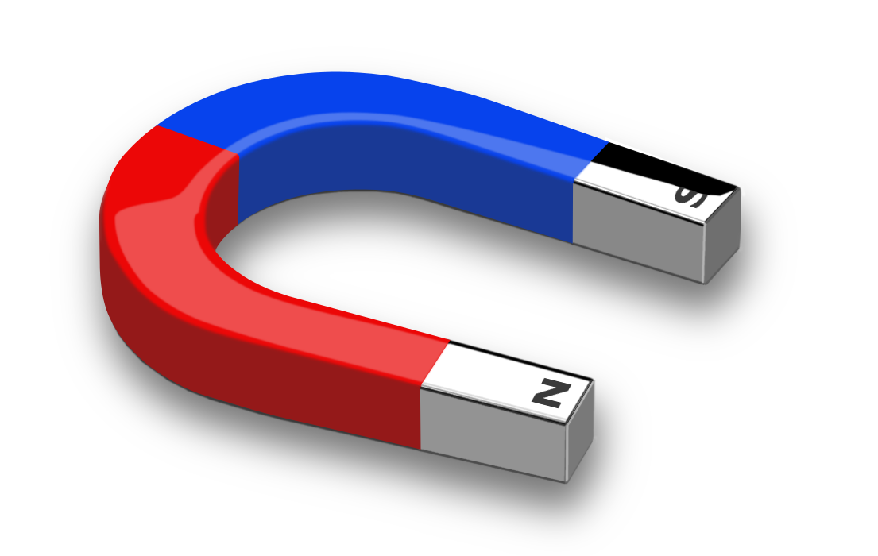
GENERAL RELATIVISTIC RADIATIVE MAGNETOHYDRODYNAMIC
Notes:
csvukrs

Slide 11
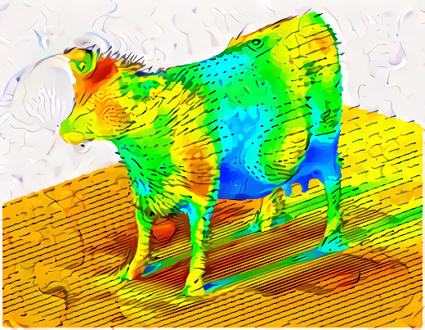
GENERAL RELATIVISTIC RADIATIVE MAGNETOHYDRODYNAMIC
Notes:
csvukrs

Slide 12
GENERAL RELATIVISTIC RADIATIVE MAGNETOHYDRODYNAMIC
Notes:
csvukrs

Slide 13
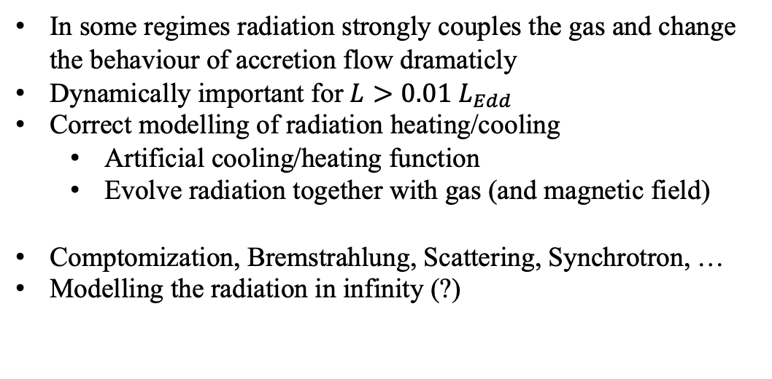
Why we need radiation?
In some regimes radiation strongly couples the gas and change the behaviour of accretion flow dramaticly
Dynamically important for $L>0.01 L_{Edd}$
Correct modelling of radiation heating/cooling
  Artificial cooling/heating function
  Evolve radiation together with gas (and magnetic field)
Comptomization, Bremstrahlung, Scattering, Synchrotron, …
Modelling the radiation in infinity (?)

Slide 14
KORAL
Sądowski+ 2013a,b, 2015, 2017, Chael+ 2019
Global 3D two-temperature GRRMHD code
Godunov finite-diference code with semi-implicit radiation-gas coupling solver
Using M1 radiation closure
Arbitraty metric (analytical and numerical)
Logaritmic grid
2D dynamo – imitate 3D magnetic field – enables longer simulations with MRI
MPI paralized
https://github.com/achael/koral_lite

Slide 15
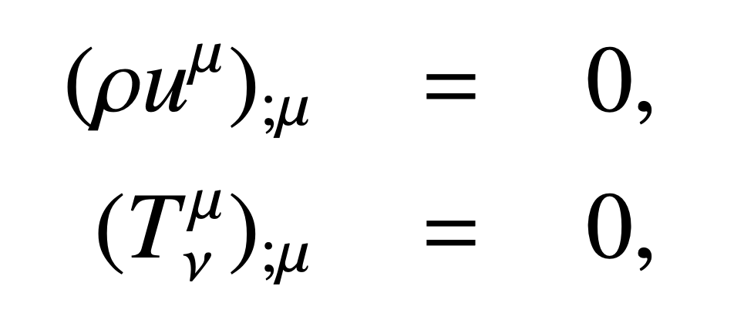
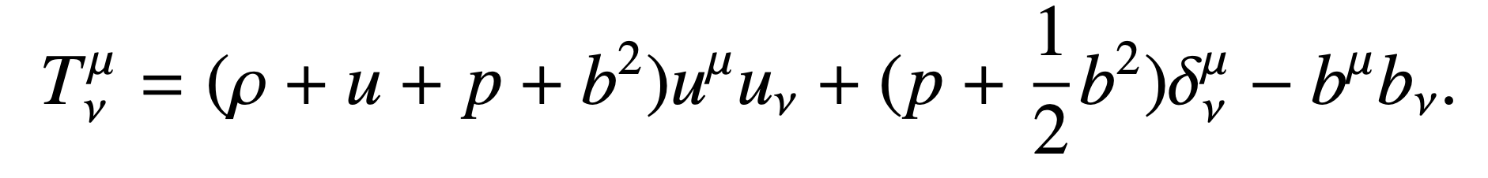
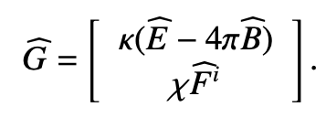
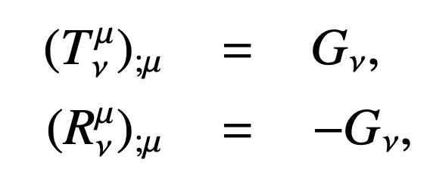
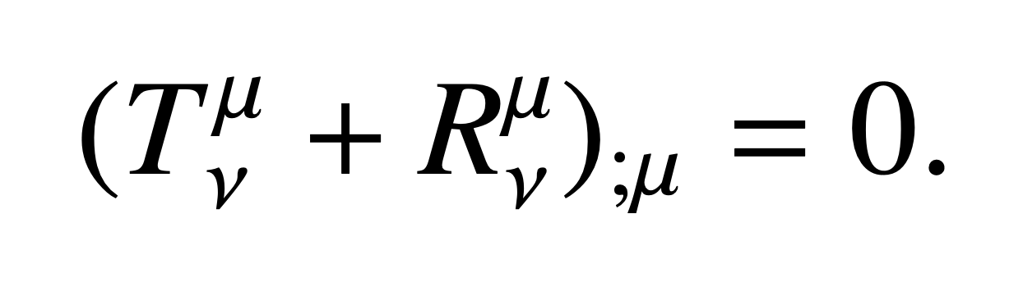
RADIATION IN MHD
CONSERVATION LAWS
MHD stress-energy tensor
RADIATION
In the fluid-frame
RADIATION 4-FORCE DENSITY
Sądowski+ 2013a,b, Mihalas+Mihalas 1984
Notes:
G given by - k – absorbtion, X – total opacity coefficient (x = k + k scattering), B integrated Planc function B=sigmaT^4/pi,

Slide 16



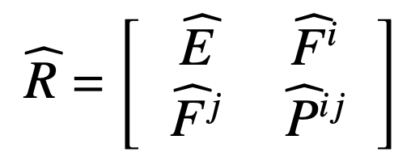
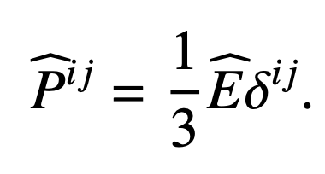
Closure scheme
How to compute full knowing only radiative energy density and fluxes
Eddington closure
  Assuming almost isotropic radiation field
  Works in optically thick regimes
Sądowski+ 2013a,b, Levermore 1984
Notes:
Pij radiation pressure tensor

Slide 17
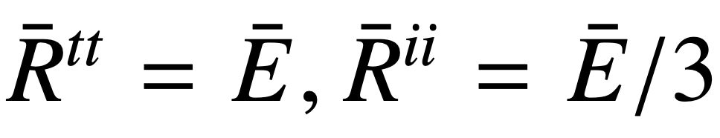
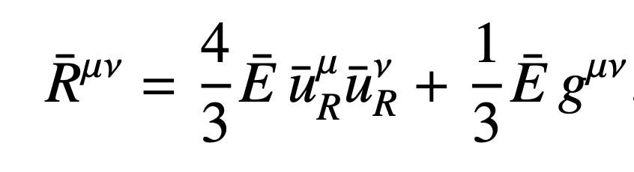

M1 closure
Radiation tensor is isotropic in orthonormal „rest frame“ of the radiation
works in lab frame with - 4velocity of radiation rest frame measured by observer in lab frame
Sądowski+ 2013a,b, Levermore 1984
Notes:
R carka is in covariant form,
Full R tensor depends only on the radiative energy density and the 4velocity of the radiation rest frame, but the 4velocity is normalised – thus we have 4 given tensor elements and 4 unknowns and we can solve for the whole tensor

Slide 18
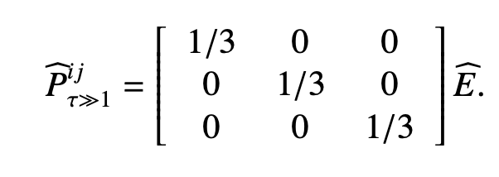
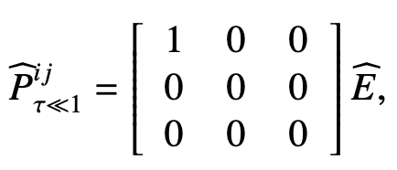

M1 closure
Optically thick
Optically thin
Specific intensity is always symmetric with respect to the mean flux
Only approximative with multiple source of light
Sądowski+ 2013a,b, Levermore 1984
Notes:
Thick – eddington, thin – intensity distribution as dirac delta function parallel to flux vector

Slide 19
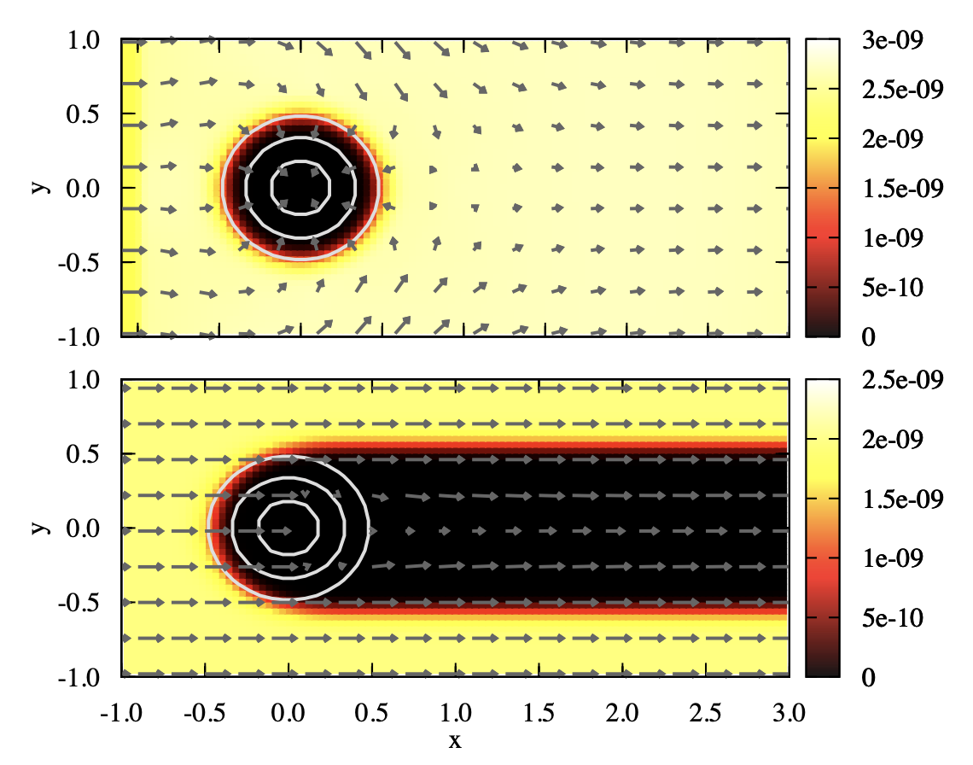
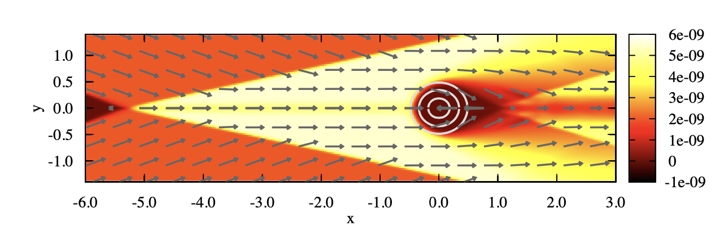
Shadow test
Eddington
M1
Sądowski+ 2013a
Notes:
Thick – eddington, thin – intensity distribution as dirac delta function parallel to flux vector

Slide 20

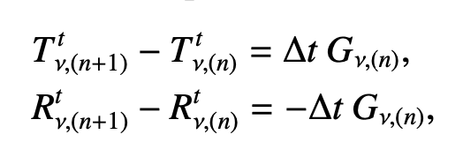
Semi-implicit scheme
Explicit scheme works well until we get into very optically thick regions - becomes too big and the solver numerically unstable
KORAL implements semi-implicit scheme and approximative analytical method if this scheme fails
Radiation shocks in optically thin regime – KORAL includes shock-capturing mechanism
Sądowski+ 2013a,b
Notes:
Thick – eddington, thin – intensity distribution as dirac delta function parallel to flux vector

Slide 21
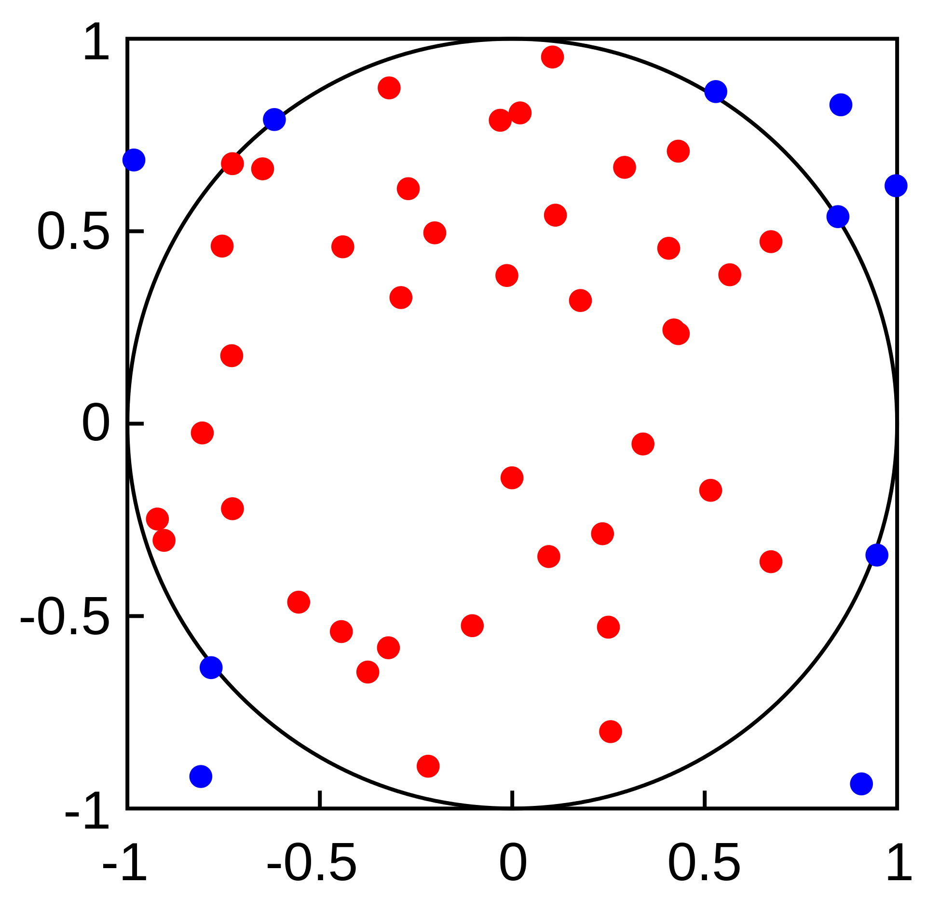
Monte Carlo methods (GRMCRMHD)
Fill the domain with sample photons and see how they interact with matter
Can be used for modelling optically thin accretion flows (eg. bhlight by Ryan+2015)
Photons can propagate in any direction – multiple light sources
Can be used for frequency-dependent radiative transport
In optically thick regions the mean free path of the photons is too short – billions of particles would be needed

Slide 22
Other methods
FLD – Flux-limited diffusion (Levermore+ 1981)
Non-LTE methods – implemented in PLUTO (Colombo+ 2019)
OTVET – time-dependent radiation transfer equations (Jiang+2014) – ATHENA code
Thank you!

Slide 23
FINAL REMARKS

Slide 24
What we learned?
A lot about X-ray observatories, data processing, different models, how to use several codes and patch them together
Timing!
How to use mc, vi, cp, cd, mv, rm, :wq …

Slide 25
Dark text is not good on adark background

Slide 26
What we learned?
A lot about X-ray observatories, data processing, different models, how to use several codes and patch them together
Timing!
How to use mc, vi, cp, cd, mv, rm, :wq …
Dark text is not good on a dark background
Apparently, internet can be eaten by something
3D people are much better than 2D people!
How many bubbles is in jacuzzi?

Slide 27
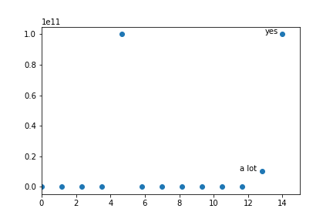
The bubbles
14 answers
Change units – a lot = 60
Remove strange data

Slide 28
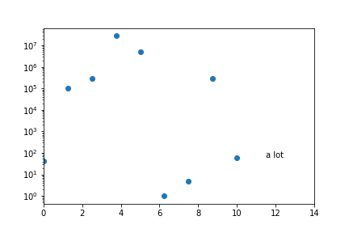
The bubbles
0 bubbles is not a jacuzzi
Is 0.5 bubble still a bubble?

Slide 29
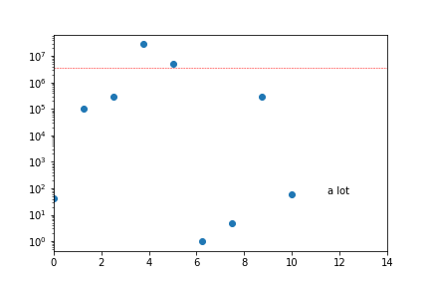
The bubbles
0 bubbles is not a jacuzzi
Is 0.5 bubble still a bubble?

Slide 30
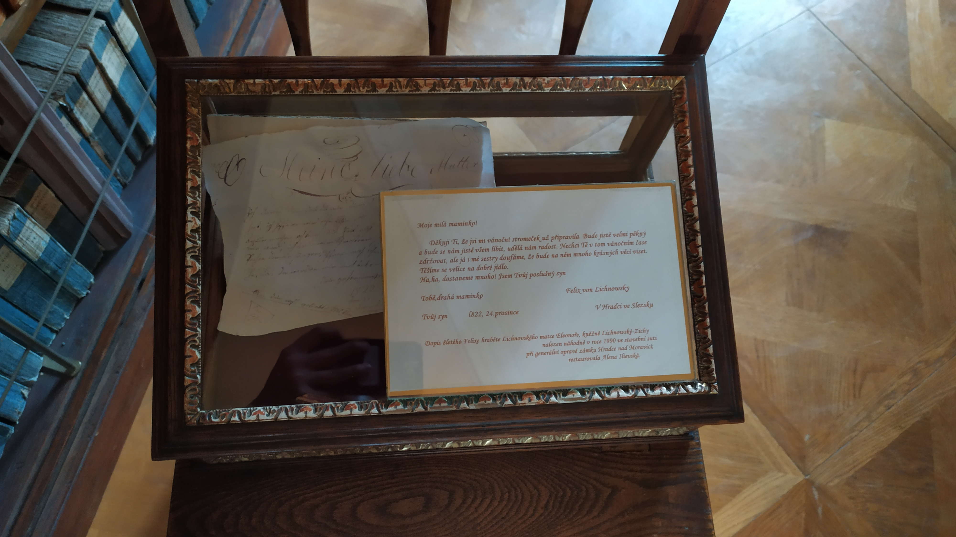
Letter from Felix to Iossif
My dear friend,
I will not apply the Fourier transform to just one light curve realization any more and will work only in the frequency domain....
Felix Lichnovsky, Hradec nad Moravici

Slide 31
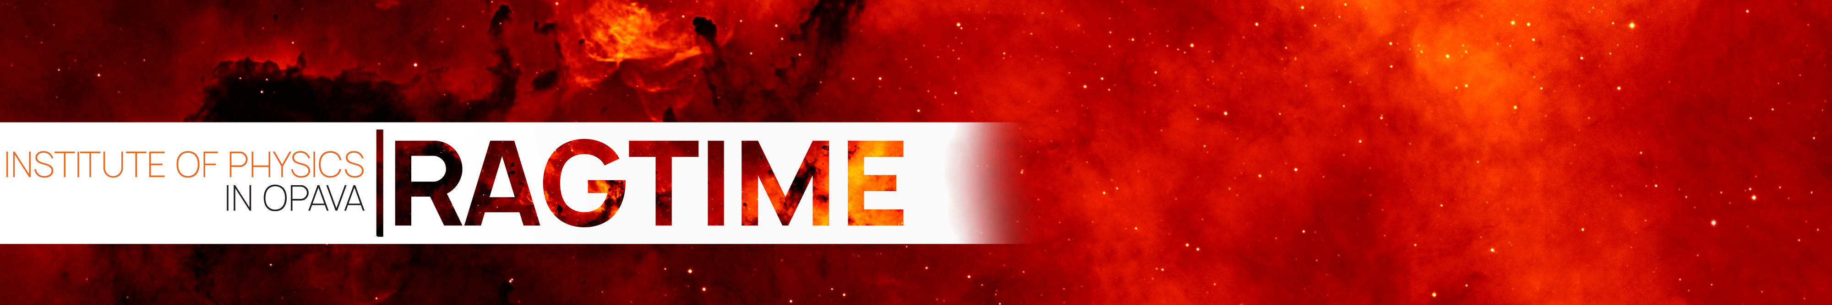
RAGTIME!
September 6-10 2021, Opava
www.ragtime23.physics.cz
Registration and abstract submission by the end of July!

Slide 32
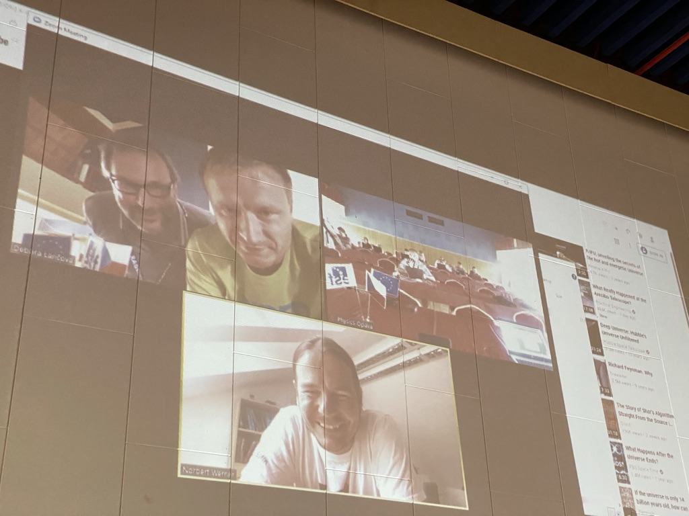

Slide 33
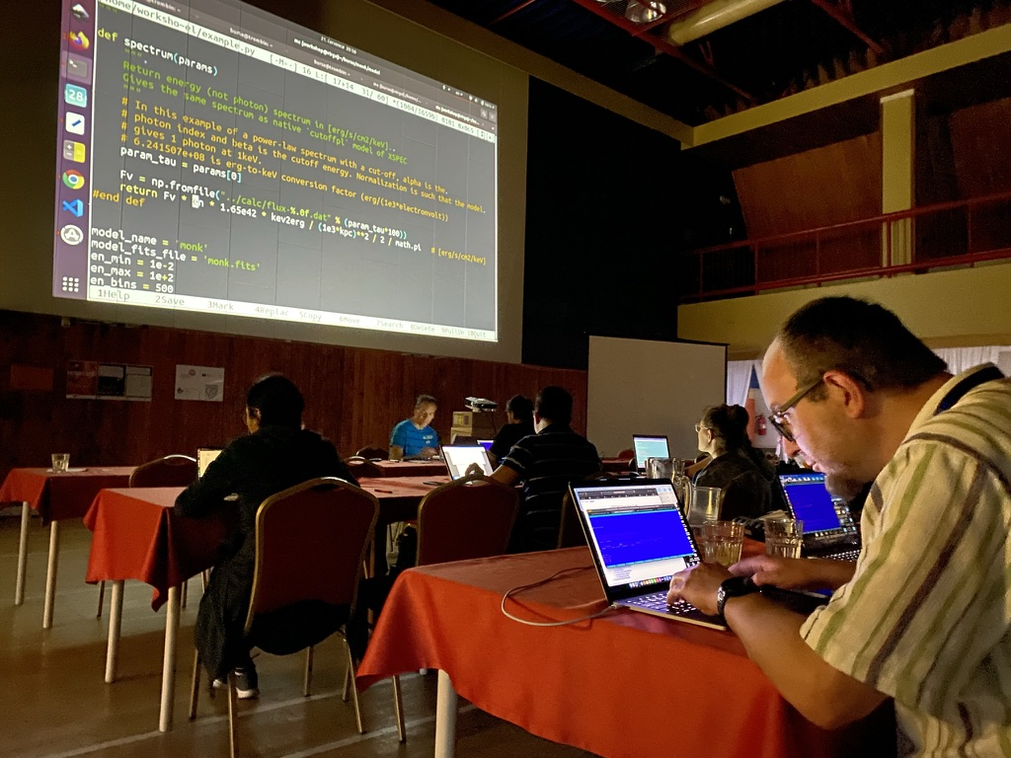

Slide 34
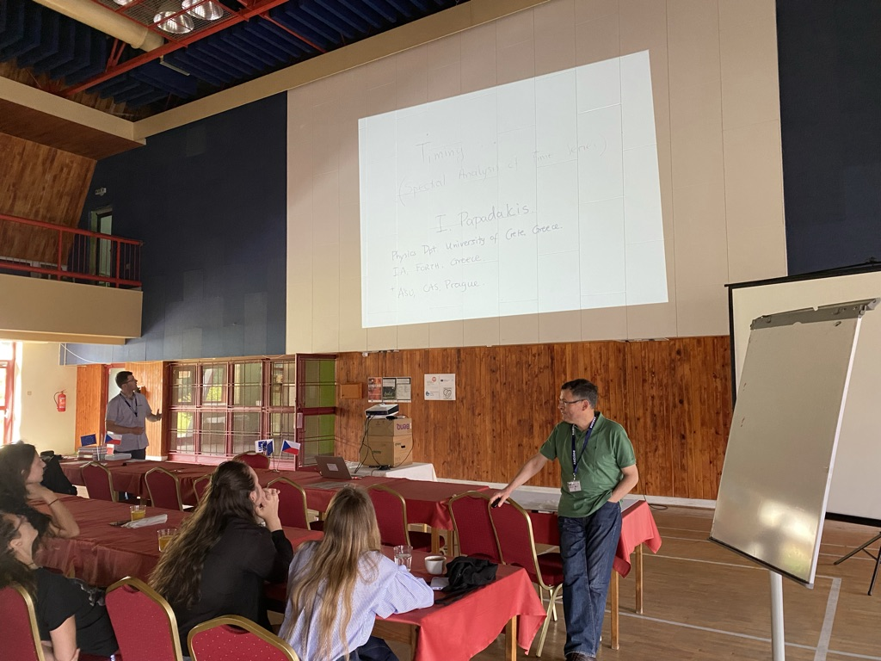
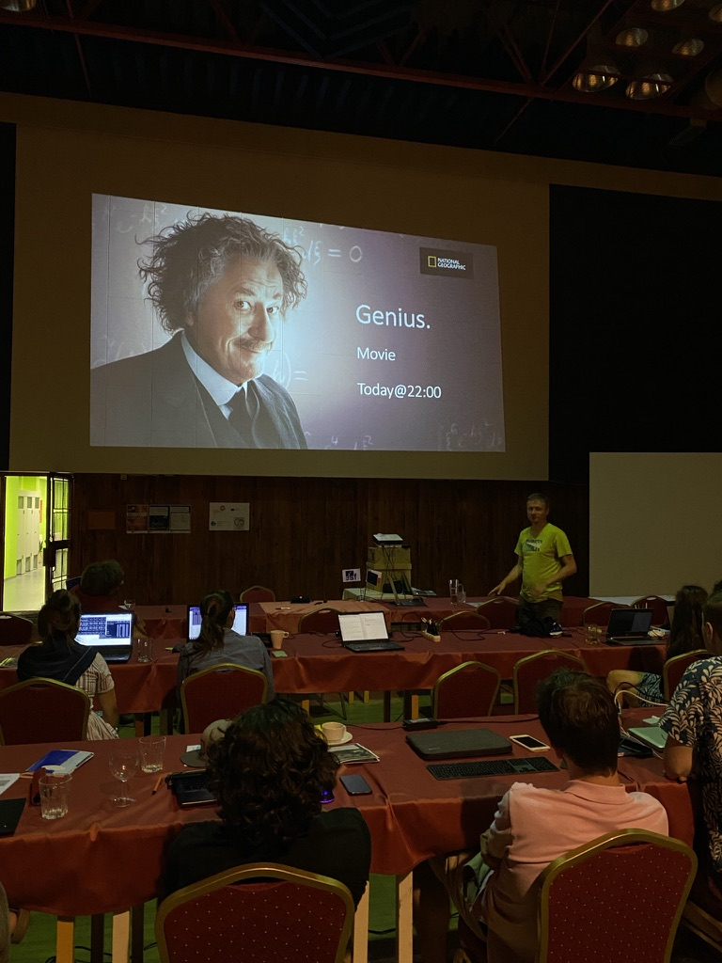
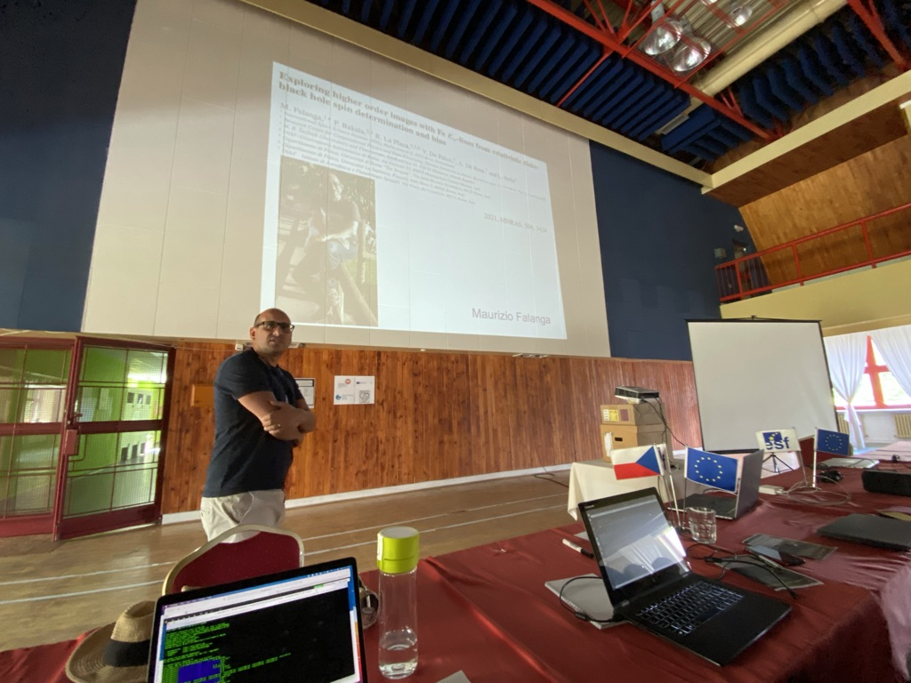

Slide 35
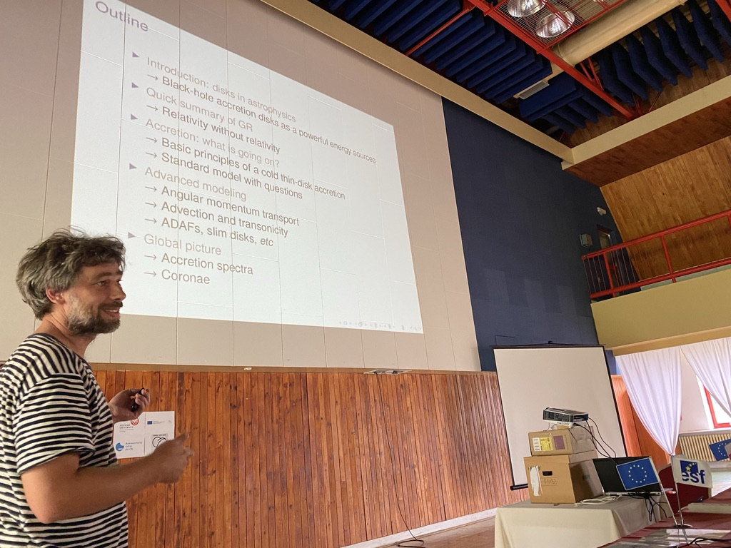

Slide 36
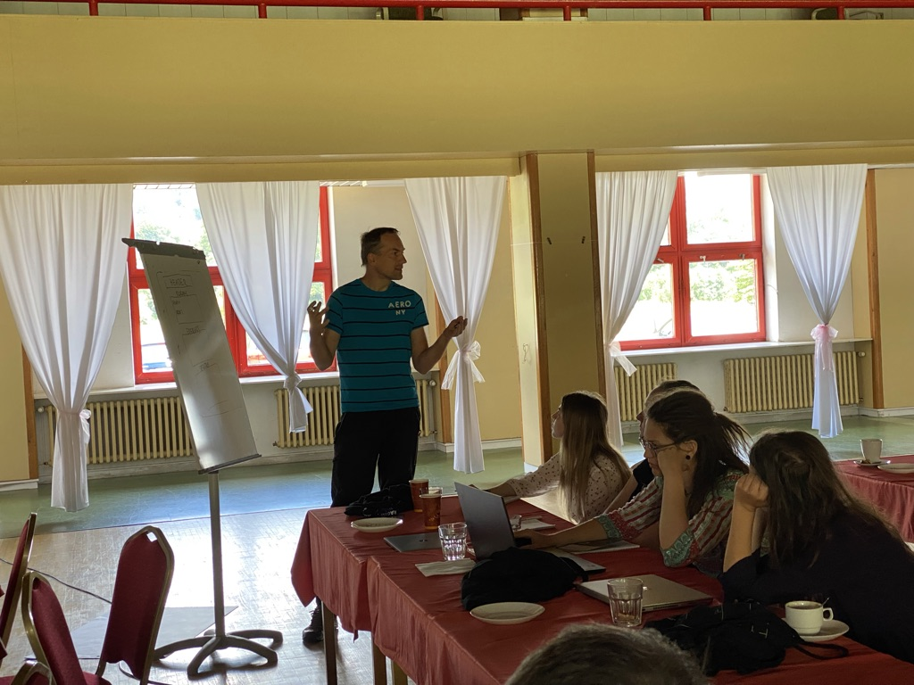
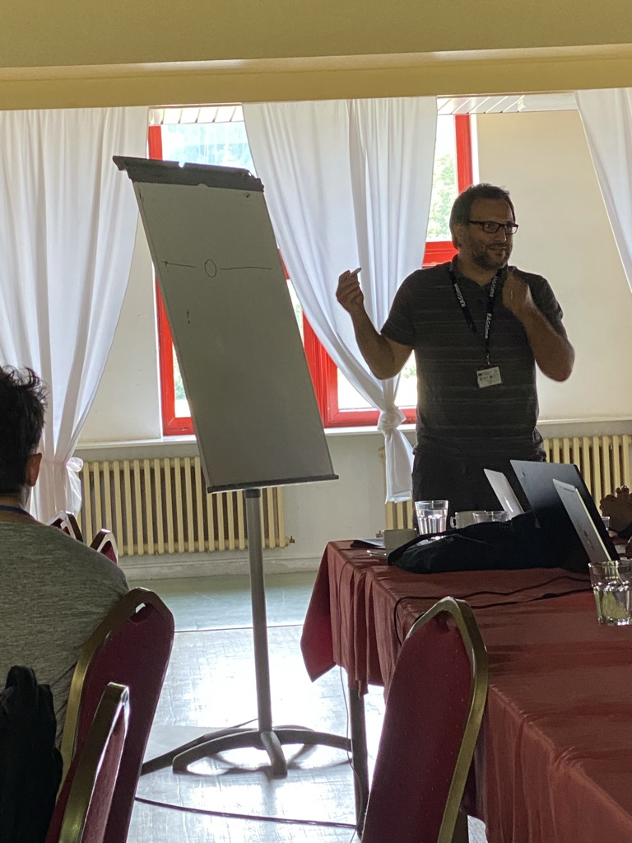
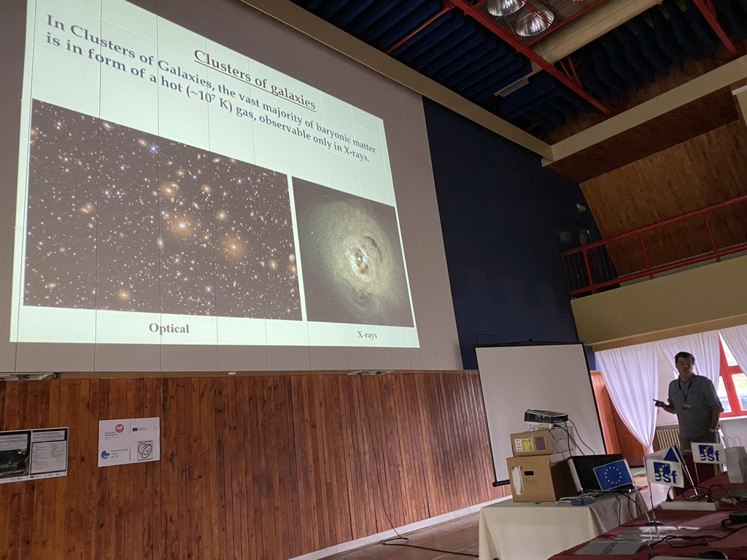

Slide 37
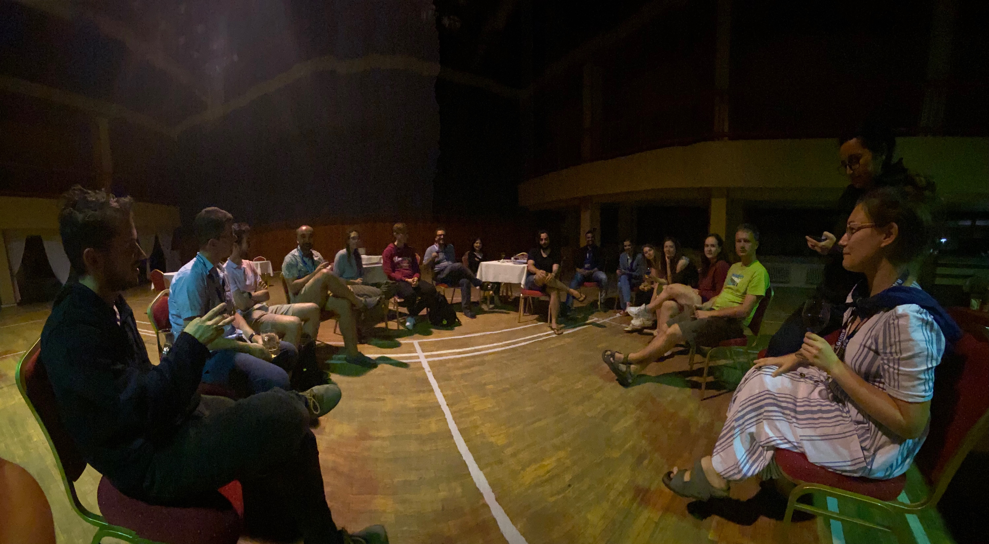
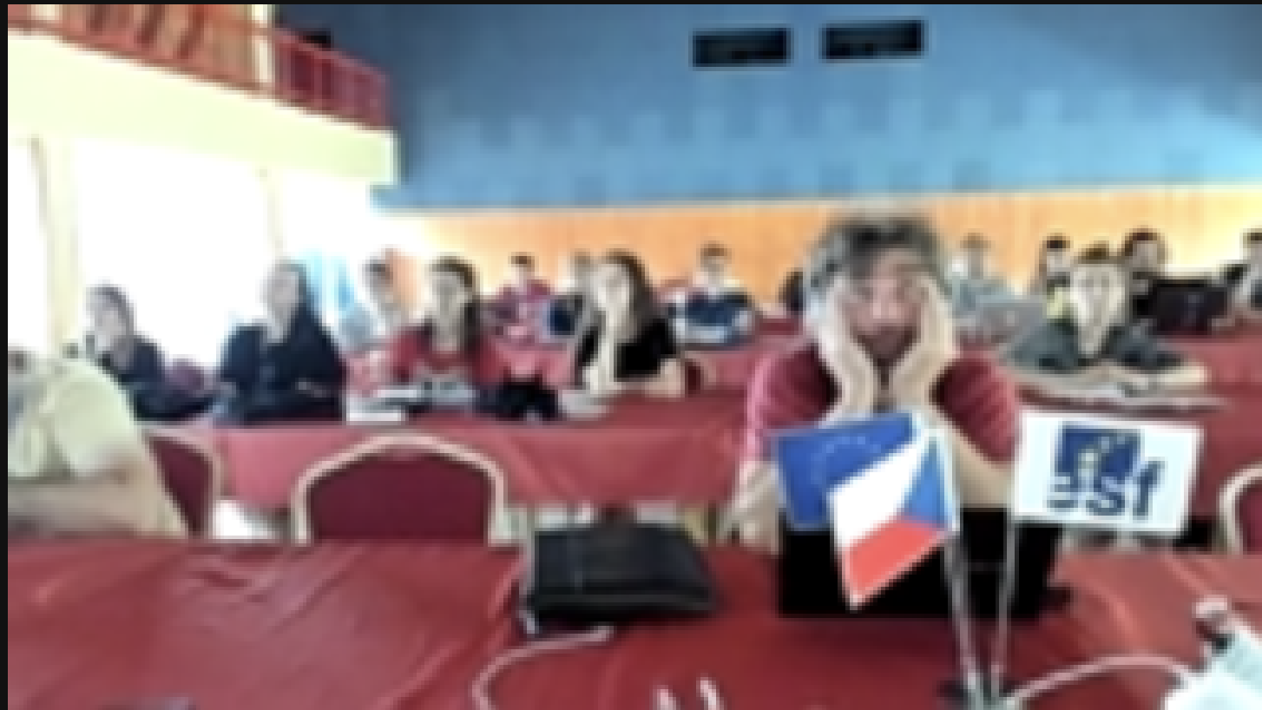
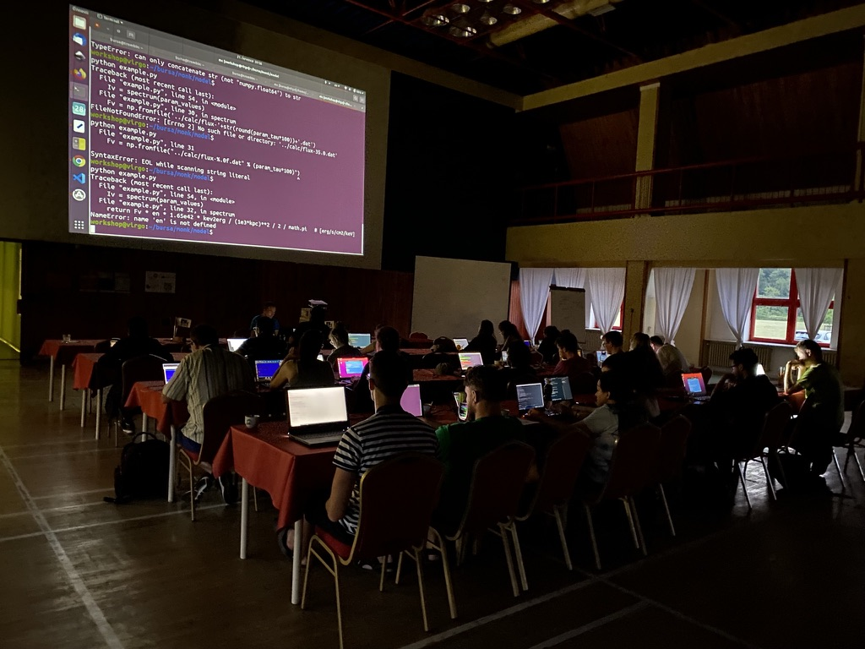

Slide 38
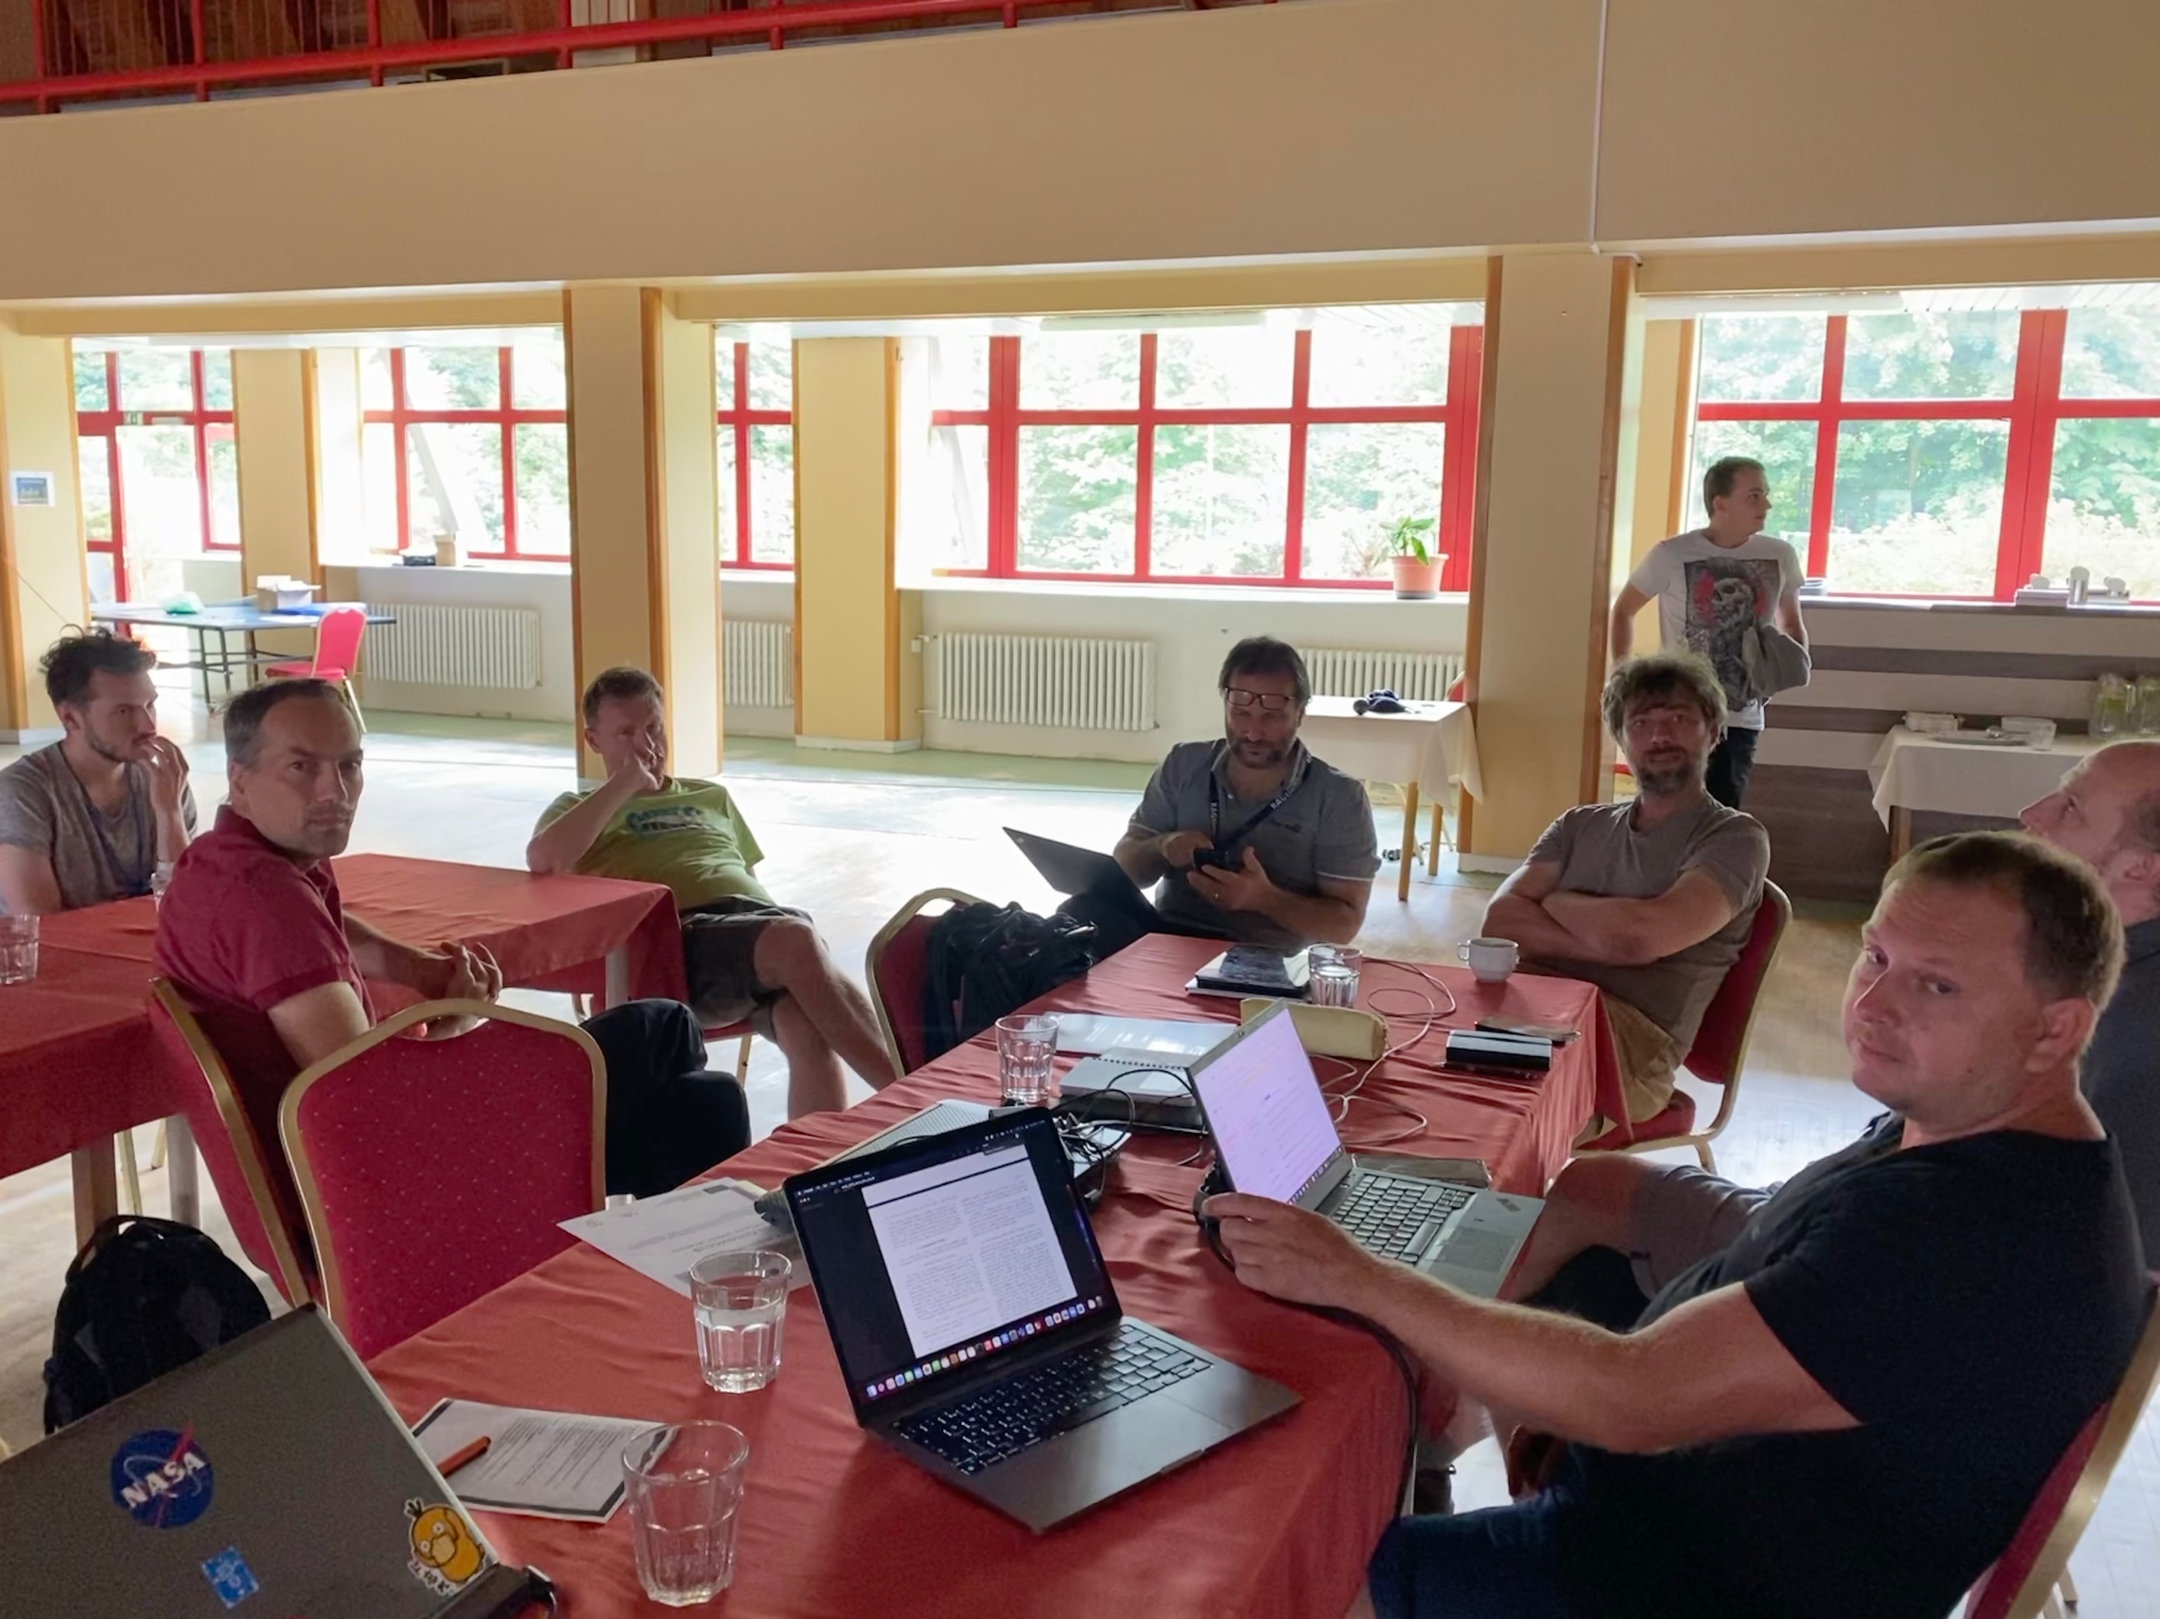
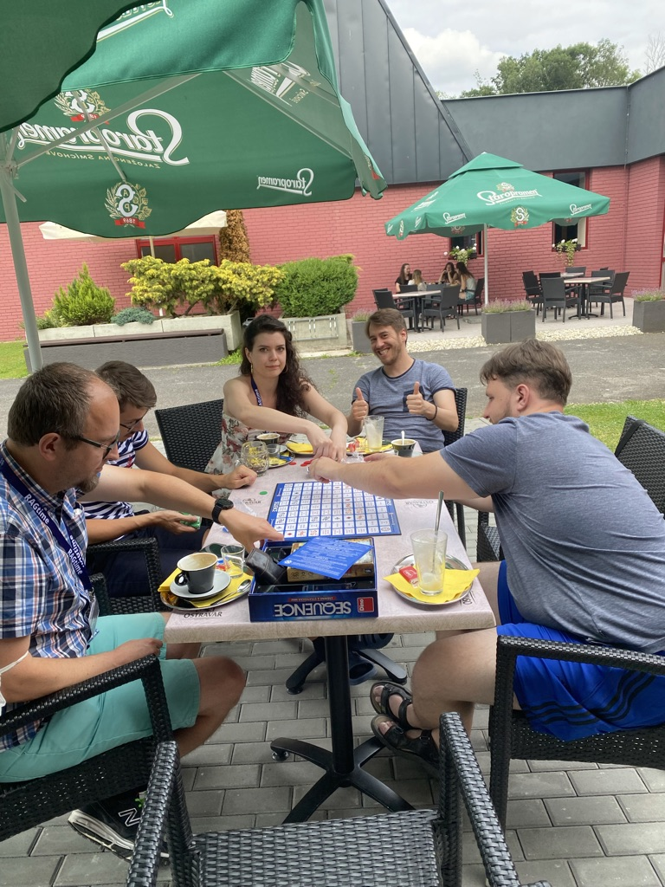
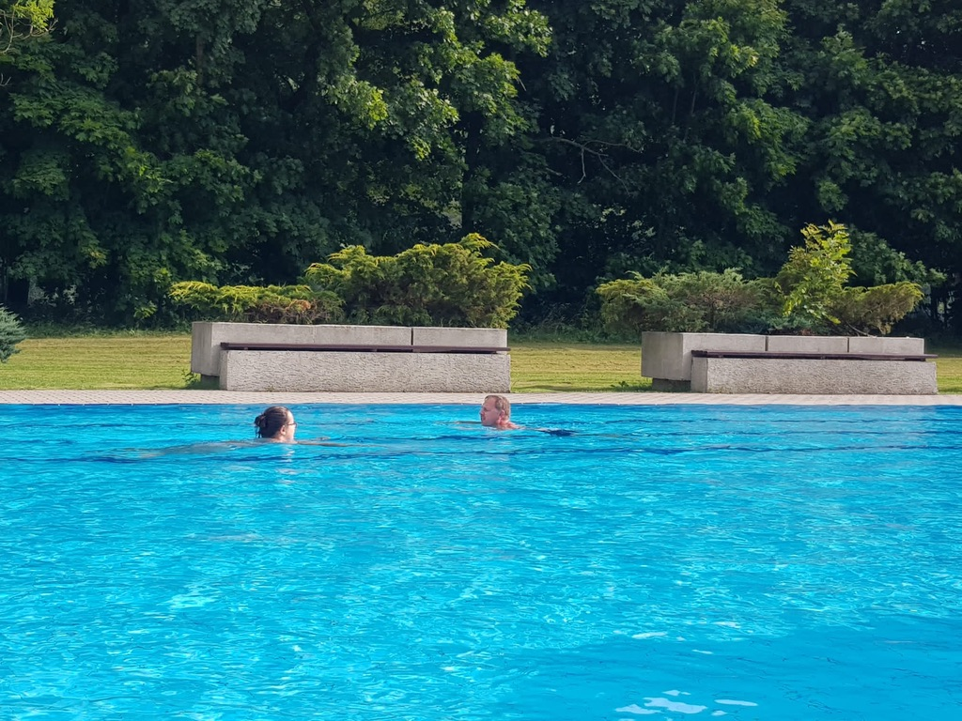
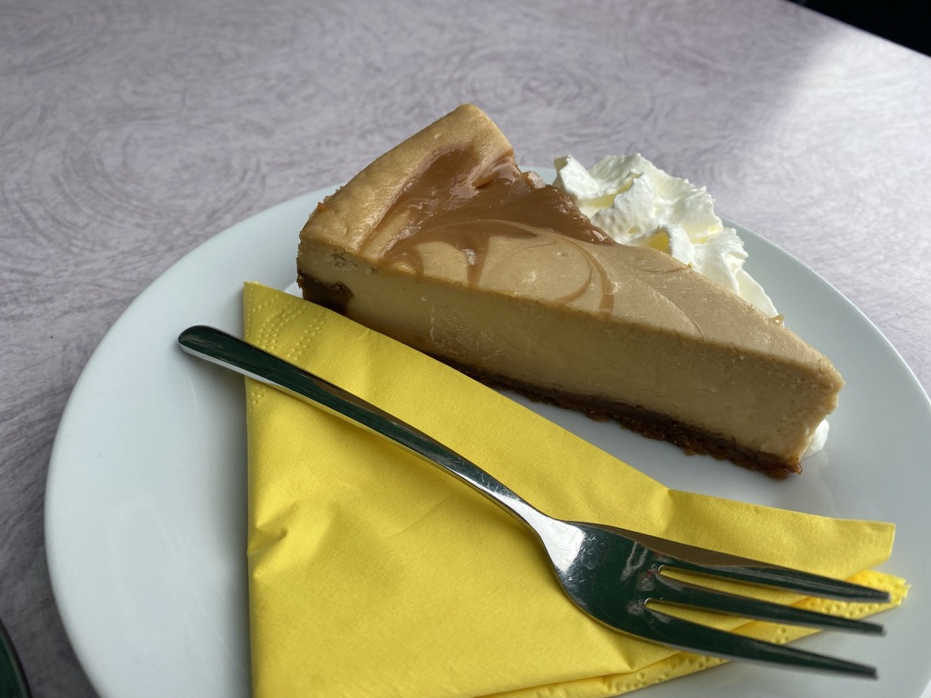

Slide 39
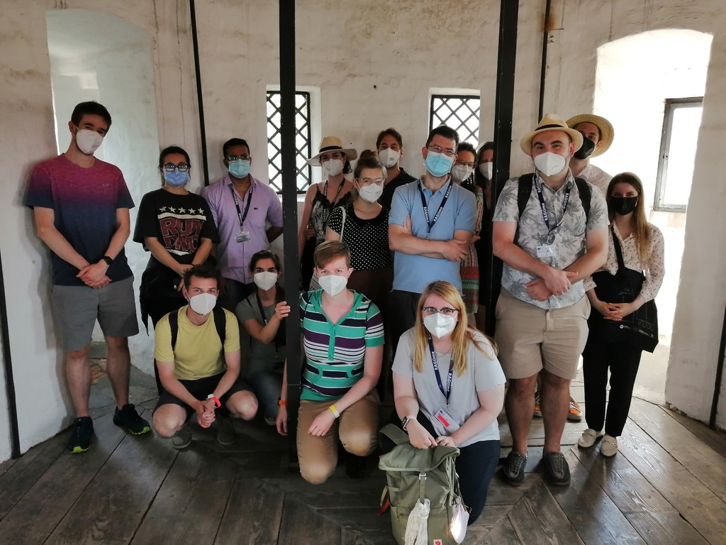

Slide 40
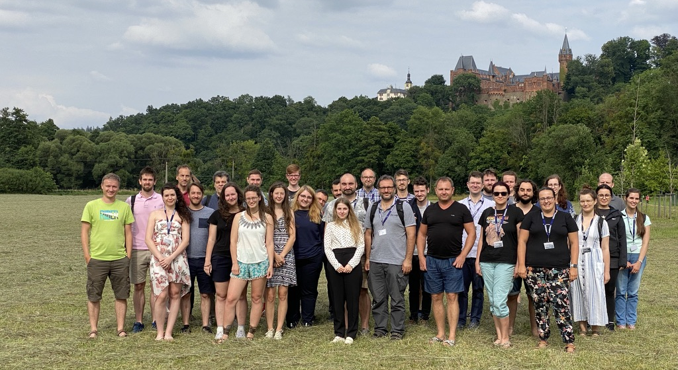
Thank you!

