Slide 1




The SANE, the MAD, and the Magnetized
GRRMHD tales of compact objects
Debora Lančová, Fatemeh Kayanikhoo​, Maciek Wielgus, Martin Urbanec

Slide 2
Black Hole or a Compact Star
Fatima showed magnetized compact star simulations
But, what if there is a black hole – the extreme compact case
The same initial conditions goes MAD in black hole case
Not all ULXs are PULXs, these may be powered by black hole accretion
(ULX review: Kaaret+ 2017)

Slide 3
GLOBAL GR RADIATIVE MAGNETOHYDRODYNAMICS - KORAL
Proper M1 radiation
Magnetic dynamo
Sądowski+ 13, 14, 17, …

Slide 4




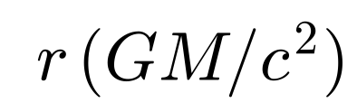

Initial state
The same torus as in the compact star simulation, poloidal magnetic field with
Non-rotating black hole
Torus initially located far from the central BH – we need very long runs
Axisymmetric simulations – MRI “consumes” , mean-field dynamo term to replenish it (Sądowski+ 2015)
Lower resolution than compact star simulations
No dipole magnetic field of the black hole
Seems obvious, but see Selvi+ 2025 – in dipole becomes split monopole
If not said otherwise, figures from Kayanikhoo+ in preparation

Slide 5
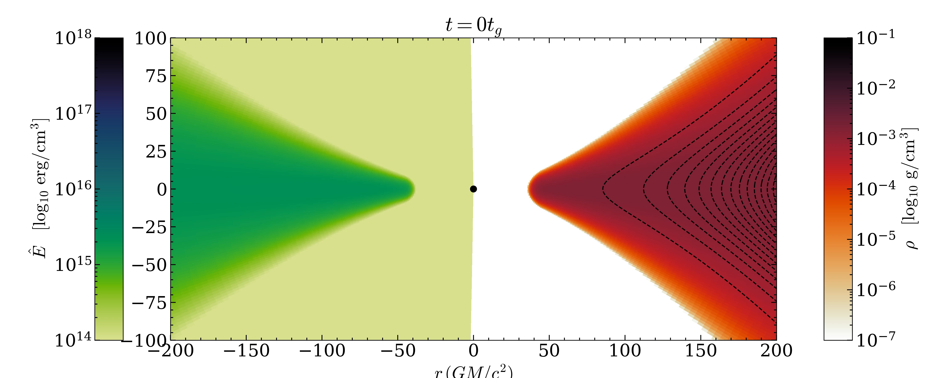

Slide 6
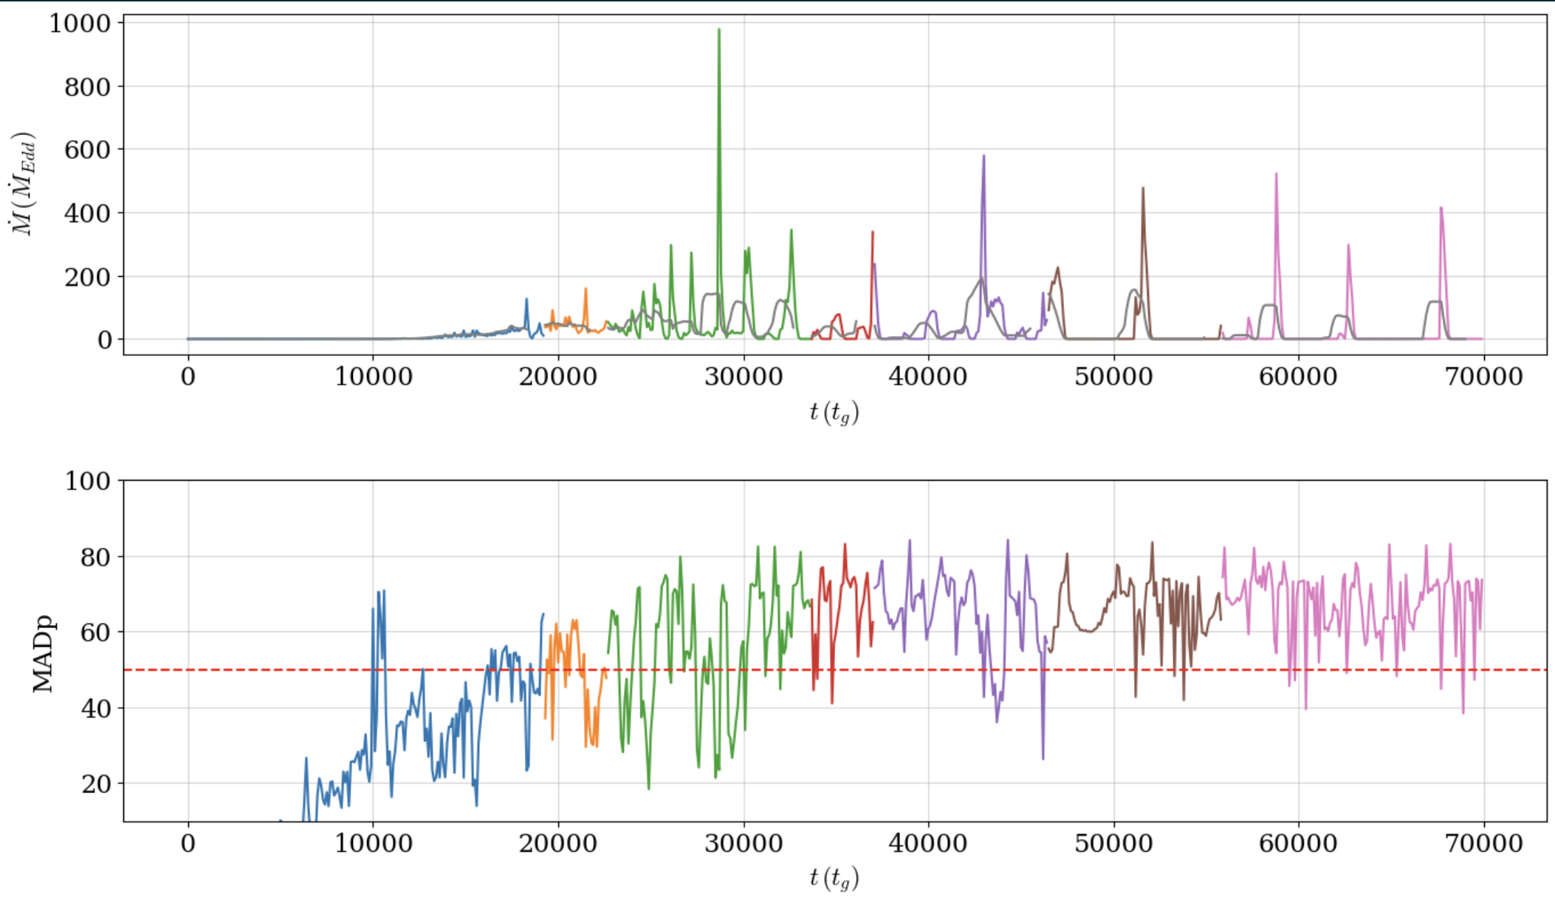

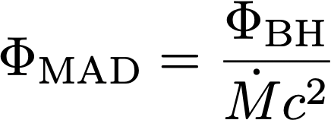

MAD parameter (Tchekhovskoy+ 2011) Limit value

Slide 7
2D MAD evolved

Slide 8
MAD & SANE
MAD = Magnetically Arrested Disc
SANE = Standard And Normal Evolution
Limited by the magnetic flux through the black hole horizon
Interplay of the magnetic and ram pressures
MAD in 2D simulations is extreme

Slide 9
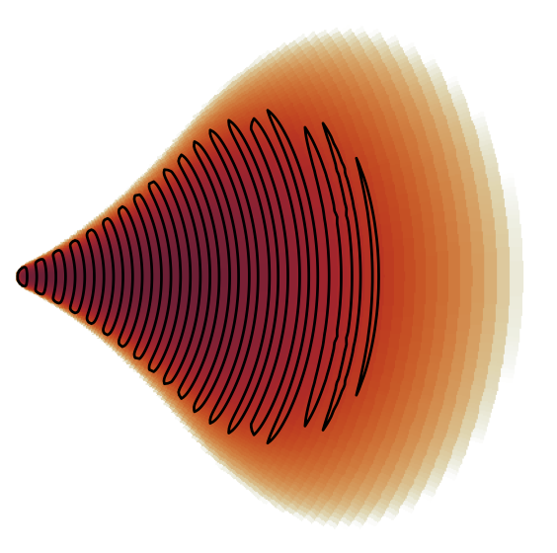
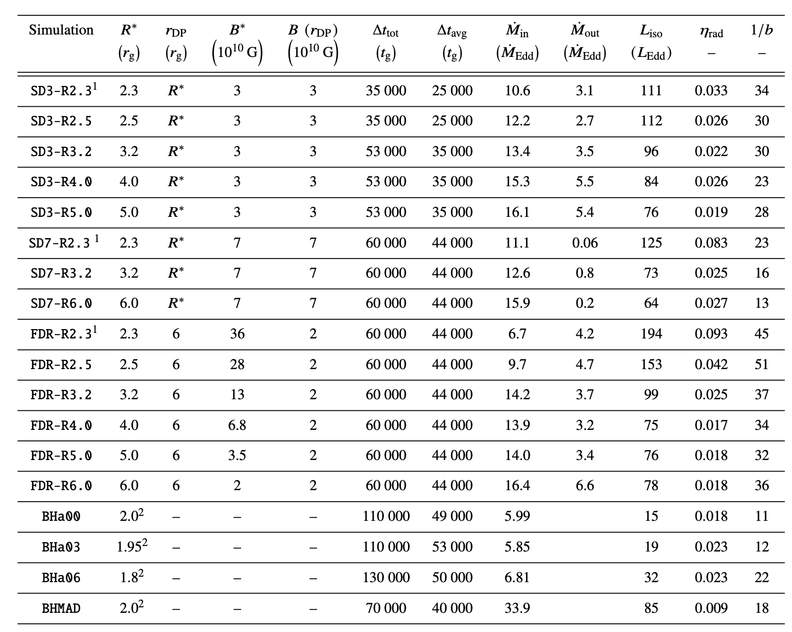
Initial state
The same torus as in the compact star simulation, MULTILOOP magnetic field with => SANE
3 spin values, a = 0, 0.3, 0.6
Torus initially located far from the central black hole – we need very long runs
Axisymmetric simulations – MRI “consumes”, artificial dynamo term
Lower resolution than compact star
For
No dipole magnetic field of the black hole
Seems obvious, but see Selvi+ 2025 – in a few 100 GM/c^3 dipole becomes split monopole

Slide 10
Evolution

Slide 12
SANE config

Slide 13
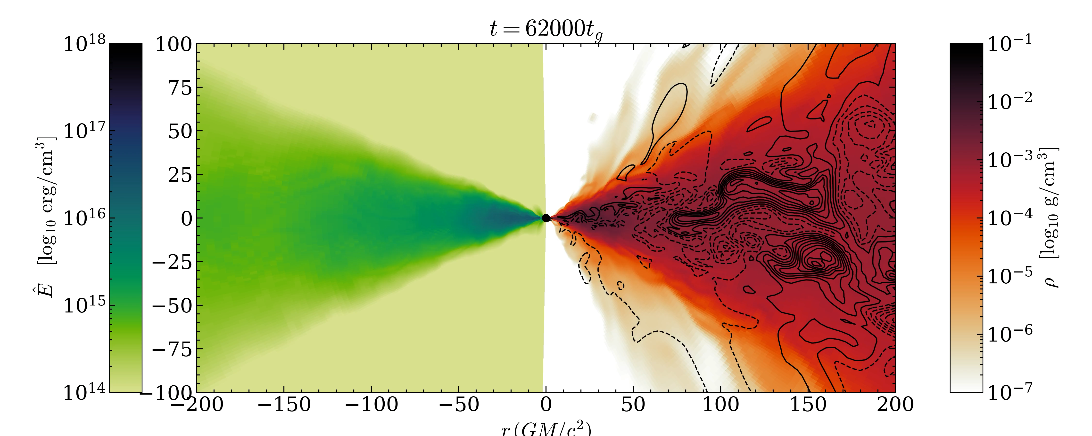

Slide 14


Slide 15
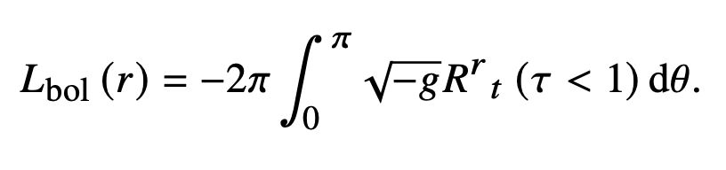
Luminosity

Slide 16
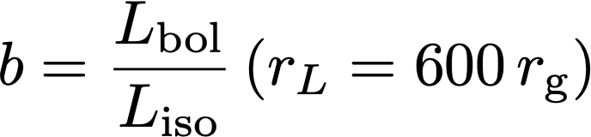




Beamed luminosity
BH

Slide 17
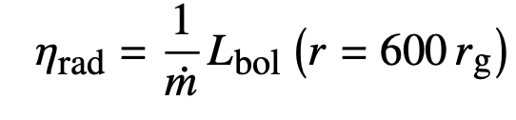
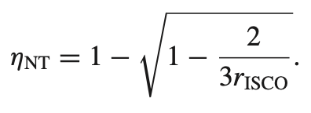

Slide 18
Conclusions
For the same mass, the compact star accretion is much more luminous than black hole, even rotating one
Stronger beaming towards observers close to the axis and higher radiative efficiency for star accretion
Black hole accretion goes MAD, when neutron star disc cannot exist in this state
Caveats of the axisymmetry
Dynamo – higher variability and luminostity than 3D (Sądowski&Narayan 2015) – compact star simulations are also 2D, good enough for comparision
MAD simulations are wrong on all fronts in 2D

Slide 19


Thank you for your attention
Computational resources provided by

Slide 20
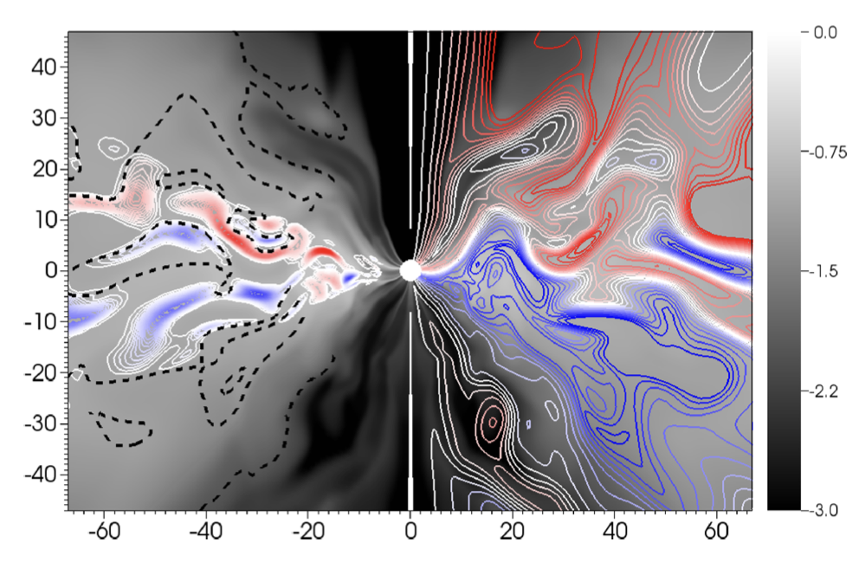
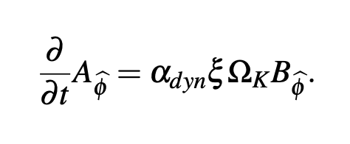
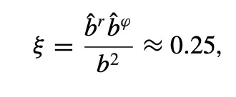
Dynamo
2D
3D
Magnetic energy is dissipated by MRI
Mean-field dynamo effect replenish it => saturated state
Axisymmetry – anti-dynamo theorem (Crowling 1933; Brandenburg+ 01)
Sądowski&Narayan 2015

