Slide 1
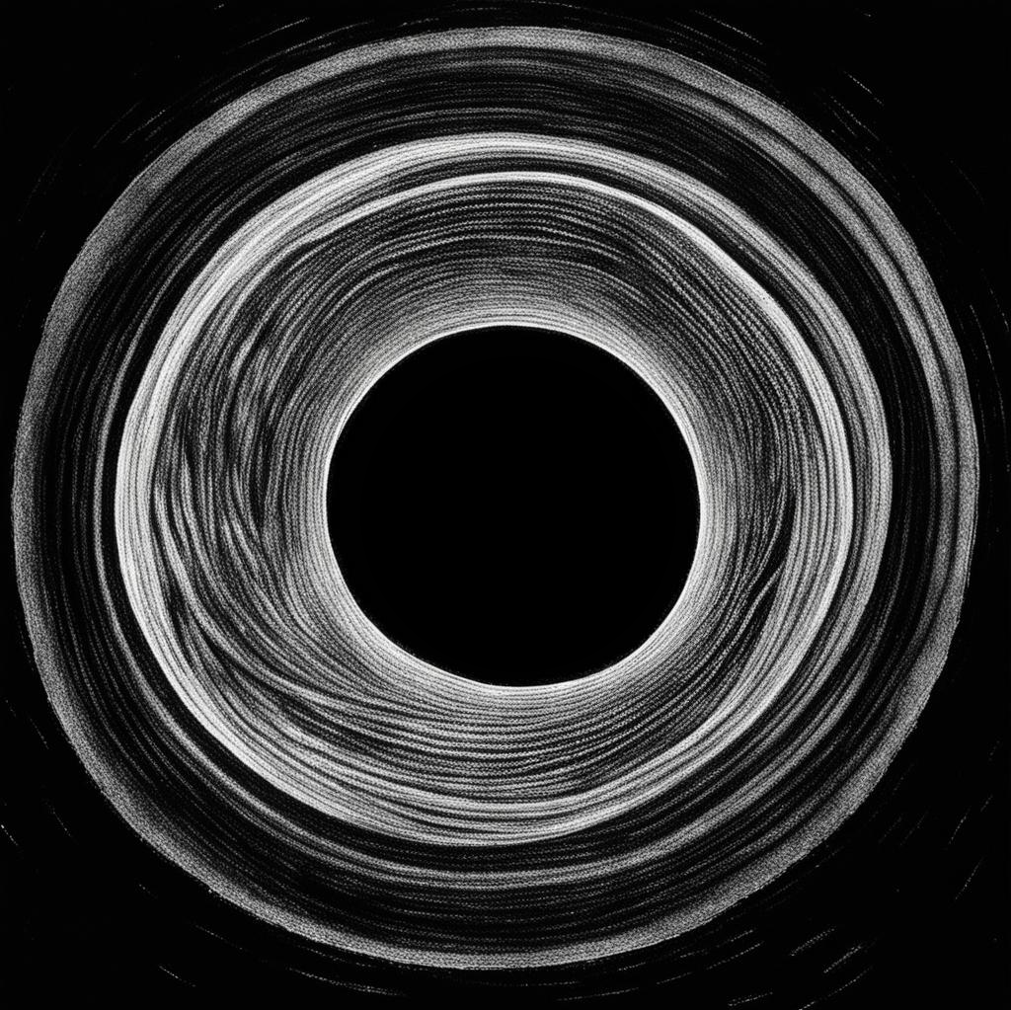
Quasinormal ringing of Bardeen spacetime
Dmitriy Ovchinnikov
Opava, 30. 11. 2023
Based on R. A. Konoplya, D. Ovchinnikov, and B. Ahmedov, Phys. Rev. D 108, 104054 (2023)

Slide 2
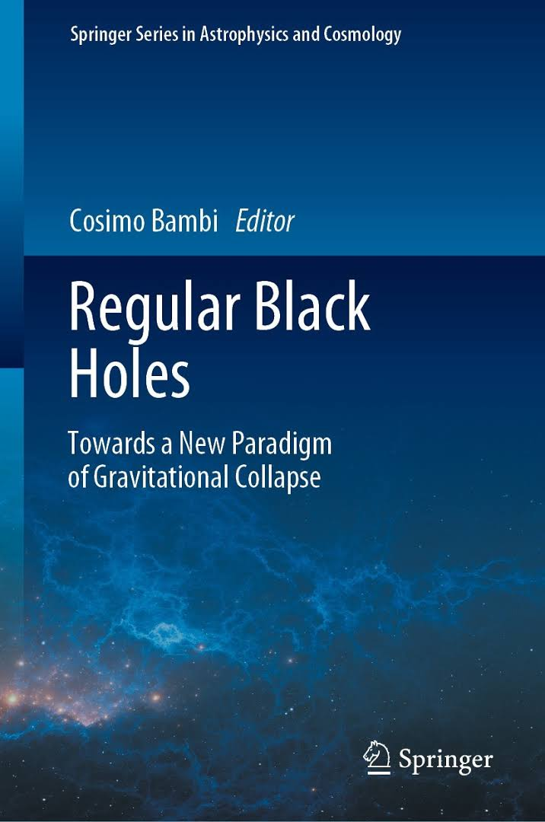
Introduction
Problem of a central singularity
Regular black holes
Bardeen black hole
Previous studies on this topic
Quasinormal modes
Our results

Slide 3
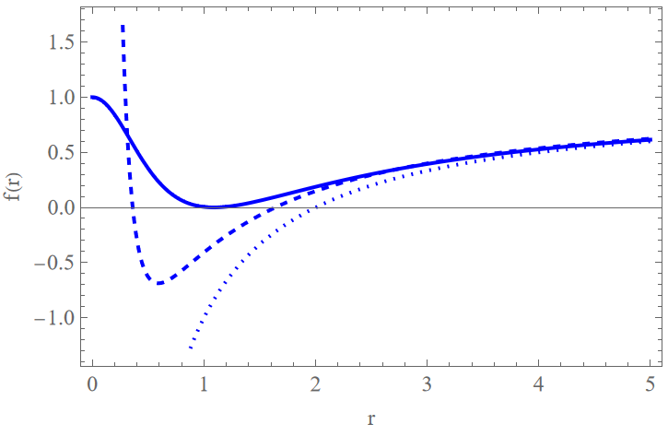
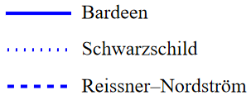
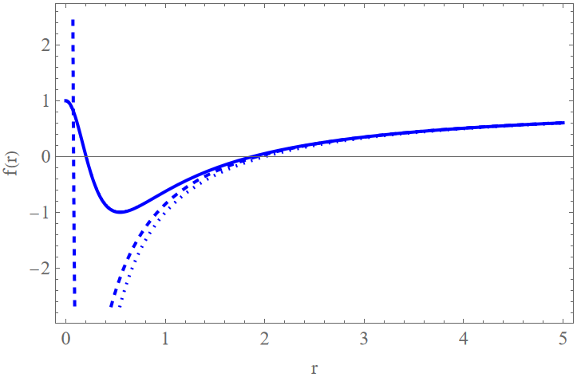
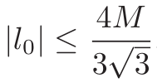
Bardeen spacetime
The spherically symmetric line element has the form
where for the Bardeen spacetime [1], the metric function is
The space-time has horizons if,
,
.
.
[1] J. M. Bardeen, “in Abstracts of the 5th international conference on gravitation and the theory of relativity (GR5), Tbilisi, USSR, Sept. 9-13, 1968,
edited by V. A. Fock et al. (Tbilisi University Press, 1968) p. 174.” (1968)

Slide 4
Bardeen black hole
- as a magnetic monopole in framework of a nonlinear electrodynamics in curved spacetime [2].
To obtain the Bardeen black hole, proposed modifying the Einstein-Hilbert action to include a nonlinear electrodynamic term
, where ,
and is the electromagnetic tensor.
In their study the authors employed the Einstein–nonlinear electrodynamics
field equations resulting from action S for the function
to obtain static spherically symmetric solution, coinciding with the Bardeen spacetime.
with
[2] E. Ayon-Beato and A. Garcia, Phys. Lett. B 493, 149 (2000)

Slide 5
Bardeen black hole
- as a quantum corrected Schwarzschild black hole.
This interpretation utilize the ultraviolet finiteness in string theory to remove the singularity in non-regular black holes[3].
By exploiting the fact that path-integral dual propagator arises from the T-dual propagator when expanded to first order, it was obtained the relation $l_{0}=2πR^{∗}$ between the self-dual radius $R^{∗}=\sqrt{α^{′}}$ (where $α^{′}$is the Regge slope$)$ in the
T-dual string theory, and an ultraviolet cut-off known as the zero point length $l_{0}$ in the path integral dual field theory.
Further in [3], path integral duality is used to obtain a regular static potential $U\left(r\right)=−\frac{M}{\sqrt{r^{2}+l_{0}^{2}}}$ .
Obtained potential $U\left(r\right)$ is used for the construction of modified energy-momentum tensor, and derivation of consistent black hole metric for a spherically symmetric, electrically neutral regular black hole, which is equivalent to the Bardeen spacetime after redefinition of constants.
[2] P. Nicolini, E. Spallucci, and M. F. Wondrak, Phys. Lett. B 797, 134888 (2019)

Slide 6
General relativistic field equations
Scalar field $Φ$
Electromagnetic field $A_{ρ}$ ($F_{ρσ}=∂_{ρ}A_{σ}−∂_{σ}A_{ρ}$)
Dirac field $Υ$
;
;
,
were $γ^{α}$ are gamma matrices,
$Γ_{α}=\frac{1}{8} \left[γ^{α},γ^{β}\right]{ g}_{νλ}{ e}_{α}^{ ν}{ ∇}_{μ} e_{β}^{ λ}$ are spin connections in the tetrad formalism.

Slide 7
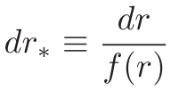
Wave-like equation
For the scalar field $Φ$we assume separation of variables
,
where $Y_{ℓ}^{m}\left(θ,φ\right)$ is spherical harmonic function.
Substituting this ansatz into the equation of motion for scalar field, one can obtain
wave-like equation
To solve this equation, we separate $r$ and $t$ variables in the wave function assuming
. Employing the stationarity of the spacetime
,
where $ω$
, one can obtain the radial part of wave-like equation
,
where $r_{∗}$ is the “tortoise coordinate”:
.

Slide 8
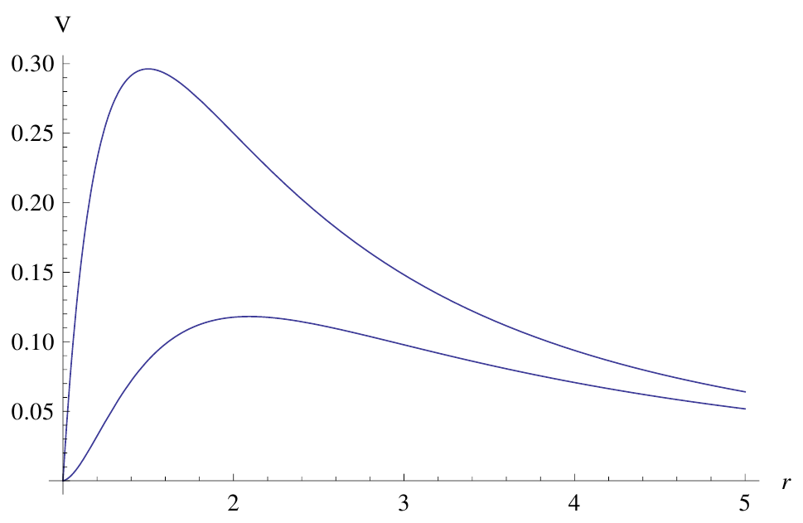
The effective potential
,
where $ℓ=s, s+1,s+2,…$ are the multipole numbers,
$s=0$ for the scalar and $s=1$ and electromagnetic fields.
For the Dirac field $s=1/2$ one has two iso-spectral potentials,
,
.
$$1$$
The eﬀective potential for the $ℓ = 1$perturbation of the Maxwell ﬁeld for the Schwarzschild (top) and near
extreme Bardeen $l_{0}=0.7$(bottom) black holes; $r_{0}= 1$.
The iso-spectral potentials can be transformed one into another
by the Darboux transformation
, $q=const$.

Slide 9
Quasinormal modes
Quasinormal modes are eigenvalues of the equation
,
that satisfy the following boundary conditions:
where $ω$ , is QNM frequencies in the following form: $ω=ω_{Re}−{iω}_{Im}$.

Slide 10
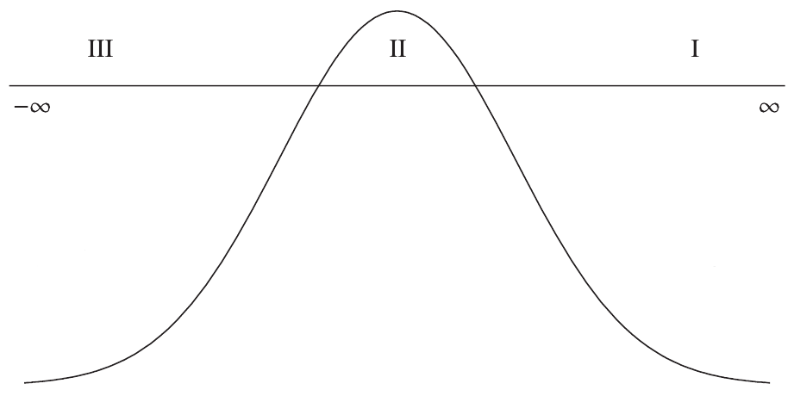
WKB approach
WKB approach is a flexible semi-analytic method, which allows one to obtain quasinormal modes with sufficiently high accuracy.
The result of the matching of the WKB and Taylor series is the general form [4]:
where $A_{p}(K^{p})$is the correction of order $p$ to the eikonal formula, and $K=n+\frac{1}{2}$.
[4] R. A. Konoplya, Phys. Rev. D 68, 024018 (2003)

Slide 11
Padé approximation
To improve the accuracy one can use an extension of the WKB-method by Padé approximation [5]
Where $k$ is the polynomial order coincides with the order of the WKB formula, parameter $ε$ introduced formally to keep track of orders in the WKB approximation.
With Padé approximation polynomial can be rewritten as rational function:
The coefficients and can be obtained in the same way as $A_{p}$ by matching the expansion of the solution
near the potential peak through the turning points.
[5] Matyjasek and M. Opala, Phys. Rev. D 96, 024011 (2017)

Slide 12
Frobenius method (Leaver method for QNMs)
To obtain accurate quasinormal mode values, including overtones with $ℓ < n$, we will employ the Frobenius method (that was employed by Leaver for calculating quasinormal modes [6]).
The wave-like equation always exhibits a regular singularity at the horizon $r = r_{0}$and an irregular singularity at spatial infinity $r = ∞$. To address this, we introduce a new function:
.
The factor $P(r,ω)$ is chosen such that is regular for $r_{0}≤ r < ∞$, ensuring that corresponds to a purely outgoing wave at spatial infinity and a purely ingoing wave at the event horizon.
The function in terms of a Frobenius series: .
By employing Gaussian elimination in the recurrence relation for the expansion coefficients, we reduce the problem to solving an algebraic equation.
[6] E. W. Leaver, Proc. Roy. Soc. Lond. A 402, 285 (1985)

Slide 13
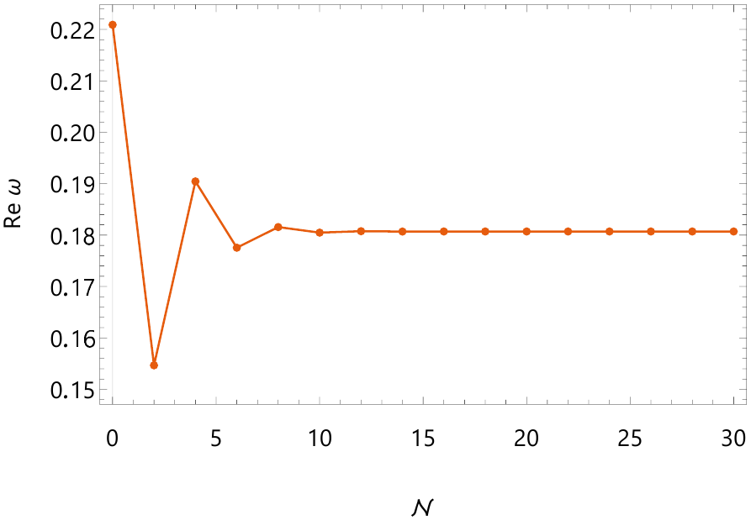
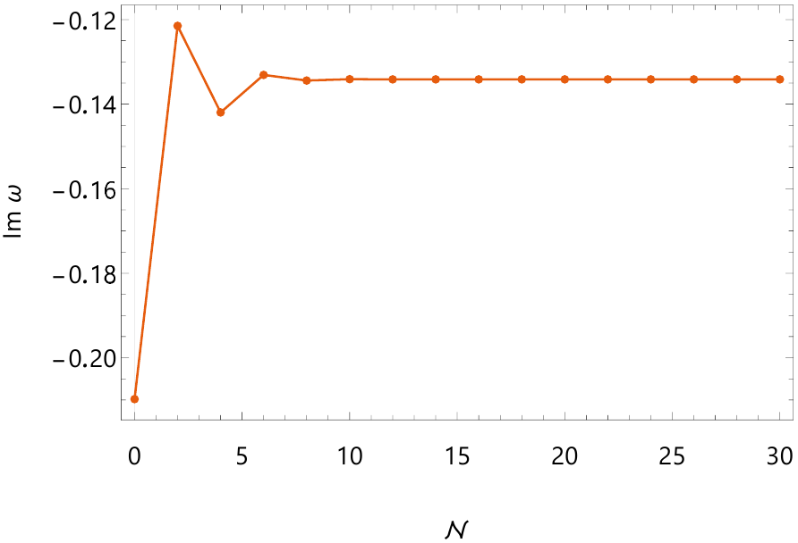
Power series representation for the metric function $f\left(r\right)$in terms of small $l_{0}$
An example of scalar ﬁeld perturbation QNMs ω calculated by the Frobenius method for the different order N of the expansion in terms of small $l_{0}$ for ($n = 0$, $ℓ = 0$) and $l_{0}=0.46669$.

Slide 14
Results
Fundamental quasinormal modes for the scalar perturbations ($n=$0, $ℓ=$0).

Slide 15
Results
Fundamental quasinormal modes for the electromagnetic perturbations ($n=$0, $ℓ=$1).

Slide 16
Results
Fundamental quasinormal modes for the Dirac perturbations ($n=$0, $ℓ=1/2$).

Slide 17
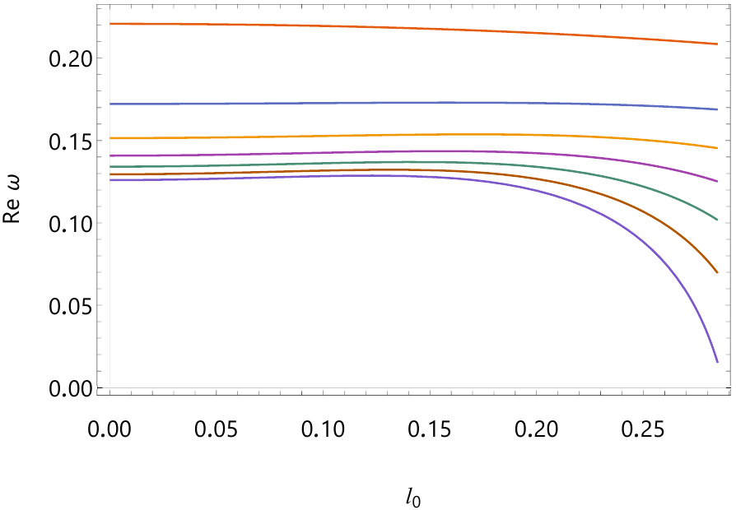
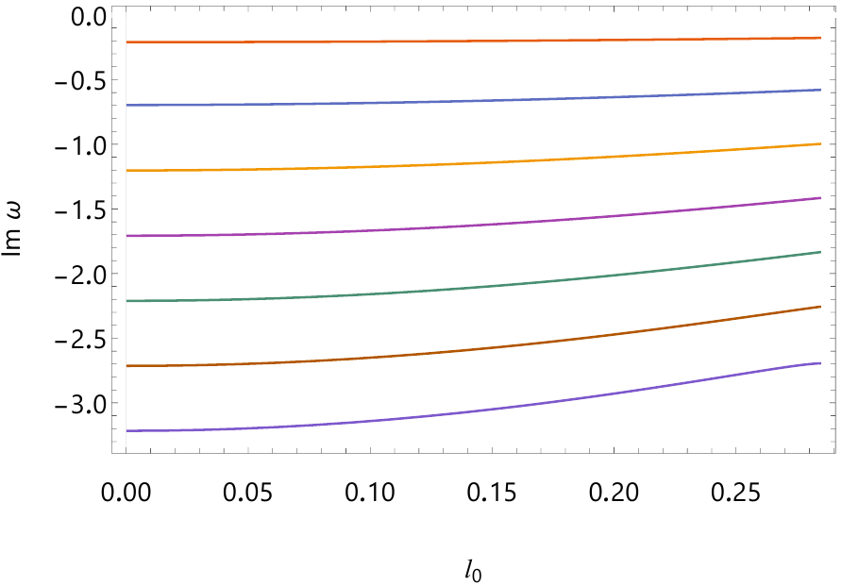
Results
Quasinormal frequencies for the scalar perturbations ($ℓ=$0) and ($n$) goes from 0 to 6.

Slide 18
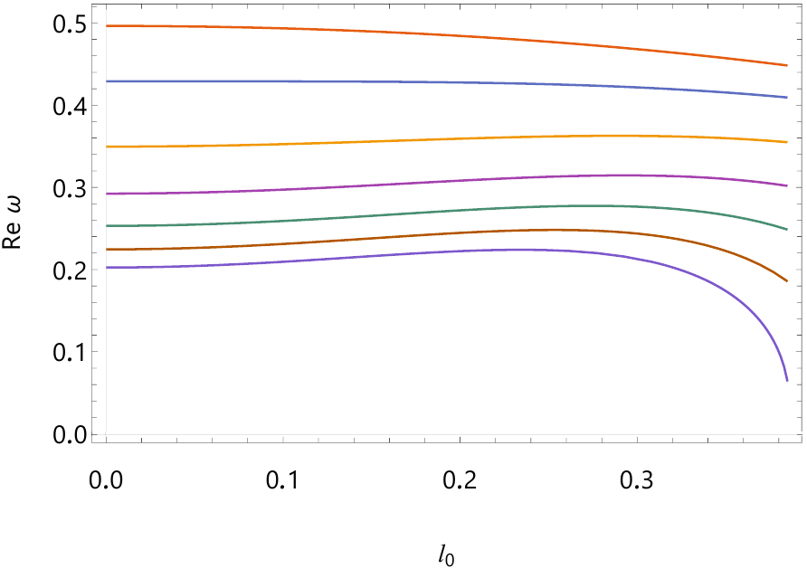
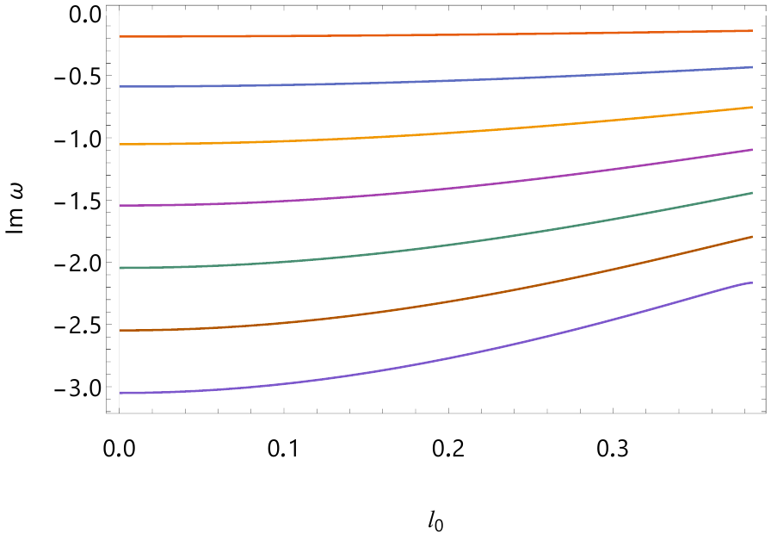
Results
Quasinormal frequencies for the electromagnetic perturbations ($ℓ=1$) and ($n$) goes from 0 to 6.

Slide 19
Conclusion
We conducted an extensive analysis of the quasinormal spectrum, exploring how scalar, electromagnetic, and Dirac fields behave in the background of the Bardeen spacetime interpreted as a quantum-corrected Schwarzschild black hole.
We identified inaccuracies (up to 10%) in previous studies related to the calculations of the fundamental mode. These inaccuracies stem from the approximative nature of the methods employed in previous studies.
In our work, we primarily focused on the calculations of overtones, which probe the geometry near the event horizon and play a pivotal role in detecting potential quantum corrections of the Bardeen black hole.
We showed that the deviation in the initial overtones, with change of the parameter responsible for the quantum corrections, occurred at a considerably higher rate compared to the fundamental mode.

Slide 20
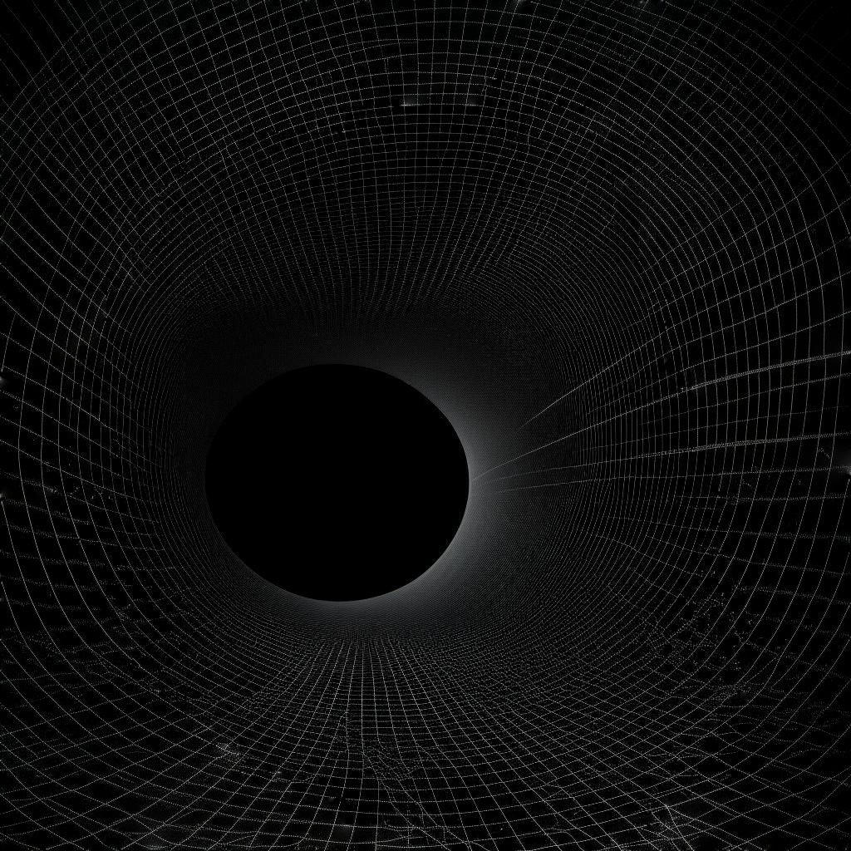
Thank You for Your attention!

