Slide 1
Observational phenomena in axially symmetric spacetimes with non-negative cosmological constant
Based on:
D. Charbulák & Z. Stuchlík, Photon motion in Kerr-de Sitter spacetimes, The Eur. Phys. J. C, 2017
Z. Stuchlík, D. Charbulák & J. Schee, Light escape cones in local reference frames of Kerr-de Sitter black hole spacetimes and related black hole shadows, The Eur. Phys. J. C, 2018
D. Charbulák & Z. Stuchlík, Spherical photon orbits in the field of Kerr naked singularities, The Eur. Phys. J. C, 2018
Z. Stuchlík & D. Charbulák, Shadows of Kerr-de Sitter naked singularities, submitted to Phys. Rev. D, 2022
Daniel Charbulák
The 24th RAGtime Meting
10-14 October 2022

Slide 2
Outline
Motivation
the astrophysics community's interest in imaging the shadows of BHs after the first image was taken in the galaxy M87
progress in development of observational devices (EHT, JWT, ...)
Kerr de-Sitter (KdS) geometry and equations of motion
Division of the KdS spacetimes according to character of the photon motion
Some optical phenomena and their observational relevance
Measuring the KdS NS spin by observation shadows of compact objects
Spherical photon orbits (SPOs) in Kerr case and observational consequences
Summary
2
Notes:
csvukrs

Slide 3
Kerr-de Sitter geometry
M – mass parameter, J – angular momentum of the central object ,
$a=J/M$ - spin parameter
Boyer-Lindquist coordinates {t, r, $θ, φ$}/ geometric system of units c=G=1
Λ – cosmological constant → $y=\frac{1}{3}ΛM^{2}$ - dimensionless cosmological parameter
$s/M→s$ $t/M→t$ $r/M→r$ $a/M→a$ $⟺M=1$ $(s, t, r, a −dimensionless)$
Line element:
${ds}^{2}=−\frac{Δ_{r}}{I^{2} ρ^{2}} {\left(dt−a\sin^{2}{θ}dφ\right)}^{2}+\frac{Δ_{θ }\sin^{2}{θ}}{I^{2} ρ^{2}}{\left[a dt−\left(r^{2}−a^{2}\right)dφ\right]}^{2}+\frac{ρ^{2}}{Δ_{r}} {dr}^{2}+\frac{ρ^{2}}{Δ_{θ }} {dθ}^{2}$
$Δ_{θ }=1+a^{2}y\cos^{2}{θ}$
$Δ_{r}=(1−yr^{2})(r^{2}+a^{2})$
$I=1+a^{2}y$
$ρ^{2}=r^{2}+a^{2}\cos^{2}{θ}$
$$(1)$$
Event horizons: $Δ_{r}$=0
$$(3)$$
$$(2)$$
Ergosphere: $g_{tt}=0$
$$(4)$$
3
Notes:
csvukrs

Slide 4
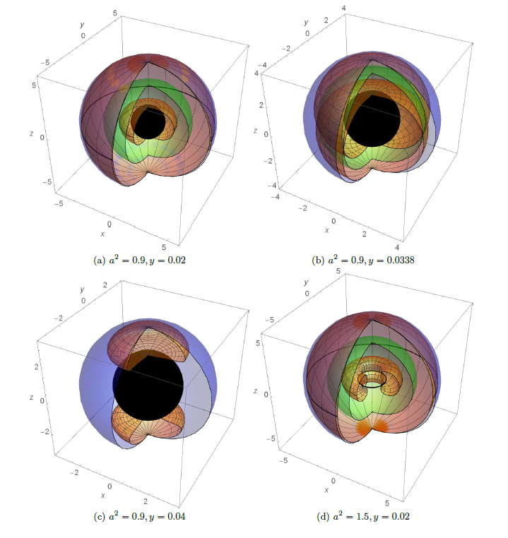
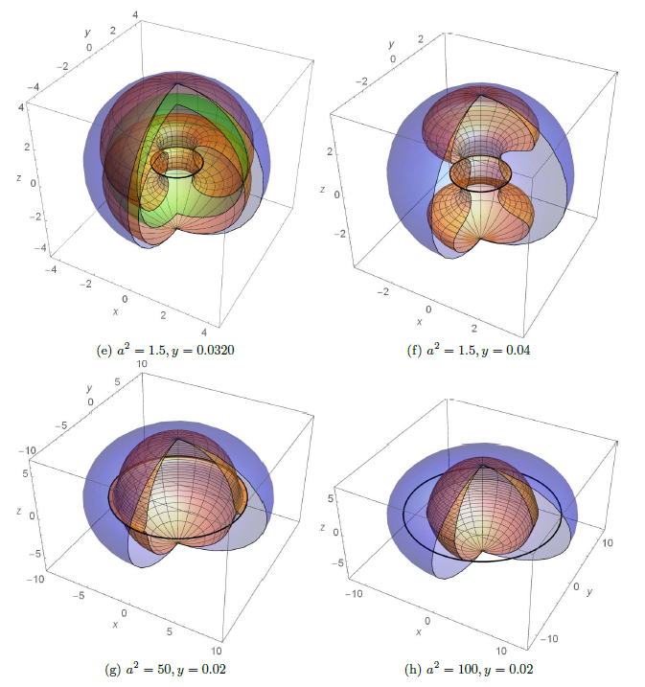
Event horizons and ergosphere
4
Notes:
csvukrs

Slide 5
Motion constants and equations of motion
Test particle four-momentum: $p^{μ}=\frac{dx^{μ}}{dλ},{ x}^{μ}=t, r, θ$, φ | $τ=μλ$
Constants of motion: $p^{μ}p_{μ}=−μ^{2}$ for photons:$μ=0$
$g_{μν,t}=0 ⇒ {−p}_{t}=E$ – ‘energy’
$g_{μν,φ}=0 ⇒ p_{φ}=Φ$ – axial angular momentum
$p_{θ}^{2}+\cos^{2}{θ}[\frac{Φ^{2}}{\sin^{2}θ}+a^{2}{(m}^{2}−E^{2})]=Q$ – fourth Carter motion constant
Carter’s equations of geodesic motion of test particle:
$ρ^{2}p^{θ}=±\sqrt{W}$
$ρ^{2}p^{r}=±\sqrt{R}$
$ρ^{2}p^{φ}=\frac{aIP_{r}}{Δ_{r}}−\frac{IP_{θ}}{Δ_{θ}\sin^{2}θ}$
$ρ^{2}p^{t}=$ $\frac{I{\left(r^{2}+a^{2}\right)P}_{r}}{Δ_{r}}−\frac{aIP_{θ}}{Δ_{θ}}$
$W={[Q+\left(Φ−aE\right)}^{2}−a^{2}m^{2}\cos^{2}{θ}]Δ_{θ}−{(\frac{P_{θ}}{\sin{θ}})}^{2}$
$R=P_{r}^{2}−Δ_{r}[m^{2}r^{2}+{\left(Φ−aE\right)}^{2}+Q]$
$P_{r}=IE\left(r^{2}+a^{2}\right)−IaΦ$
$P_{θ}=IaE\sin^{2}θ−IΦ$
$$(5)$$
$$(6)$$
5
Notes:
csvukrs

Slide 6
Motion of photons
Photon four-momentum: $k^{μ}=\frac{dx^{μ}}{dλ}$ $k^{μ}k_{μ}=0$
Constants of motion:
$ℓ=Φ/E , E≠0$ - impact parameter
$$X=ℓ−a$$
$$q=Q/{{I^{2}E}^{2}}$$
$W(θ)=I^{2}E^{2}\left[ \left(X^{2}+q\right)Δ_{θ}−\frac{{\left(a\cos^{2}{θ}+X\right)}^{2}}{\sin^{2}θ}\right]$
For computational purposes: $θ→m=\cos^{2}{θ,}$ $k^{θ}→{ρ^{2}k}^{m}=±2\sqrt{M}$
$M(m)=$ $I^{2}E^{2}m[\left(1−m\right)\left(X^{2}+q\right)Δ_{m}−{(am+X)}^{2}]$
$$(7)$$
$$(8)$$
$$(9)$$
$R(r)=I^{2}E^{2}[{\left(r^{2}−aX\right)}^{2}−Δ_{r}(X^{2}+q)]$
Reality conditions:
$M\left(m;X\right)≥0⇒X⋛X_{±}^{θ}\left(m\right)≡\frac{−am±\sqrt{m\left(1−m\right)△_{m}\left[a^{2}m+q\left(△_{m}−a^{2}y\right)\right]}}{m(△_{m}−a^{2}y)]}$
$R(r;X)≥0⇒X⋛X_{±}(r)≡\frac{−ar^{2}±\sqrt{△_{r}\left[r^{4}+q\left({a^{2}−△}_{r}\right)\right]}}{{a^{2}−△}_{r}}$
$$(10)$$
effective
potentials
$$(11)$$
6
Notes:
csvukrs

Slide 7
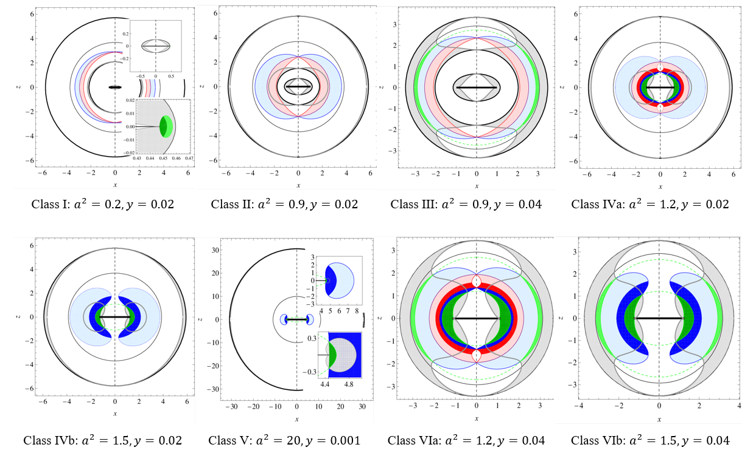
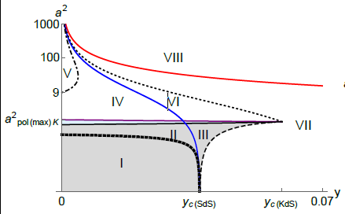
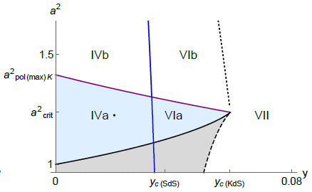
Spherical photon orbits (SPOs) and classification of the KdS spacetimes
Conditions for existence of the SPOs: $R=0, \frac{dR}{dr}=0$
$$(12)$$
Stability condition: $\frac{d^{2}R}{{dr}^{2}}0<0$
$$(13)$$
7
Notes:
csvukrs

Slide 8
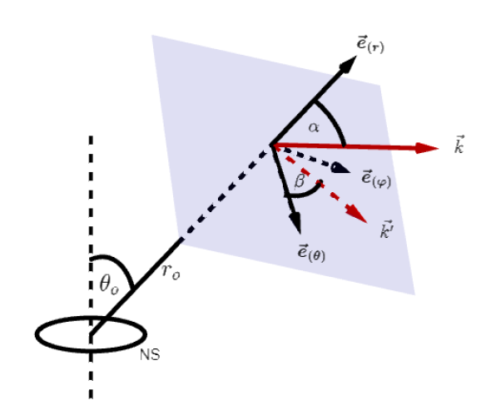
Light escape (capture) cones and related shadows of compact objects
Construction of the LECs in local reference frame
Locally Non-rotating Reference Frames (LNRFs) are accelerated frames to orbit at fixed coordinates $r, θ$, being carried by the rotation of the spacetime and having thus zero angular momentum; observers related to the LNRFs are also called Zero Angular Momentum Observers (ZAMOs)
Relation between coordinate components $k^{μ}$ and locally measured components $k^{(a)}$ of photon’s wave vector $\vec{k}$:
$$k^{(a)}=ω_{μ}^{(a)}k^{μ}$$
$$(14)$$
Locally measured directional angles $α, β:$
$k^{(t)}=1$
$k^{(r)}$= $\cos{α}$
$k^{(θ)}=\sin{α \cos{β}}$
$k^{(φ)}=\sin{α \sin{β}}$
$$(15)$$
Differential one-forms of the LNRFs:
$ω^{(t)}=\sqrt{\frac{Δ_{r}Δ_{θ}ρ^{2}}{I^{2}A}}dt$
$ω^{(r)}=\sqrt{\frac{ρ^{2}}{Δ_{r}}}dr$
$ω^{(θ)}=\sqrt{\frac{ρ^{2}}{Δ_{θ}}}dθ$
$ω^{(φ)}=\sqrt{\frac{A\sin^{2}θ}{I^{2}ρ^{2}}}(dφ−Ω_{LNRF}dt)$
$$(16)$$
$Ω_{LNRF}=−\frac{g_{tφ}}{g_{φφ}}=\frac{a[Δ_{θ}\left(r^{2}+a^{2}\right)−Δ_{r}]}{A}$
$$(17)$$
8
Notes:
csvukrs

Slide 9
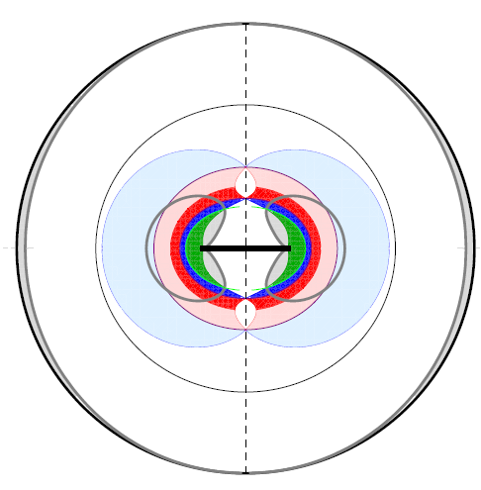
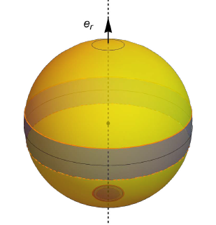
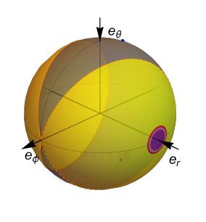
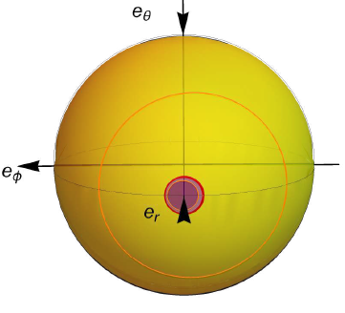
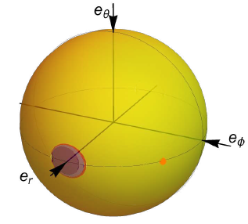
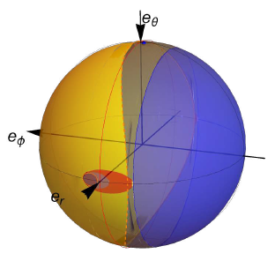
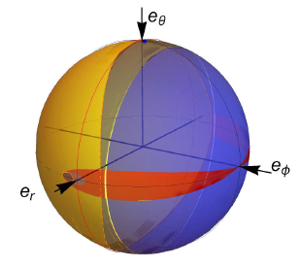
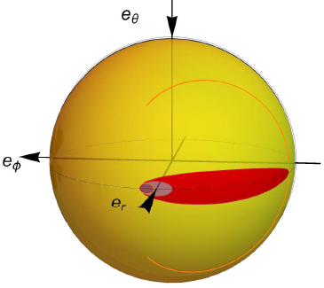
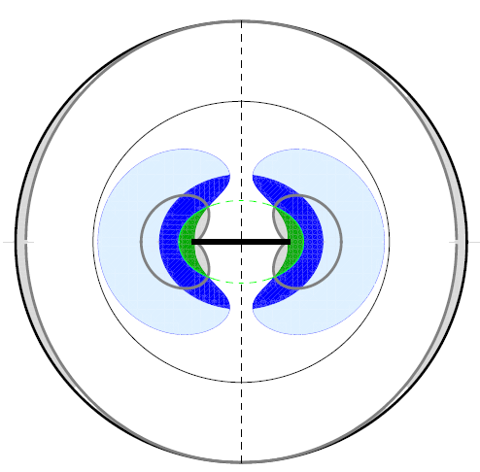
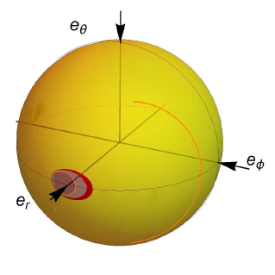
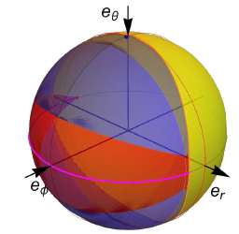
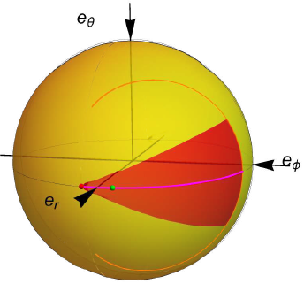
LECs/ shadows of KdS naked singulariries/superspinars
Class IVa: $a^{2}=1.2, y=0.02$ – NS with polar SPOs:
Class IVb: $a^{2}=2, y=0.02$ – NS with no polar SPOs:
$$r_{e}=1.25<r_{erg}^{+}$$
$$r_{e}=3.7≈r_{s}$$
$$r_{e}=3.7≈r_{s}$$
$$θ_{e}=0^{°}$$
$$θ_{e}=θ_{max⁡(circ)}={5.7}^{°}$$
$$θ_{o}=θ_{max⁡(circ)}={8.3}^{°}$$
$$θ_{o}=θ_{min(arc)}={21.8}^{°}$$
Class IVa
$$θ_{e}={66}^{°}>θ_{erg}={22}^{°}$$
$$θ_{e}={73}^{°}$$
$$θ_{o}={64}^{°}$$
$$R=0.1$$
R = 0
$$θ_{o}={45}^{°}>θ_{min(arc)}$$
r < 0
Class IVb
$$θ_{o}={90}^{°}$$
$$θ_{e}={90}^{°}$$
Shadows
LECs
Shadows
9
Notes:
csvukrs

Slide 10
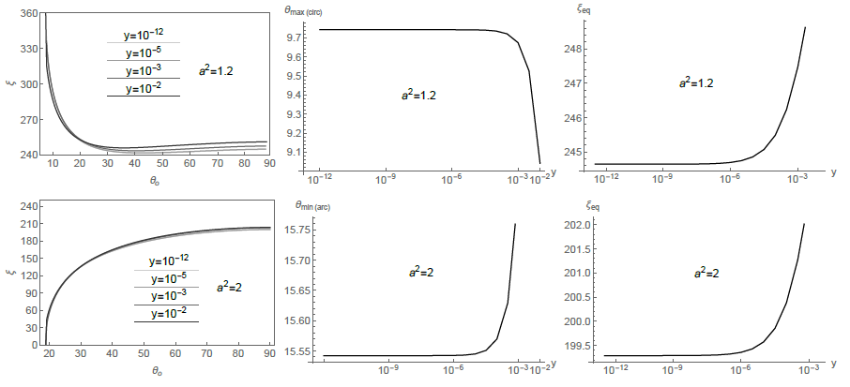
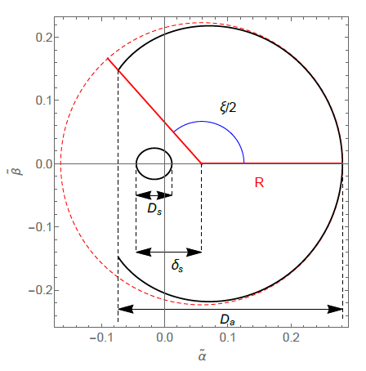
Measuring NS spin/ observer’s latitude
Maximum spin parameter allowing existence of polar SPOs:
Radii of polar SPOs for $a^{2}<a_{\max\left(pol\right)}^{2}\left(y\right)$:
$a_{\max\left(pol\right)}^{2}\left(y\right)=\frac{2}{3y}\left(\cosh{\frac{ψ}{3}−1}\right)$
$\cosh{ψ=\frac{27}{2}ya_{\max\left(pol\right)K}^{2}+1}$
$a_{\max\left(pol\right)K}^{2}=6\sqrt{3}−9=1.39$
$$(18)$$
$r_{pol}^{±}=I^{−1}\left[1+2\sqrt{1−\frac{a^{2}I^{2}}{3}}\cos\left(\frac{π±χ}{3}\right)\right]$
$\cos{χ=(a^{2}I^{2}−1){(1−\frac{a^{2}I^{2}}{3})}^{−3/2} }$
$$(19)$$
10
Notes:
csvukrs

Slide 11
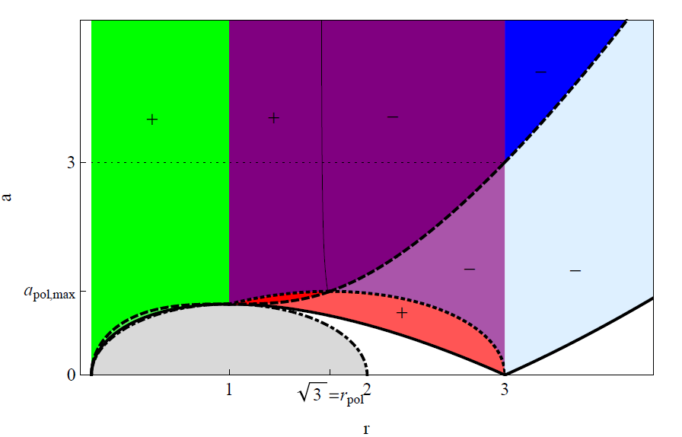
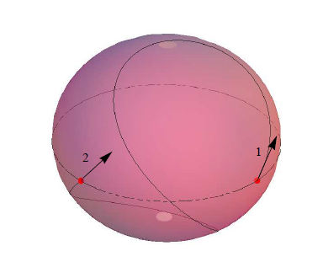
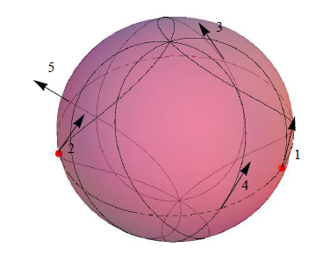
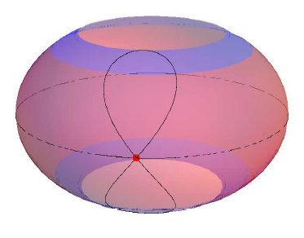
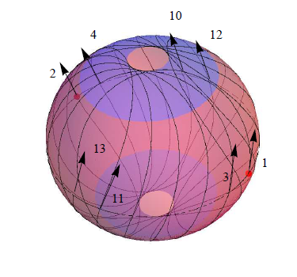
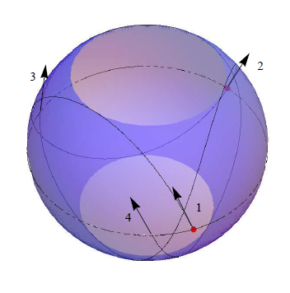
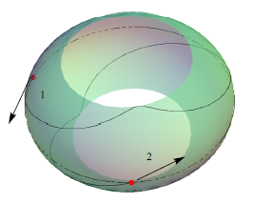
SPOs in the Kerr NS spacetimes
Examples of various types of SPOs:
Special cases:
$$E<0$$
N A K E D S I N G U L A R I T I ES
prograde - $k^{φ}>0;$
$$a^{2}=1.1, r=2$$
polar; $ℓ_{SPO}=0$,
$$a^{2}=1.1, r_{pol−}=2.2$$
with zero nodal shift - $Δφ=0$
$a^{2}=3, r=1.$7
BH
event horizons
$$k^{φ}>0$$
equatorial circular orbits
mixed, with $k^{φ}=0;$
$$a^{2}=1.1, r=2.6$$
retrograde - $k^{φ}>0;$
$$a^{2}=1.1, r=3.4$$
with negative energy - $E<0$
$$a^{2}=1.1, r=0.9$$
$$k^{φ}⋛0$$
marginally stable SPOs
polar SPOs
zero nodal shift SPOs
$$k^{φ}<0$$
11
Notes:
csvukrs

Slide 12
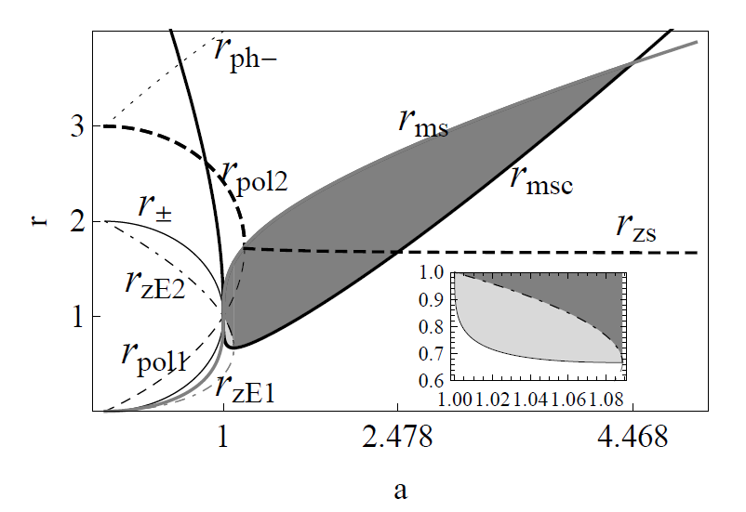
SPOs related to Keplerian accretion disks and possible observational consequences
The half-period of a photon on an orbit with zero nodal shift
(return time to node):
$$Δt_{nod}=2\frac{r^{2}\left(r^{2}+a^{2}\right)−2ar\left(ℓ_{SPO}−a\right)}{aΔ\sqrt{m_{+}−m_{−}}} K\left(\frac{m_{+}}{m_{+}−m_{−}}\right)$$
$$+4a\left[\frac{m_{−}}{\sqrt{m_{+}−m_{−}}}K\left(\frac{m_{+}}{m_{+}−m_{−}}\right)+\sqrt{m_{+}−m_{−}} E\left(\frac{m_{+}}{m_{+}−m_{−}}\right)\right]$$
$m_{±}$- positive/negative roots of $M\left(m\right),$
$K\left(s\right)/E(s)$ – complete elliptic integrals of first/second kind
$$(20)$$
$r_{msc}$ - marginally stable circular equatorial orbits of the so-called I. family for particles 𝑚≠0
$r_{zE1,2}$ - orbits of zero-energy particles 𝐸=0
(Z. Stuchlík, Equatorial circular orbits and the motion of the shell
of dust in the field of a rotating naked singularity. Bull. Astronom.
Inst. Czechoslov. 31, 129–144 (1980))
In standard dimensional units: $Δt_{nod(dim)}=\frac{GM}{c^{3}}Δt_{nod}$
$$(21)$$
in the area of orbits of massive particles with negative energy, the possibility of capturing the extracted rotational energy of a naked singularity (superspinar) emitted in the form of el-mag. radiation or gravitational waves ⇒ disruption of the stability and structure of the thin Keplerian disk
in the area of overlap of stable SPOs with the Keplerian accretion disc, the possibility of capturing thermal energy; self-illumination
periodic light echo, long-lasting afterglow – sign of existence of NSs
For KNS $a=1.1:$
$$M\sim M_{⨀}⇒ Δt_{nod(dim)}\sim 0.01s$$
Sgr $A^{∗}: M\sim {10}^{6}M_{⨀}⇒ Δt_{nod(dim)}\sim {10}^{3}s\sim 1/4$ hour
Center of galaxy M 87: $M\sim {6.6×10}^{9}M_{⨀}$ $⇒Δt_{nod(dim)}\sim {10}^{6}s\sim 12days$
12
Notes:
csvukrs

Slide 13
Summary & plans for further work
Kerr spacetimes:
Stable SPOs with zero nodal shift $Δφ$ that could lead to periodic light echo or long-lasting afterglow
Kerr de-Sitter (KdS) spacetimes:
Existence of maximum latitude $θ_{max⁡(circ)}$ allowing for occurrence of light circle in spacetimes with polar SPOs
Existence of minimum latitude $θ_{min⁡(arc)}$ needed for occurrence of light arc in spacetimes with no polar SPOs
$ξ\left(a_{NS}^{2}<a^{2}<a_{\max\left(pol\right)}^{2}\left(y\right)\right)>ξ(a_{\max\left(pol\right)}^{2}\left(y\right)<a^{2})$
Observers in different state of motion?
Another spacetimes?
13
Notes:
csvukrs

Slide 14
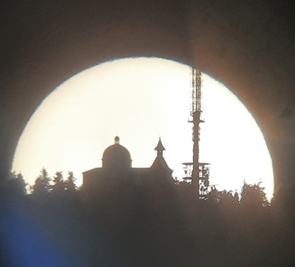
Thanks for your attention

Slide 15
Latitudinal motion – behaviour of $X_{±}^{θ}\text{(}\text{m}\text{; }\text{q}\text{, }\text{y}\text{, }a^{2}\text{)}$
Case $a^{2}y<1$
Lowest allowed value of $q$: $q_{min}=−a^{2} ⟹X=−a (ℓ=0)$ – motion along the spin axis (stable)
$−a^{2}<q<0$– motion stably confined between two cones of constant latitude (vortical motion)
maxima $X_{+}^{θ}≡X_{PNC}=−a\cos^{2}{θ}$,
$q_{PNC}=−a^{2}\cos^{4}{θ}$
minima $X_{−}^{θ}≡X^{⋆}=a\frac{\cos^{2}{θ}\left(1−a^{2}\right)−2}{Δ_{2θ}^{2}},$
$q^{⋆}=−\frac{aI\sin^{2}θ}{Δ_{2θ}}$
$q≥0$ – motion confined to or crossing the equatorial plane (orbital motion)
(Principal Null Congruences of the geometry)
15
Notes:
csvukrs

Slide 16
Latitudinal motion – behaviour of $X_{±}^{θ}\text{(}\text{m}\text{; }\text{q}\text{, }\text{y}\text{, }a^{2}\text{)}$
Case $a^{2}y<1$
$$X_{+}^{θ}$$
Case $a^{2}y=1$
Case $a^{2}y>1$
$$X_{+}^{θ}$$
forbidden region, $M<0$
allowed region, $M≥0$
$$X_{−}^{θ}$$
16
Notes:
csvukrs

Slide 17
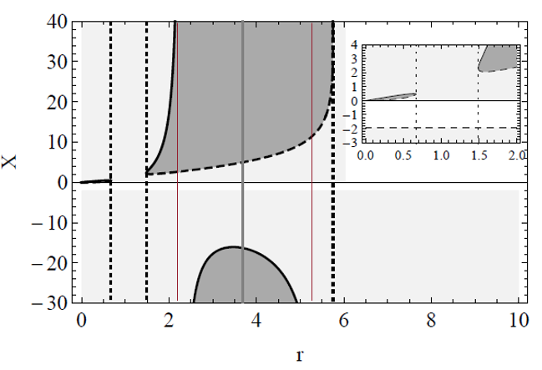
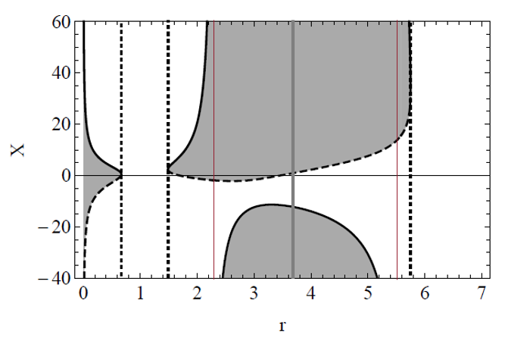
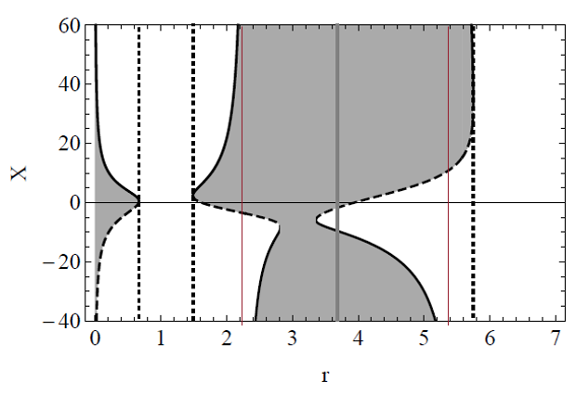
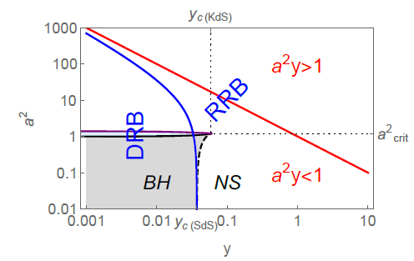
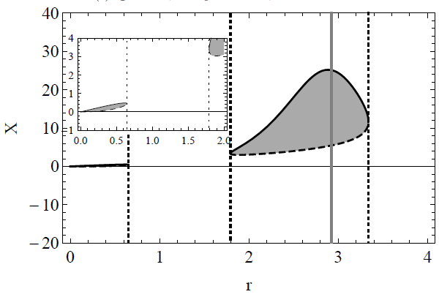
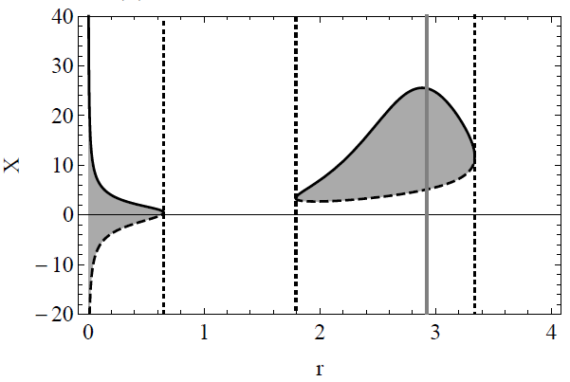
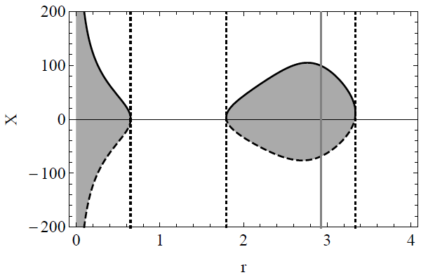
Radial motion – behaviour of $X_{±}\text{(}\text{r}\text{; }\text{q}\text{, }\text{y}\text{, }a^{2}\text{)}$
KdS BLACK HOLE (BH) SPACETIMES WITH DIVERGENT REPULSIVE BARRIER (DRB): $y=0.02, a^{2}=0.9$
$$q>0$$
$$q≫0$$
$$q→0^{−}$$
KdS BLACK HOLE (BH) SPACETIMES WITH RESTRICTED REPULSIVE BARRIER (RRB): $y=0.04, a^{2}=0.9$
$$q=0$$
$$q>0$$
$$q≫0$$
17
Notes:
csvukrs

Slide 18
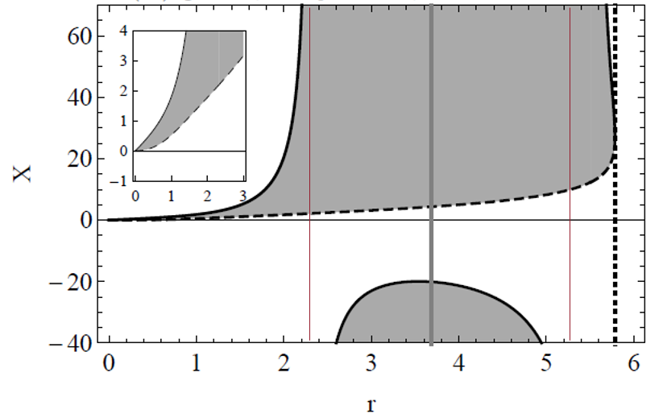
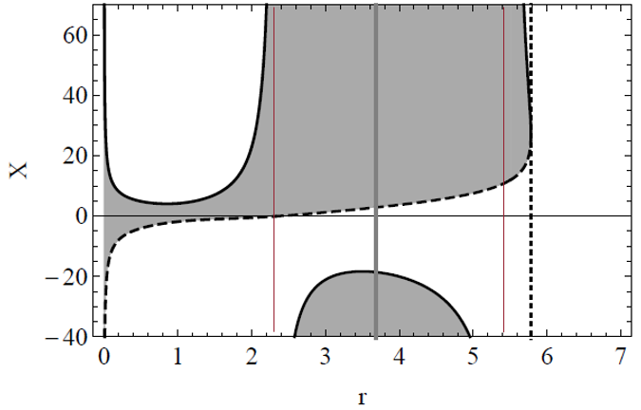
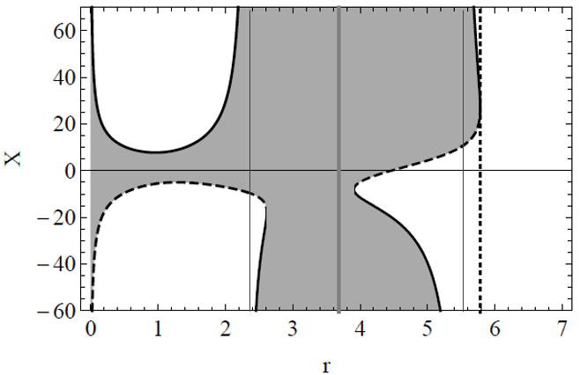
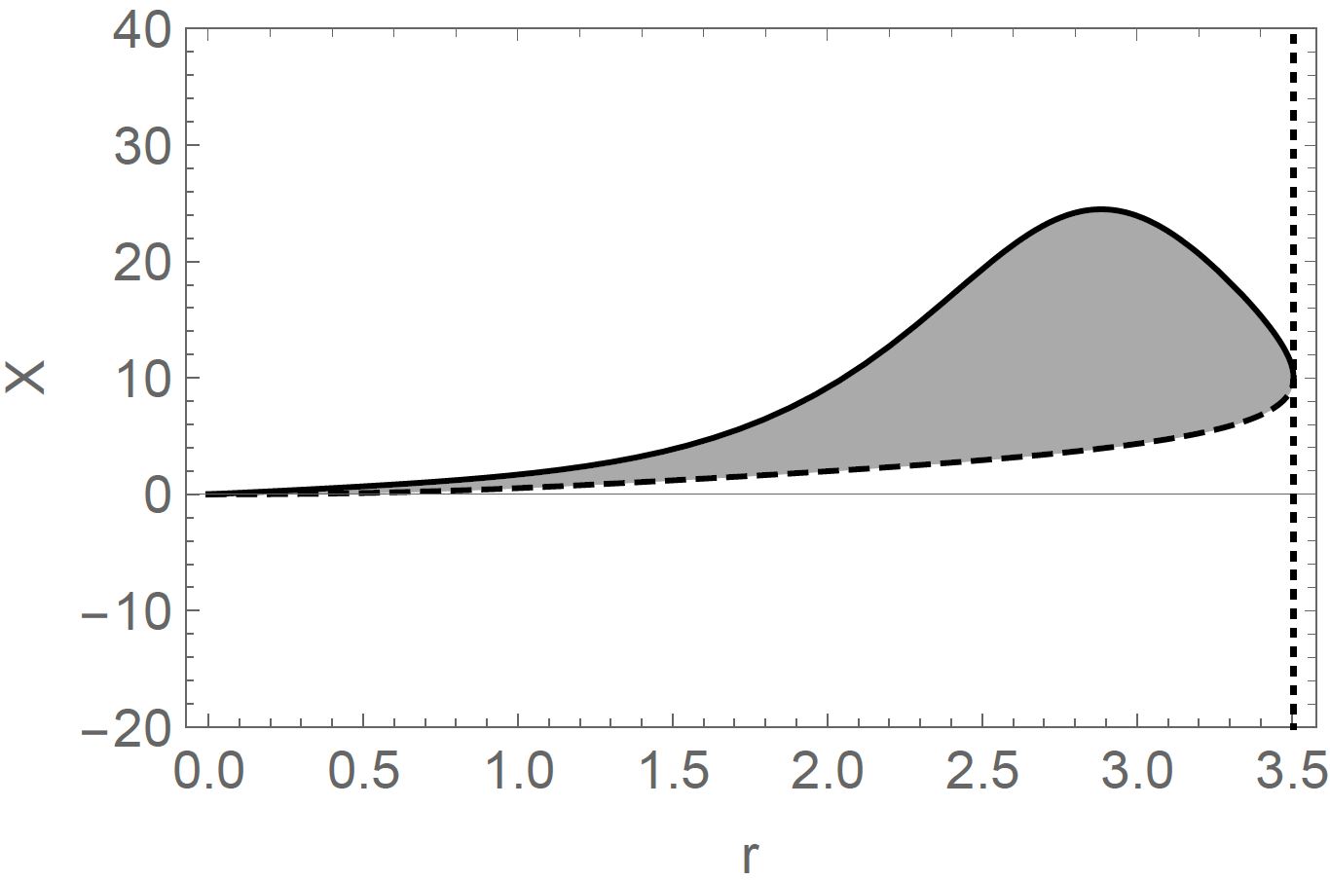
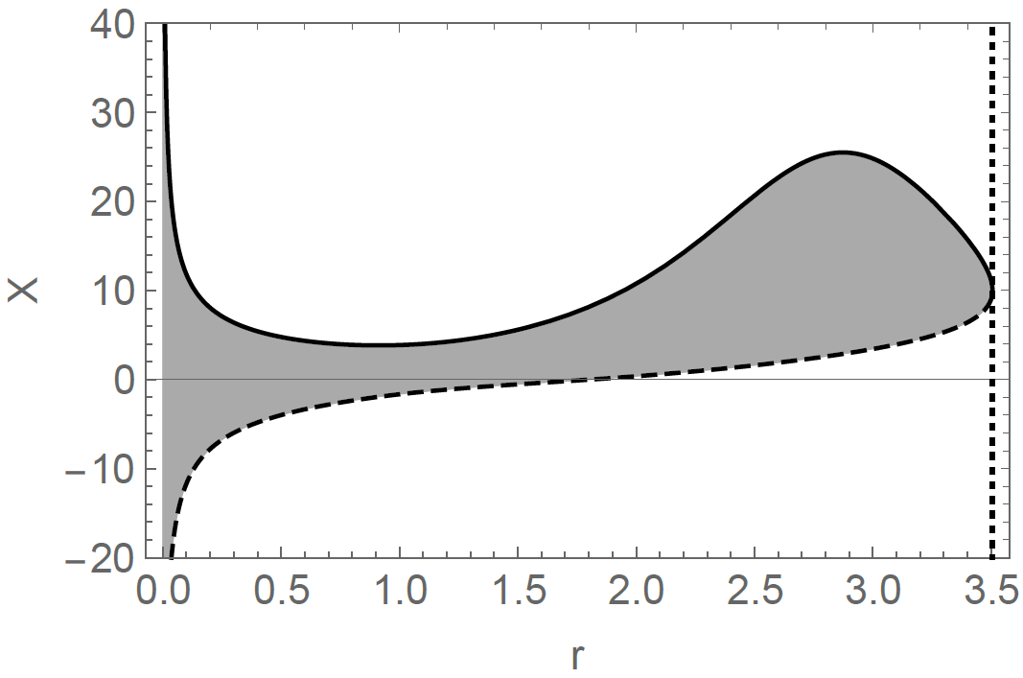
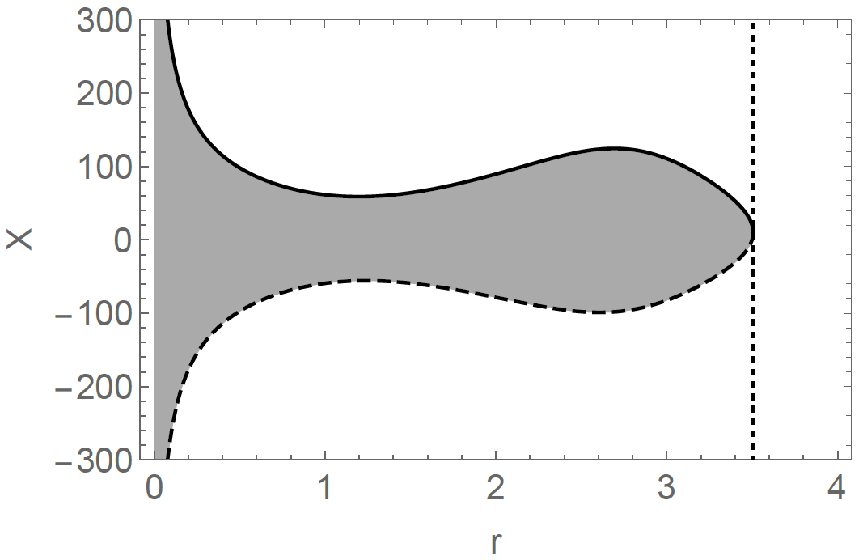
Radial motion – behaviour of $X_{±}\text{(}\text{r}\text{; }\text{q}\text{, }\text{y}\text{, }a^{2}\text{)}$
KdS NAKED SINGULARITY (NS) SPACETIMES WITH DIVERGENT REPULSIVE BARRIER (DRB): $y=0.02, a^{2}=1.5$
$$q=0$$
$$q>0$$
$$q≫0$$
KdS NAKED SINGULARITY (NS) SPACETIMES WITH RESTRICTED REPULSIVE BARRIER (RRB): $y=0.04, a^{2}=1.5$
$$q=0$$
$$q>0$$
$$q≫0$$
18
Notes:
csvukrs

