Slide 1
Complex modeling of the radiation spectrum of accreting neutron stars
René Šprňa
Oct 2022
24th RAGtime
on Relativistic Astrophysics

Slide 2
Assumptions / Approximations
Weak magnetic field magnetospheric radius neutron star radius (inner edge of the disk on ISCO) accreting material creates boundary layer infalling material spinup the neutron star
Disk – Optically thick, no inner structure, isotropic radiation
Schwarzschild metric:

Slide 3
Frequency shift (g-factor) map
$$frequency shift=\frac{observed energy}{emitted energy}$$

Slide 4
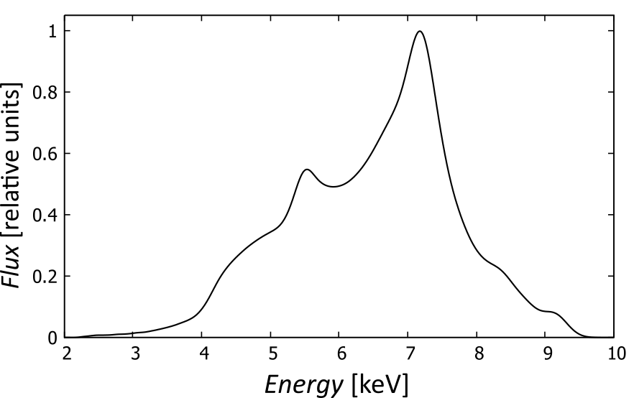
Spectral profile

Slide 5
Components of the system

Slide 6
Components of the system
+
+
accretion
disk
neutron
star
boundary
layer

Slide 7
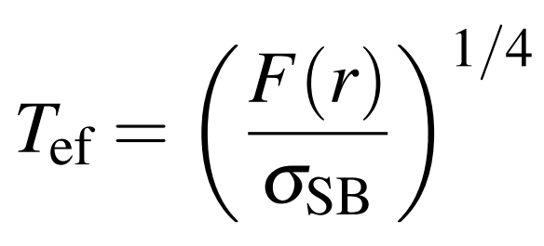
Model – Disk spectrum
Black body
Iron line
Novikov-Thorne
rest energy
Stefan-Boltzmann
Parameters of disk model: , , ,

Slide 8
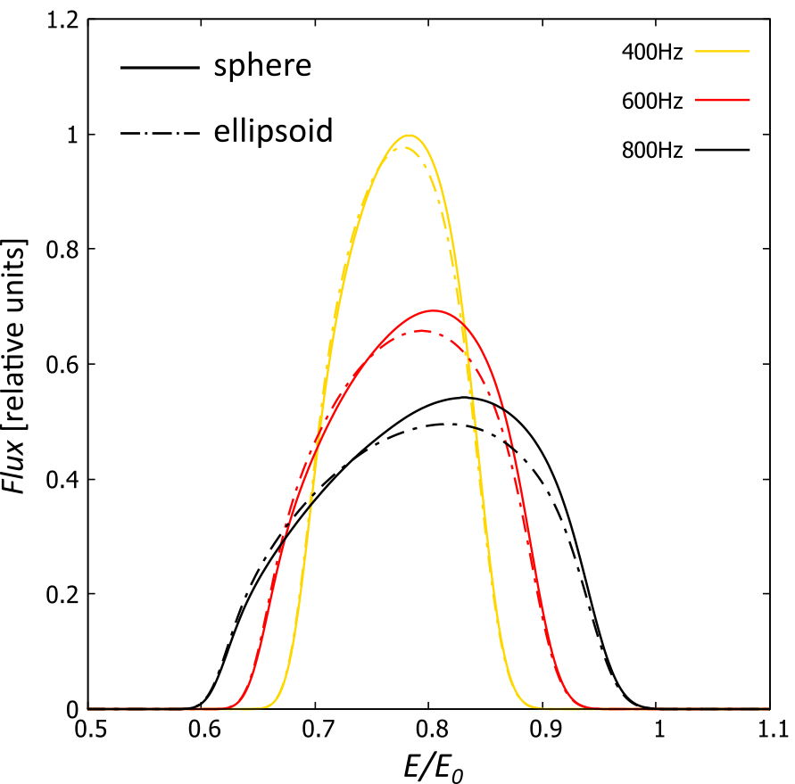
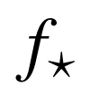
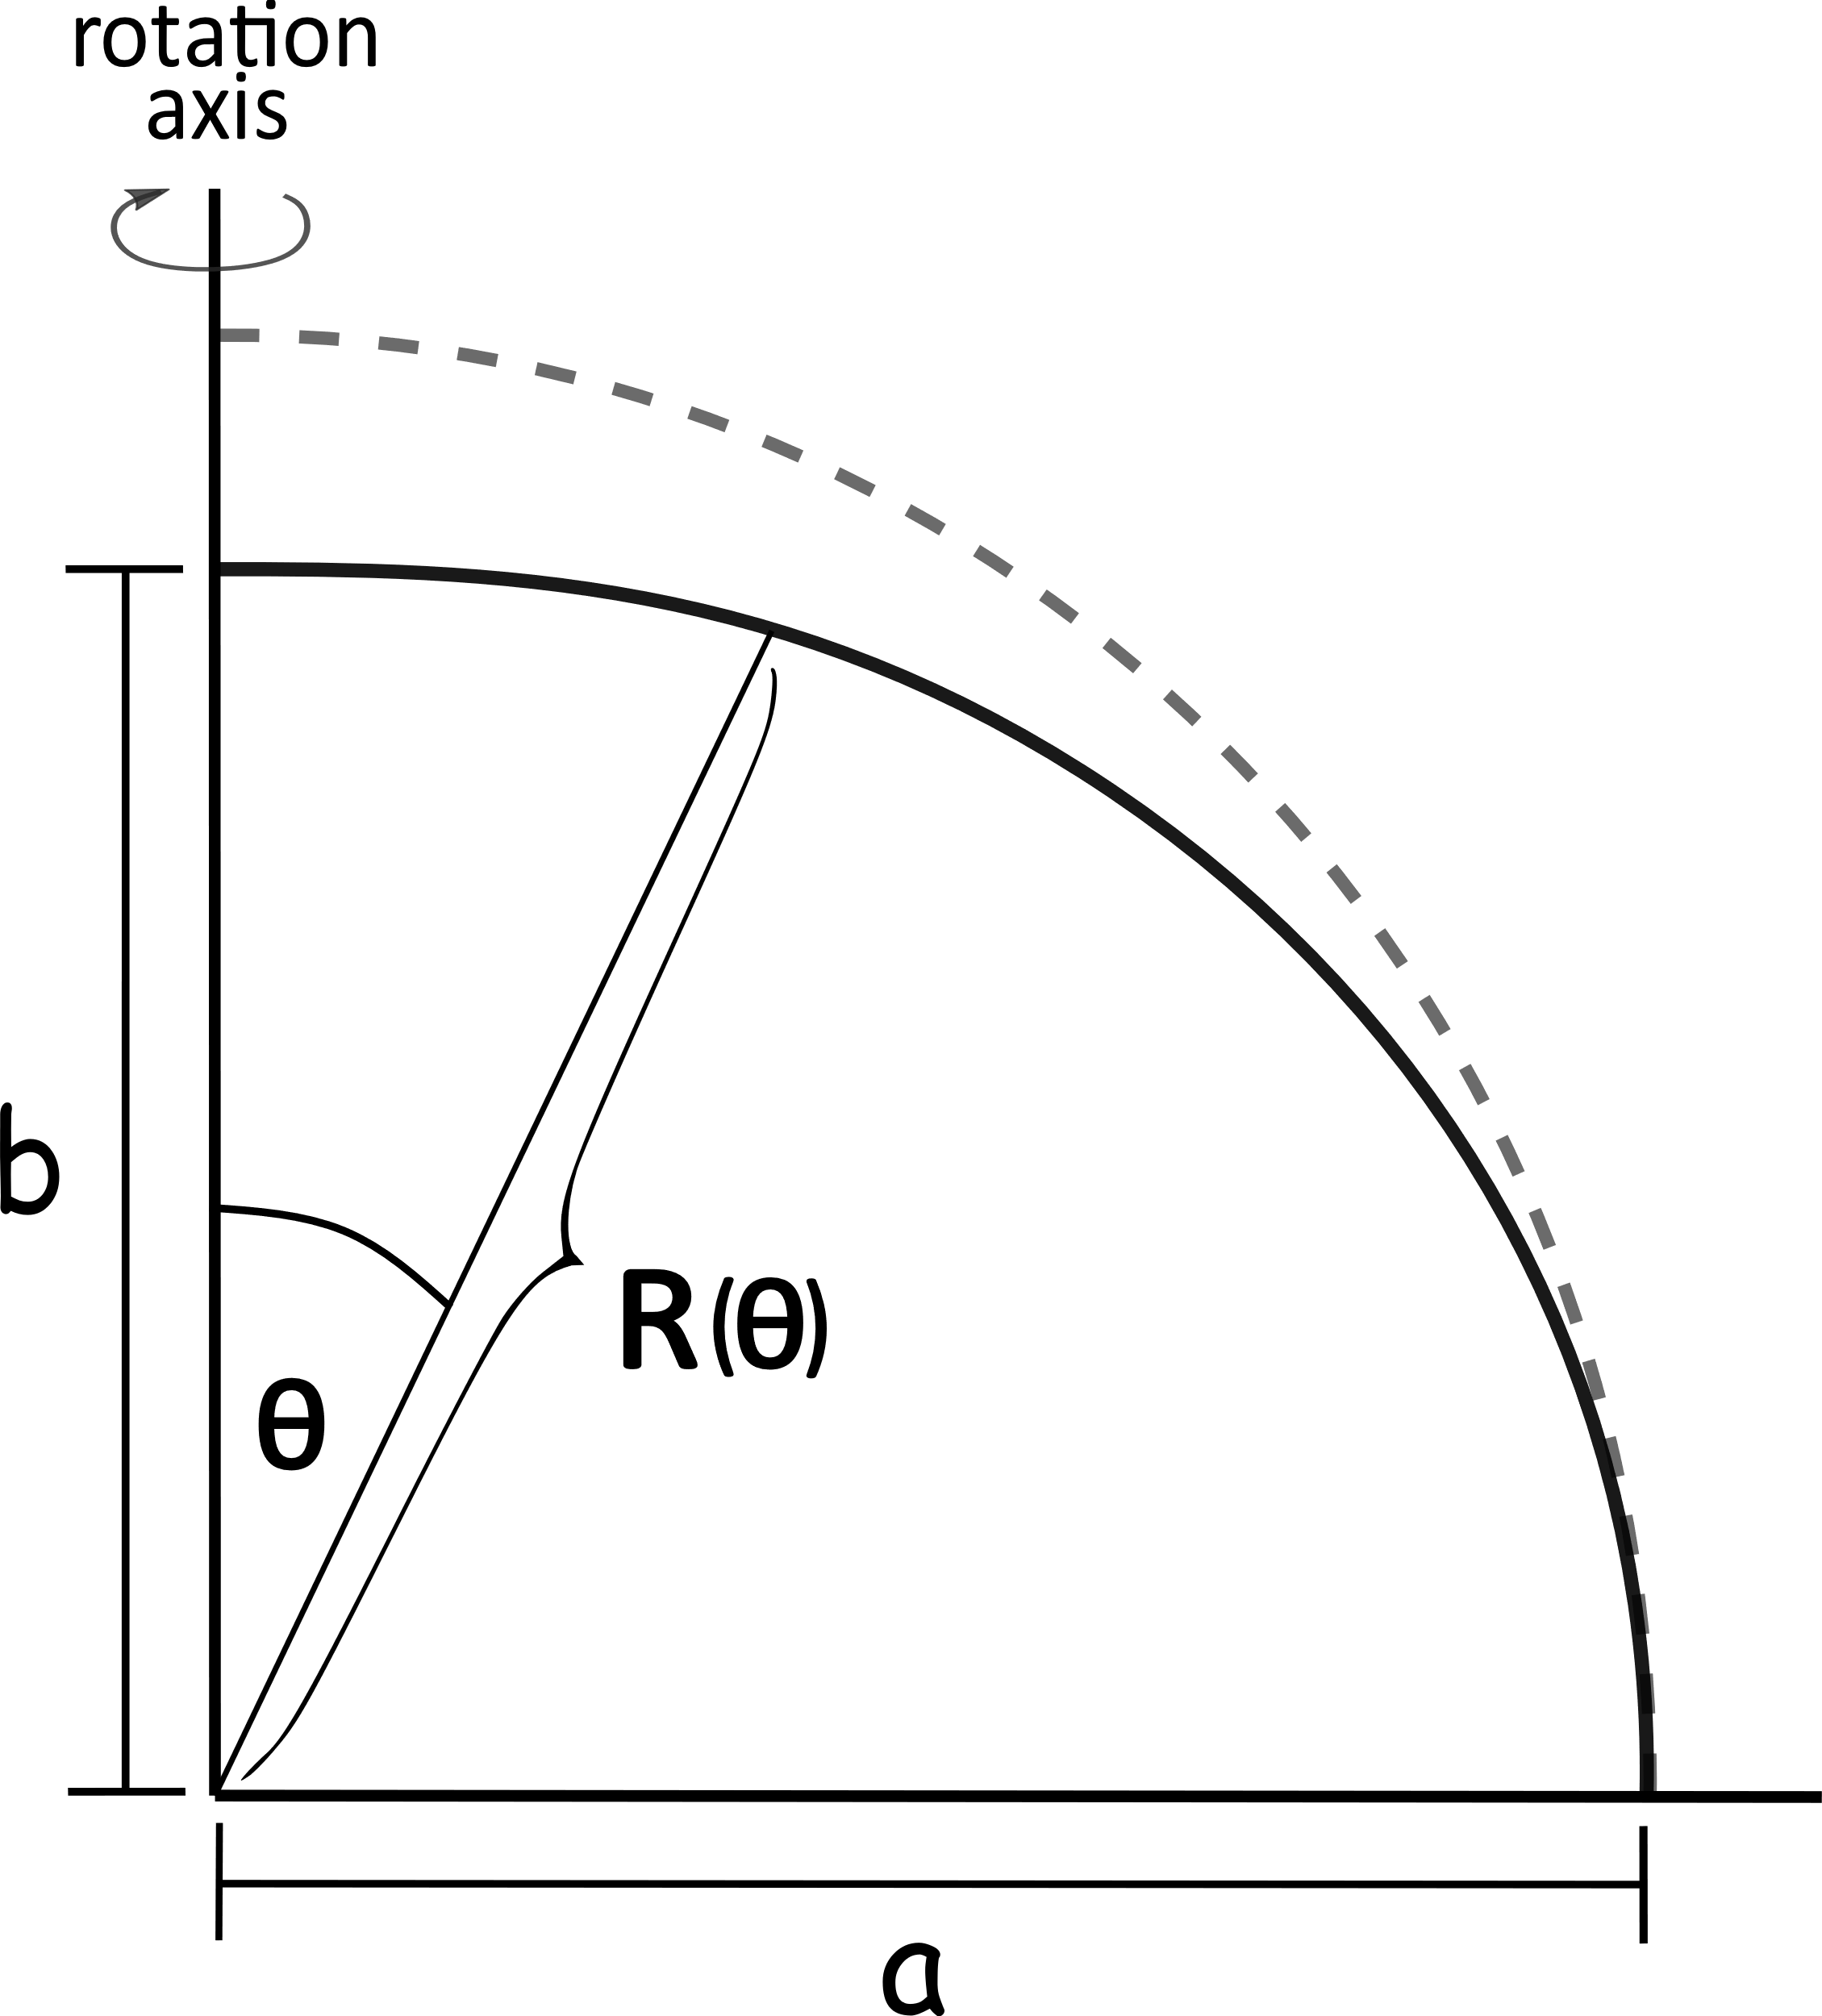
Model – NS surface
ellipsoid
sphere vs ellipsoid
“Oblateness“ values for given frequencies based on nummerical modeling
iron line profile

Slide 9
Model – NS spectrum
Black body
Iron line
Parameters of NS model: , , , ,

Slide 10
Model - BL
angular velocity of the NS
angular velocity of the BL
specific angular momentum
(in schwarzschild)
Iron line
Parameters of BL model:

Slide 11
Total intensity

Slide 12
Total intensity
(of K_{α} iron line)

Slide 13
Model – Disk – comparison
my results
When not specified, the other parameters are fixed at:

Slide 14
Model – Disk – comparison
my results
Pretty good
When not specified, the other parameters are fixed at:

Slide 15
Model – NS – comparison
my results

Slide 16
Model – NS – comparison
Pretty good
my results

Slide 17
Photon geodesics
Numerically calculated using numerical code LSD created by pavel bakala.
The geodesics are computed for the whole system all at once – all obscuration effects are automatically included.

Slide 18
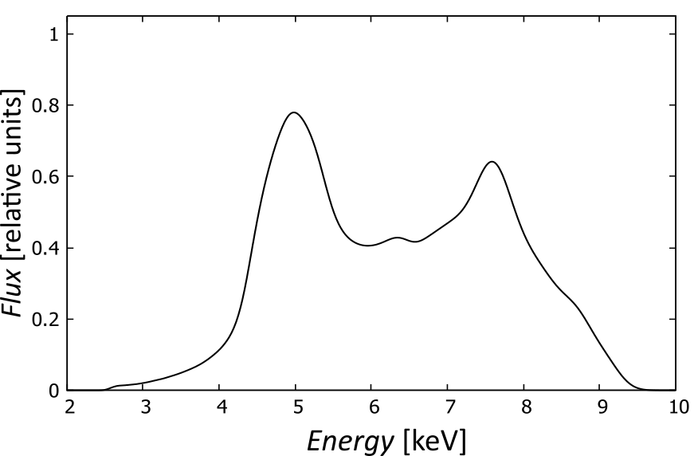
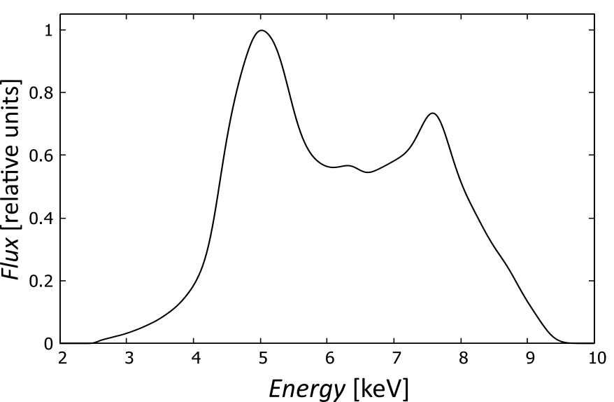
Obscuration effects
Frequency shift map
+
Spectral profile

Slide 19
Spectral profile

Slide 20
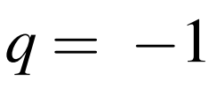
Parameters of this result

Slide 21
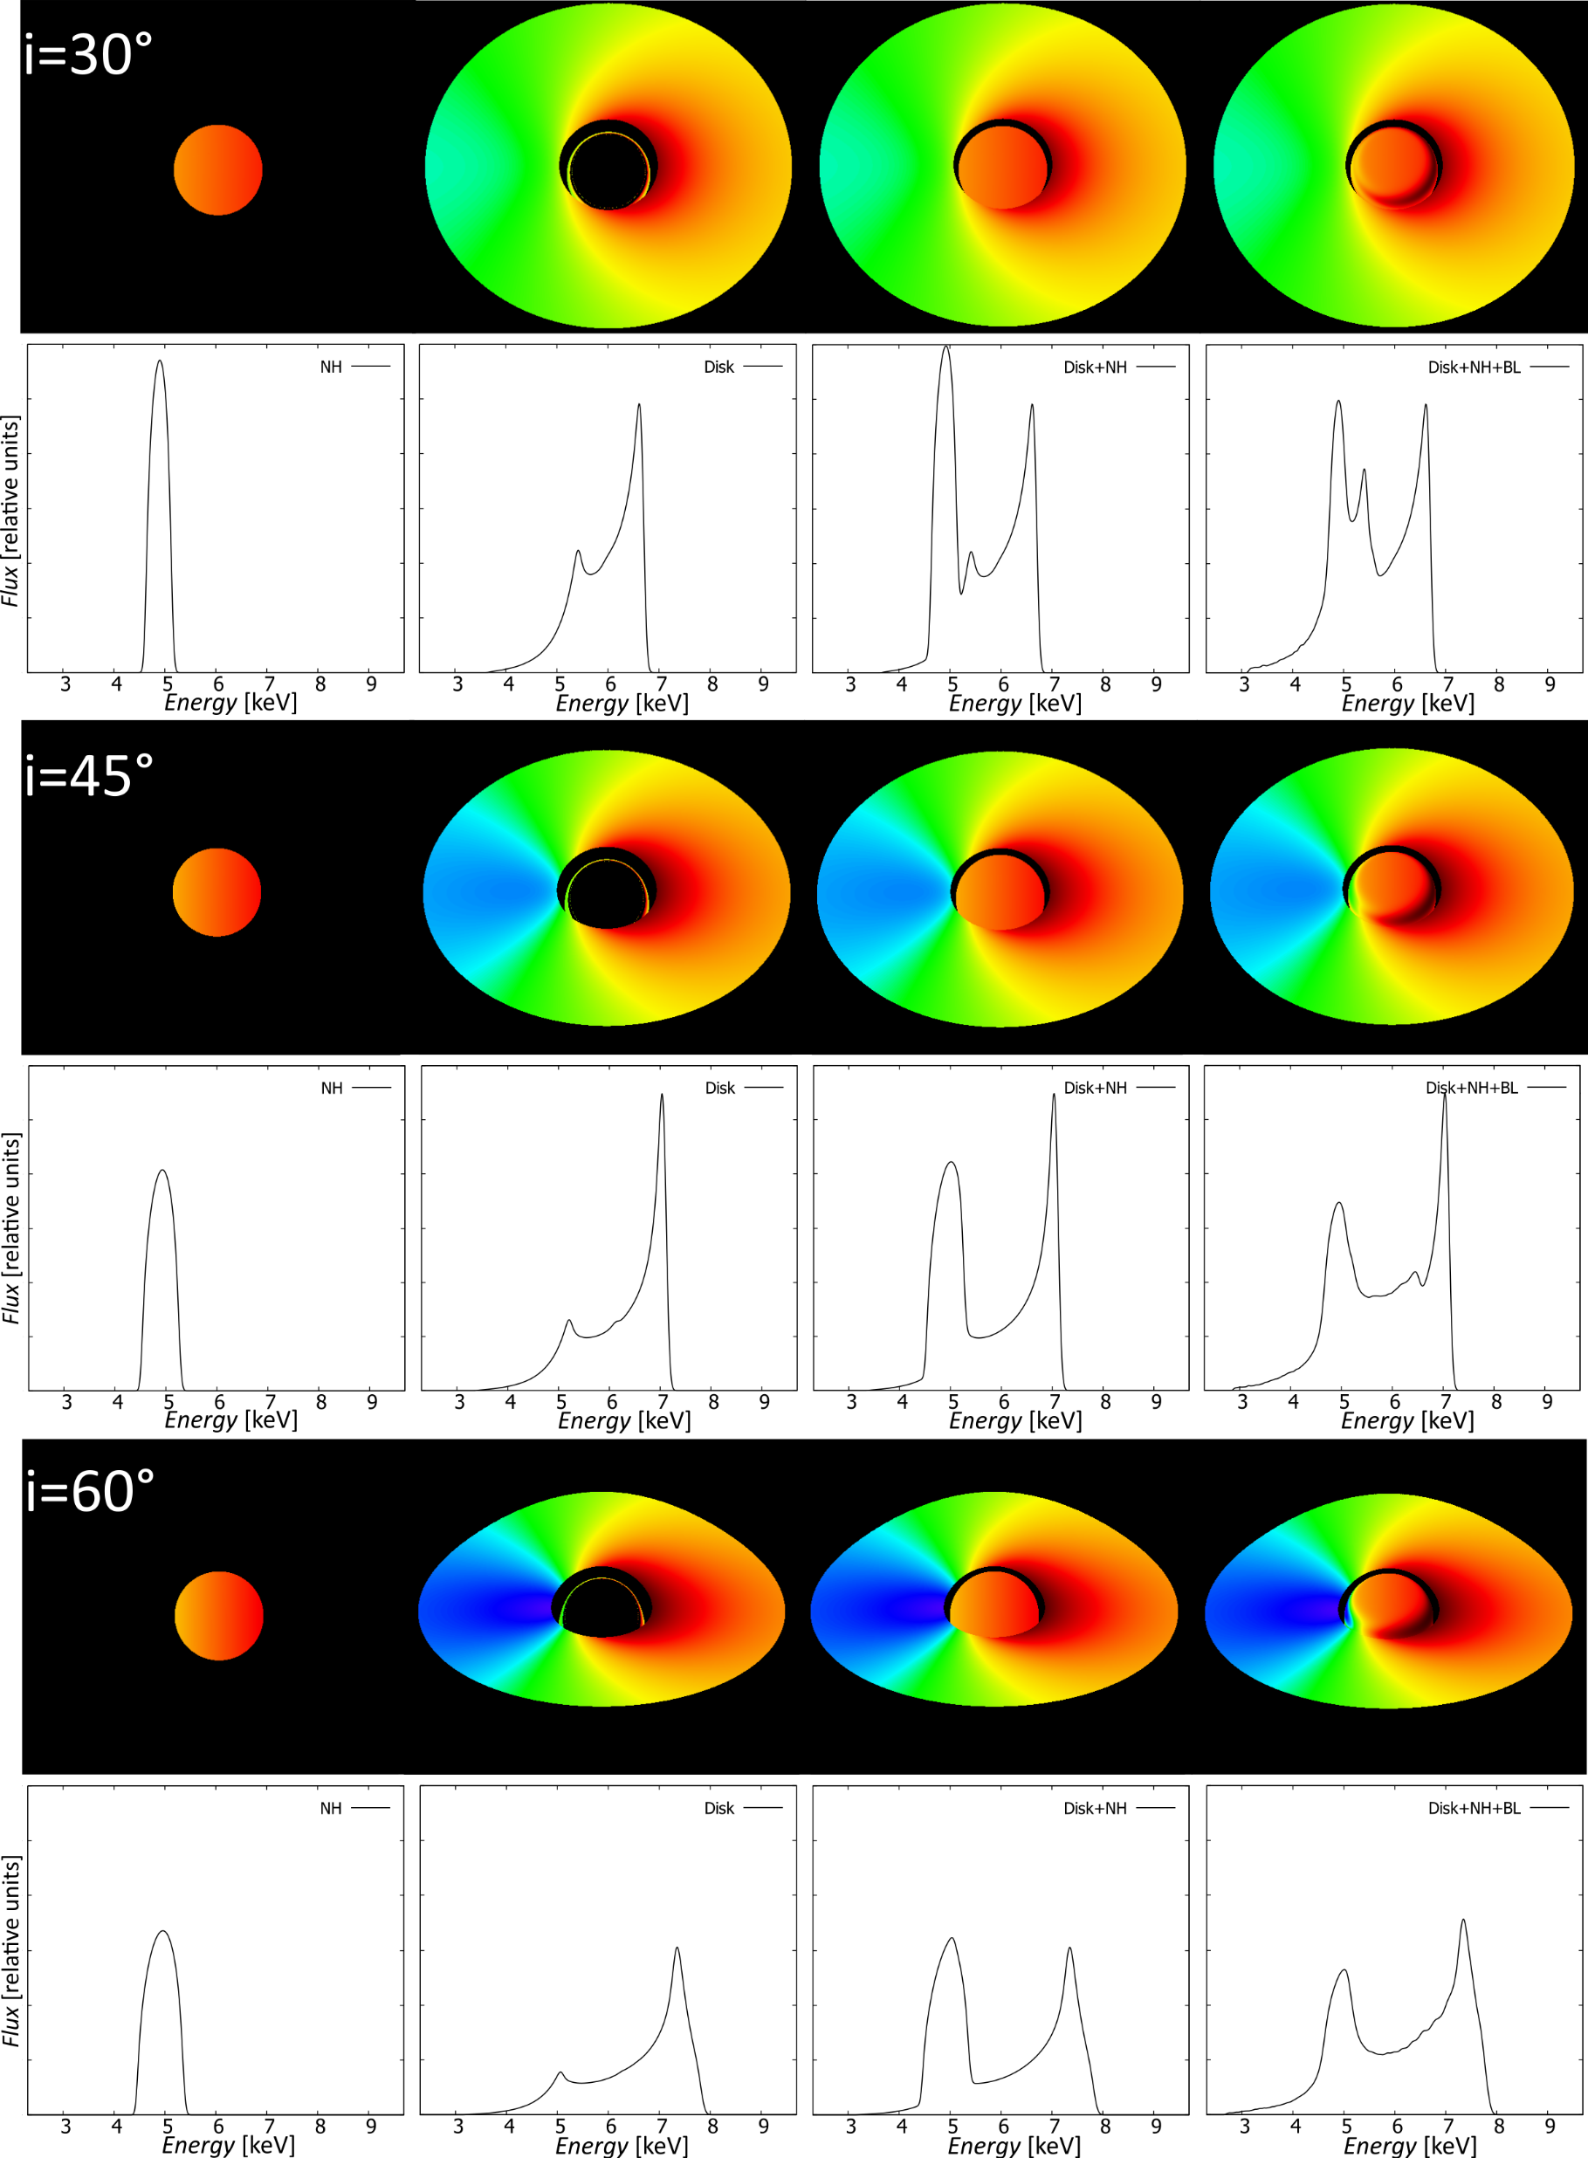
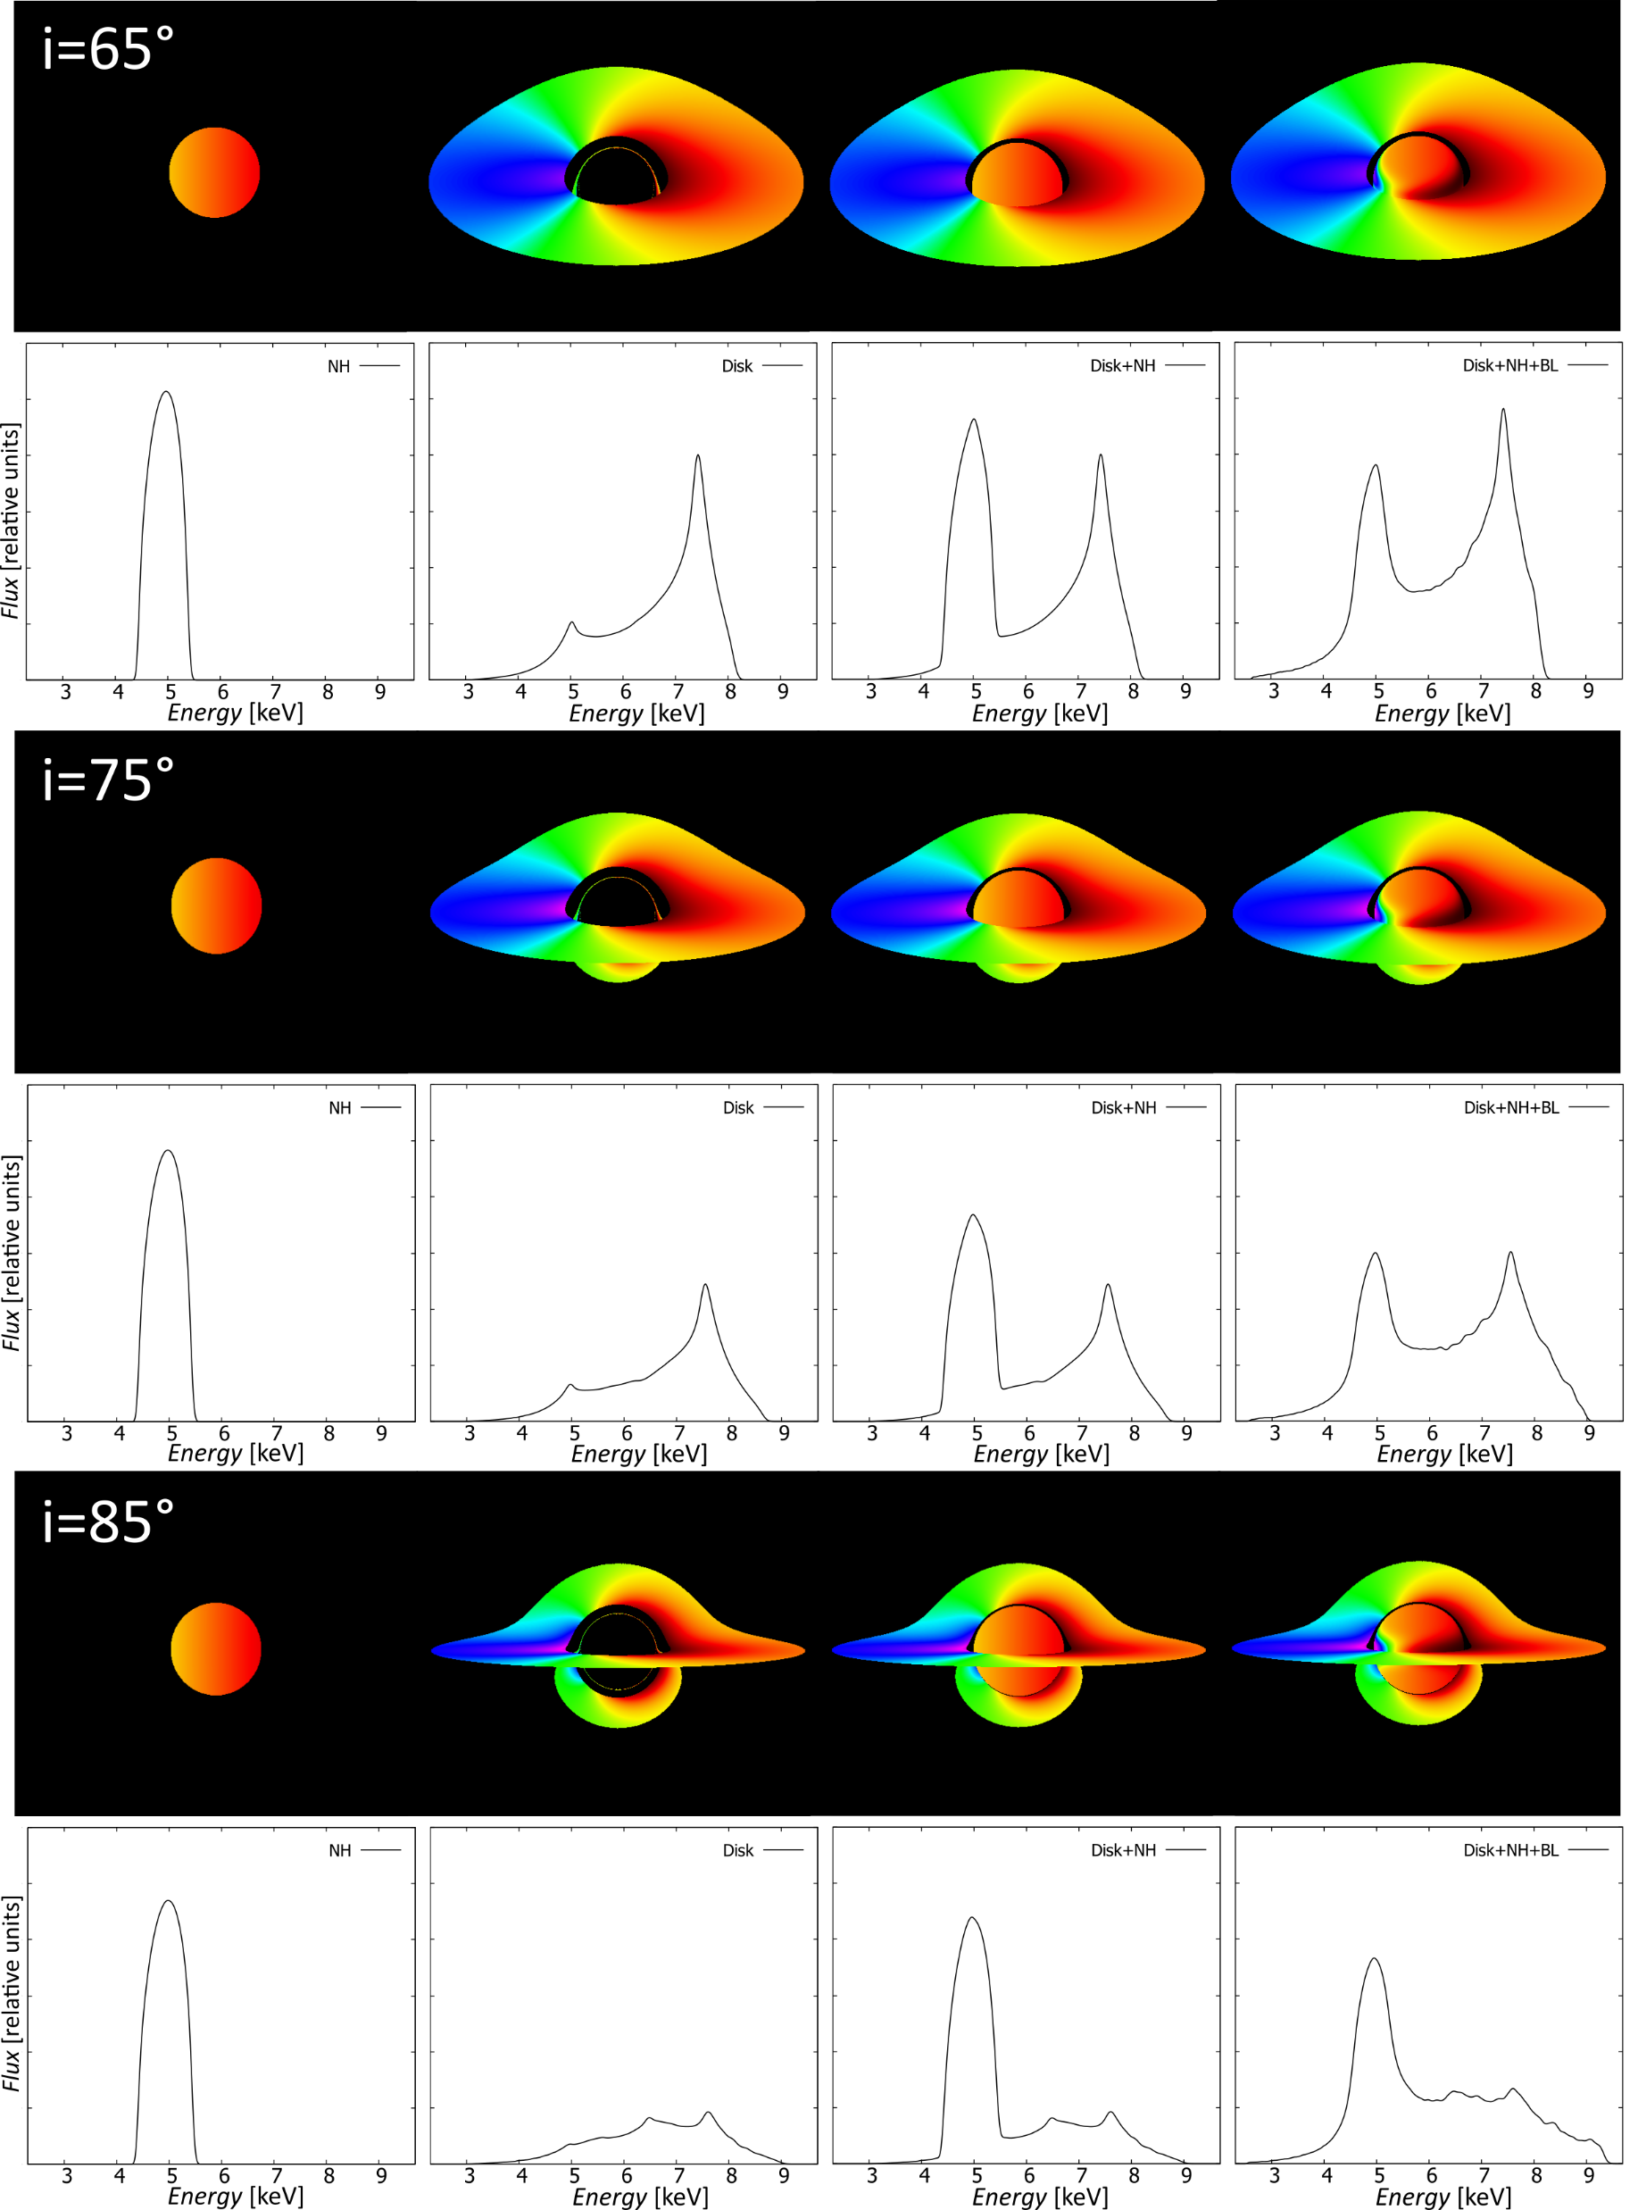
Contribution of components

Slide 22
Some more results part 1
The impact of changing the width of the BL on the overall spectrum of the system for three different observer inclinations.

Slide 23
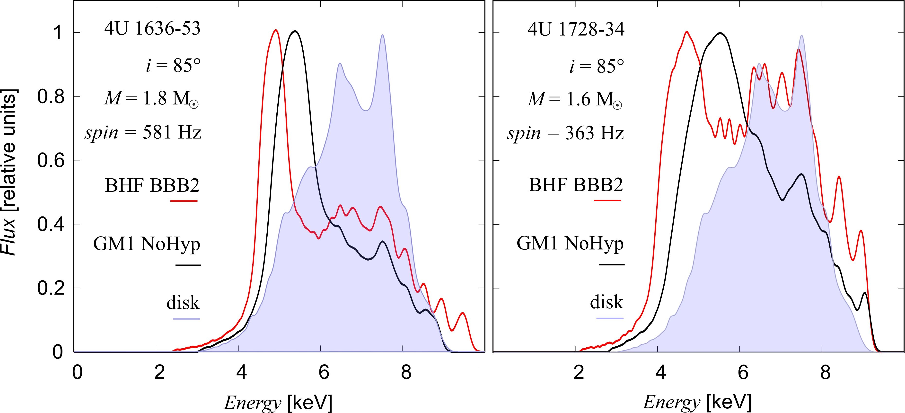
Some more results part 2
Iron line profile from accreting neutron star for two different EoS of the NS. The filled region indicates the line from the disk alone.

Slide 24
Summary and conclusions
We are able to model relativistic spectral profiles from accreting compact object and we can study the influence of individual components of the system on the resulting spectral profiles.
Modeled spectra can consist of iron line and black body emission.
Complex model including the radiation of accretion disk, neutron star, boundary layer.
Consideration of different equation of state for NS with a given mass and spin frequency may result to very different spectral signatures.

Slide 26
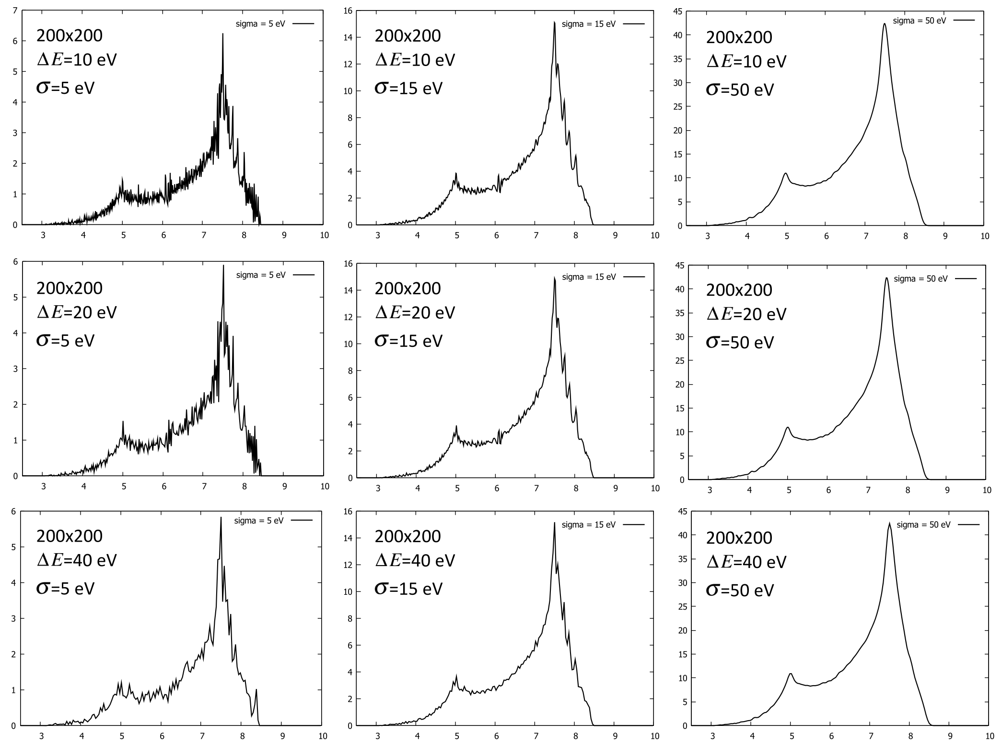
Backup slide 1
N x N pixels

Slide 27
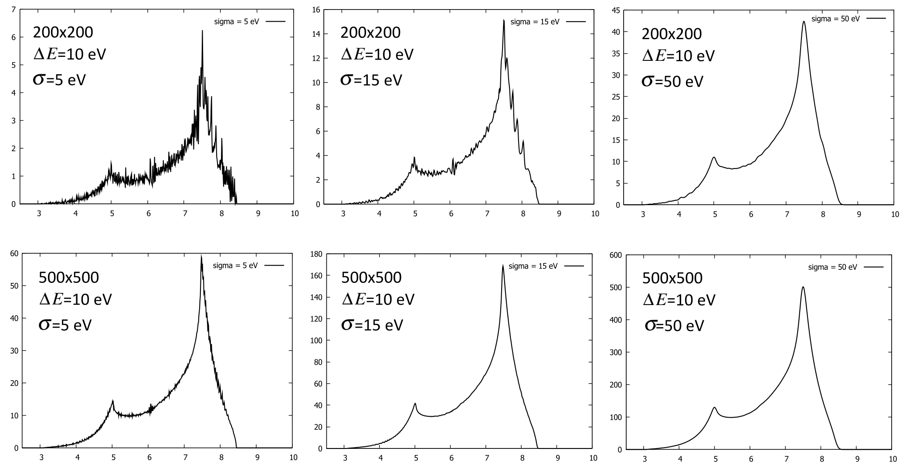
Backup slide 2

Slide 28
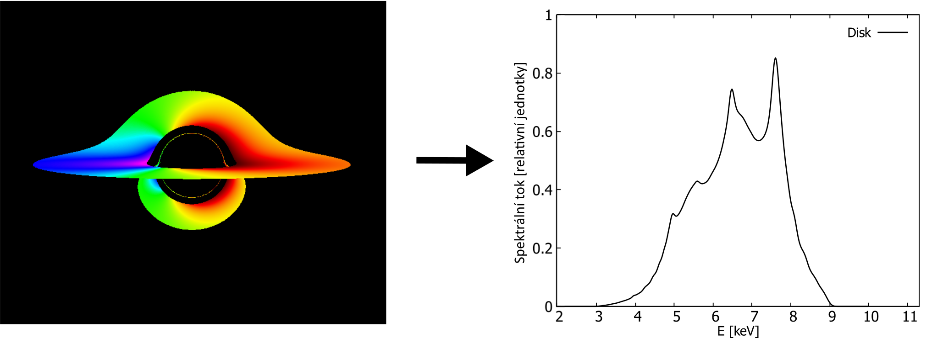
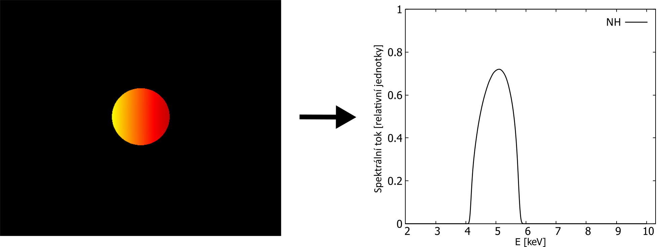
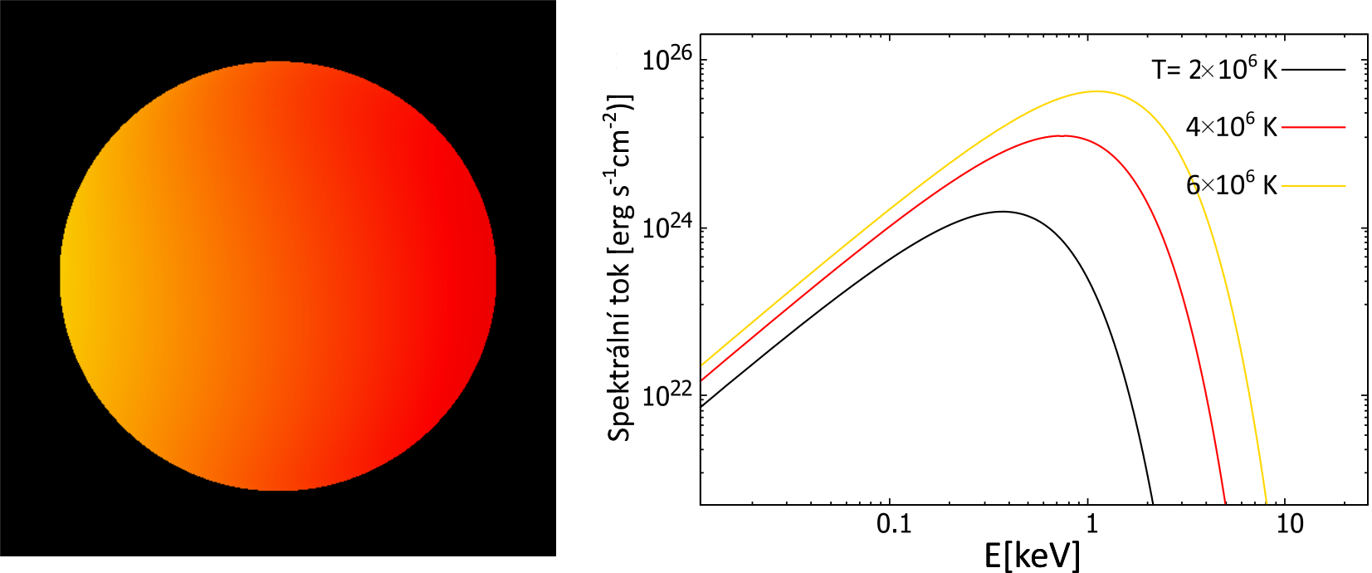
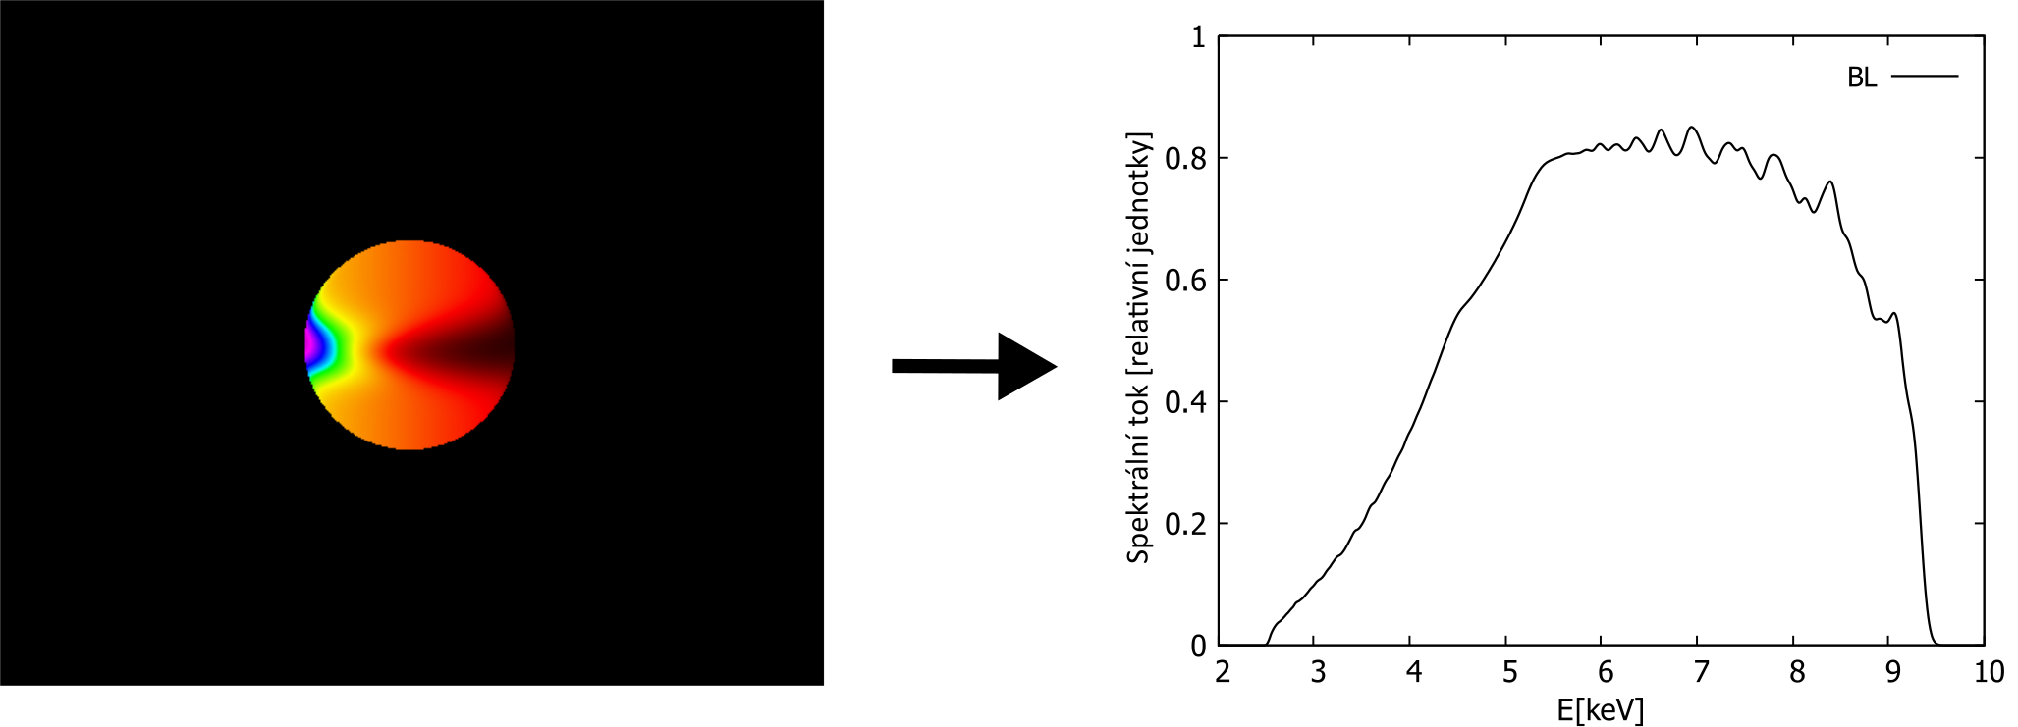
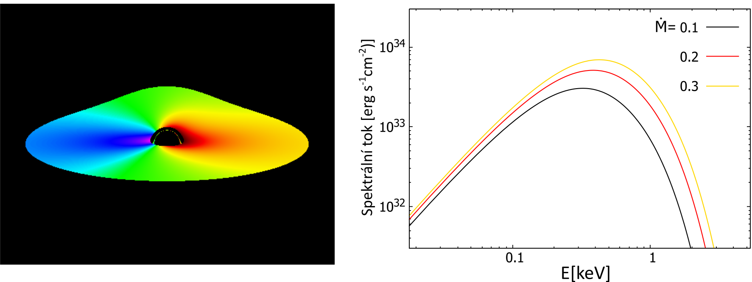
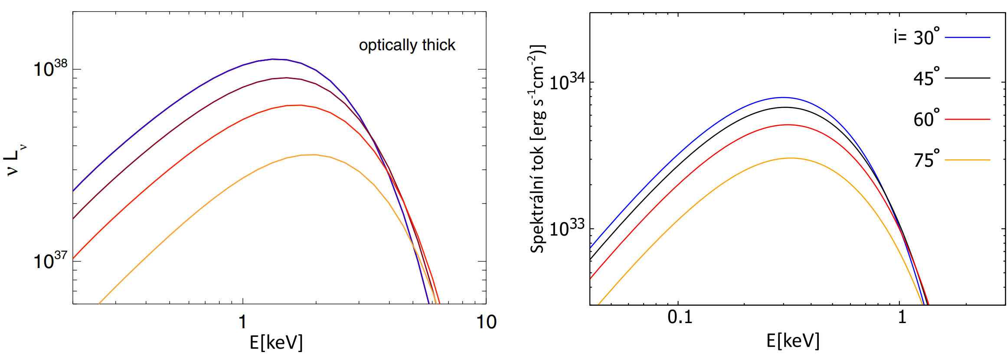
Backup slide 3

