Slide 1
NUMERICAL MODEL OF A STABLE SUB-EDDINGTON ACCRETION – THE PUFFY DISC
Debora Lančová
Institute of Physics, Silesian University in Opava
Czech Republic
Maciek Wielgus, Marek Abramowicz, Wlodek Kluzniak, David Abarca, Ramesh Narayan, Odele Straub, Frederic Vincent, Gabriel Török
RAGtime 24
Opava, October 12

Slide 2
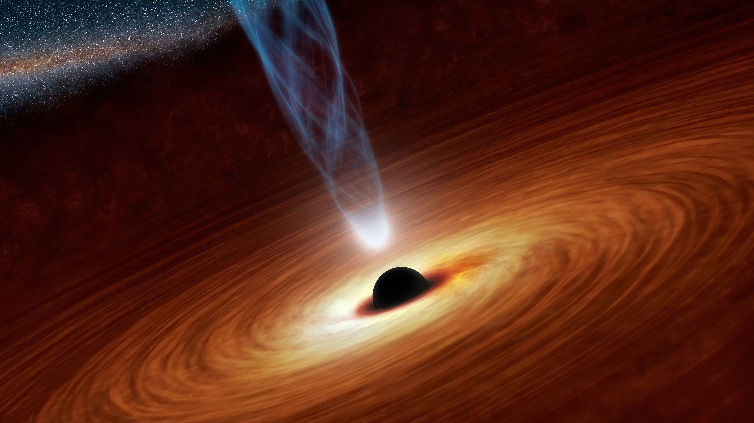
SUB-EDDINGTON ACCRETION
Standart model of a geometrically thin optically thick disc
Shakura&Sunyaev73, Novikov&Thorne73
Beautiful analytical model, quite simple, easy to calculate almost everything
BB spectra, radiatively efficient
Unfortunately, unstable

Slide 3
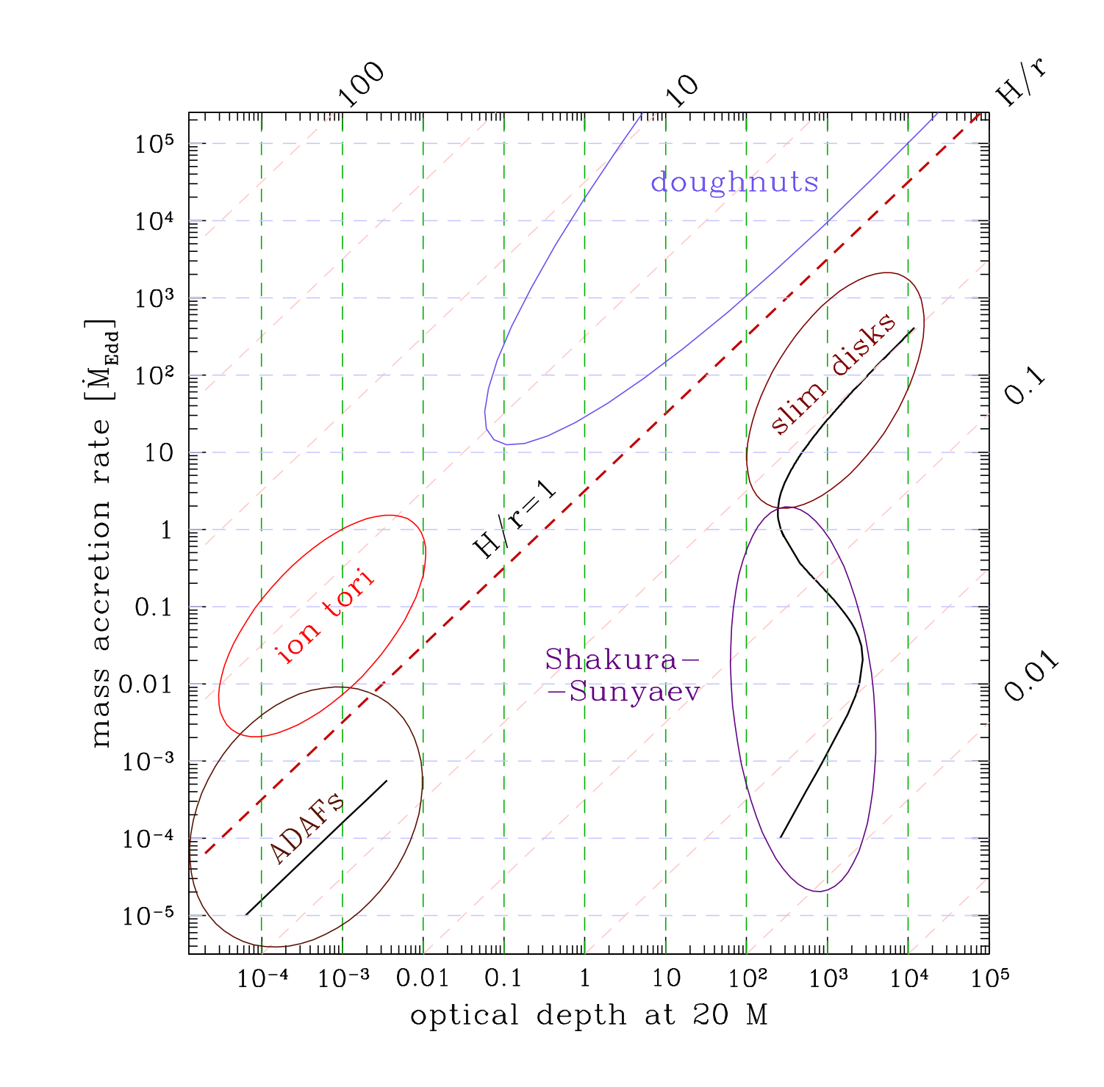

INSTABILITY
Mildly sub-Eddington accretion usually modelled by slim or thin disc + corona
Works for $\dot{m}<0.1$ and $\dot{m}>1 {\dot{m}}_{Edd}$
Thermal and viscous instabilities in between
Simulations agrees (B. Misha+ 2017, 2019)
THIS IS OK
THIS IS NOT
Sądowski 2009

Slide 4
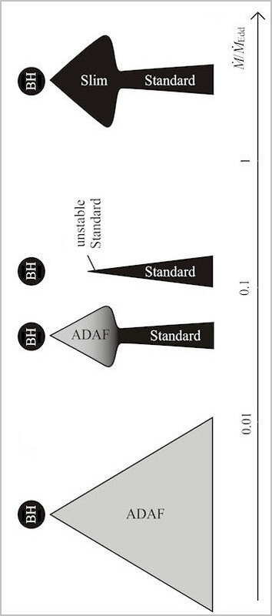
MODELS
CO-EXISTENCE
Simple thin disc coexist with another model, which stabilizes the inner parts
Confirmed by simulations (Liska+19,22) – depends on MF configuration
Mineshige+95

Slide 5
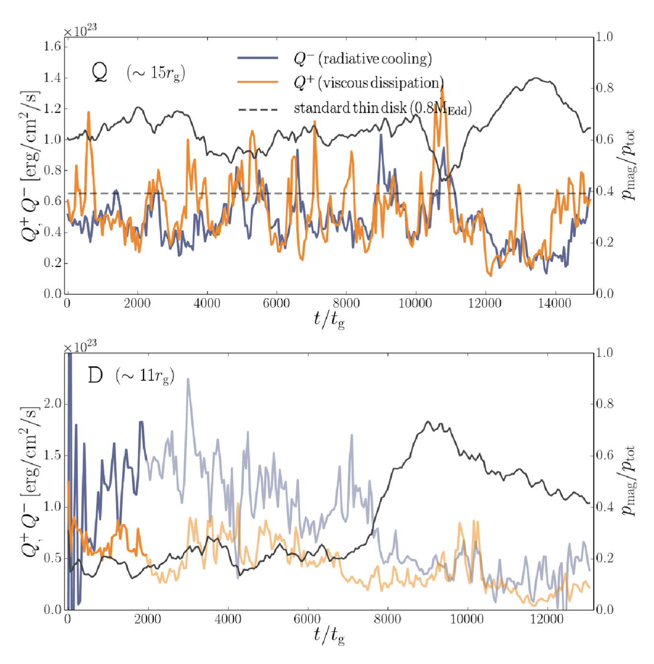
STABILIZATION BY THE MF
Magnetic pressure ~ radiation pressure in the midplane
Begelman&Pringle 07, Oda+09, Sądowski+16
Radial or vertical mf is needed to stabilize (Fragile&Sądowski 17)
Sądowski16

Slide 6
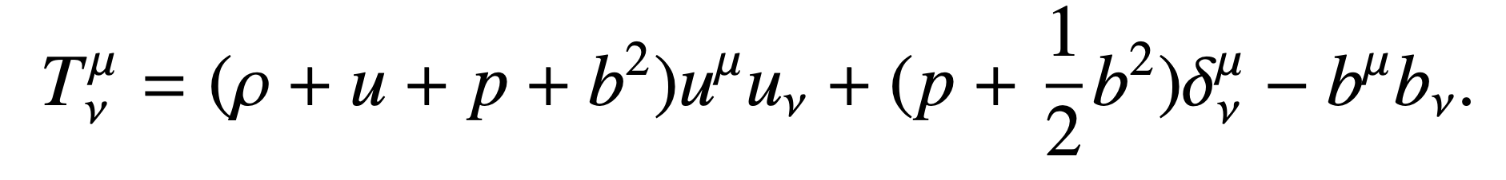
GLOBAL GENERAL RELATIVISTIC MAGNETOHYDRODYNAMICS
Ideal MHD - Electric field is zero in the fluid frame
Flux of conserved quantities + source term solved on logarithmic grid

Slide 7
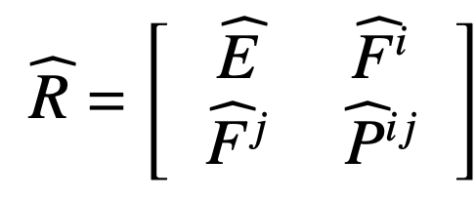
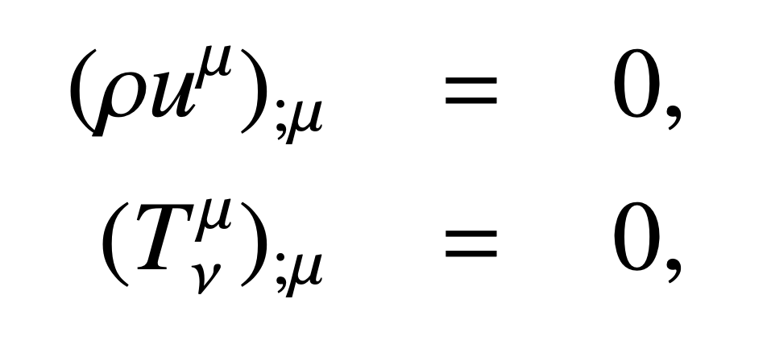
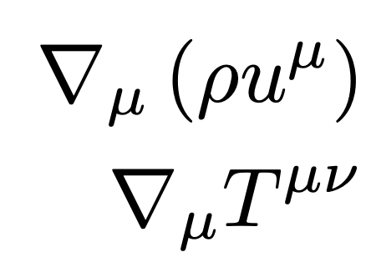
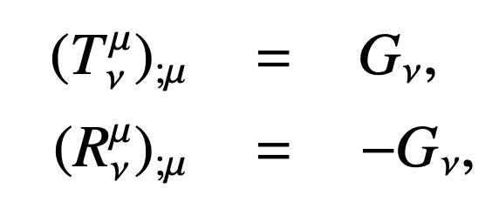
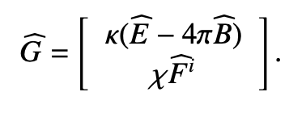
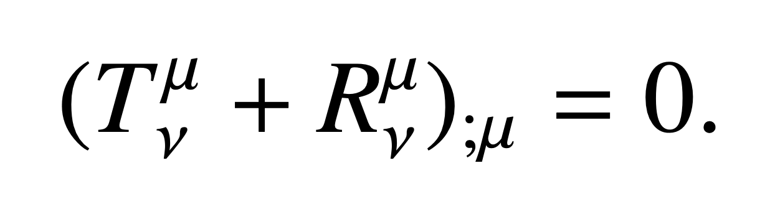
Radiative GRMHD
RADIATION REST FRAME
CONSERVATION LAWS
KORAL CODE
Sądowski + 2013ab, 2014, 2015, …
Robustly paralelized via MPI, still task for supercomputers
M1 CLOSURE
RADIATION
RADIATION 4-FORCE DENSITY
FLUID FRAME
Sądowski+ 2013a,b, Levermore 1984

Slide 8
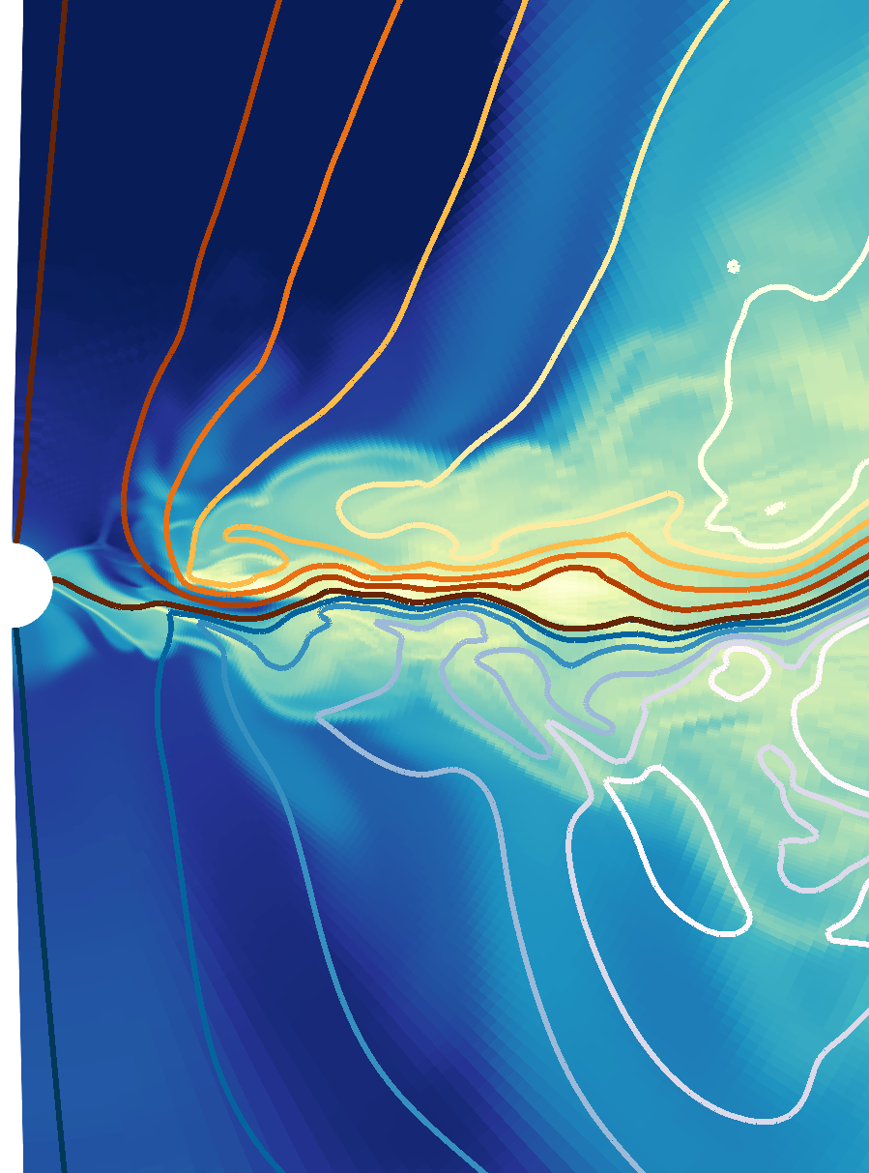
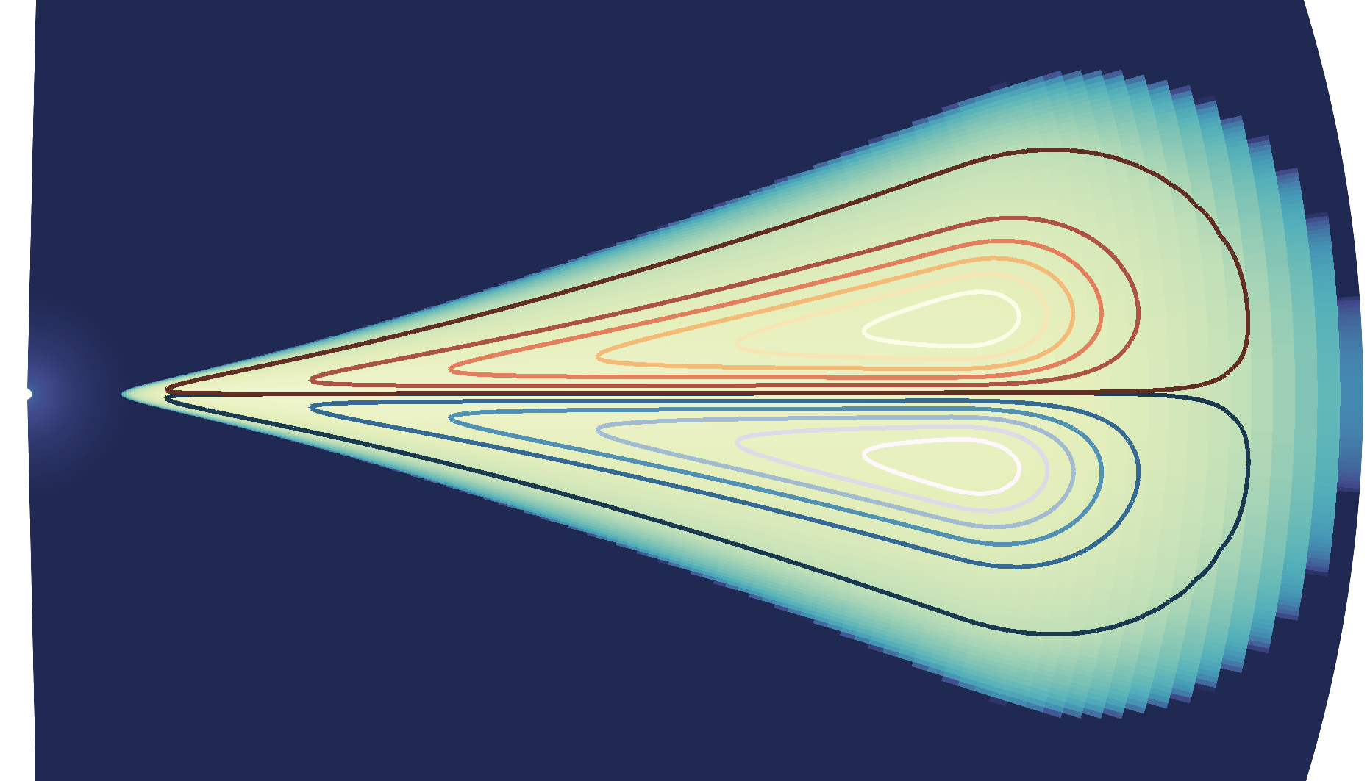

INITIAL STATE
150
Torus as a source of matter $a=0, M=10M_{⨀}$
Inner edge at $r_{0}\sim 40 M$
Quadrupole MF topology
Z/M
0
150
0
R/M
500
SĄDOWSKI 2016

Slide 9
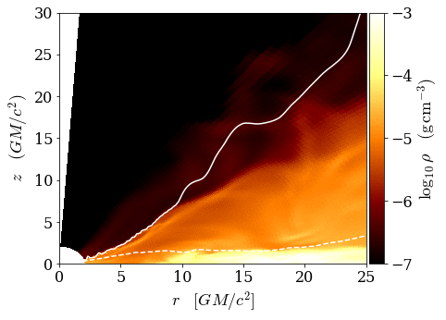
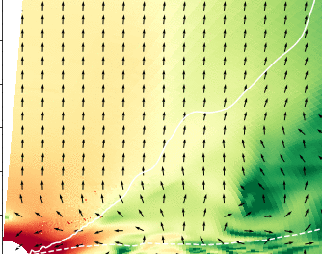
ADVECTION OF RADIATION
TURBULENT
UNRESOLVED REGION
BH
LANČOVÁ+ 2019

Slide 10
PUFFY DISC
FUNNEL
OPTICALLY THICK
PUFFY REGION
HIGH TEMPERATURE
DENSE CORE
LANČOVÁ+ 2019

Slide 11
MAGNETIC PRESSURE DOMINATES

Slide 12


DIFFERENT APPROACHES, SAME RESULTS
Sądowski+16, Lančová+19
B. Mishra+22, Fragile+18, Mishra+ 19
Quadrupole magnetic field
Initialised with torus far away from the BH, disc developed self-consistently
Geometrically thick puffy region, supported by magnetic field
$\dot{m}\sim 0.6 M_{Edd}$
Testing different MF configuration and some of them are stable!
Starting with thin disc
Lower $\dot{m}$- really in the thin disc domain

Slide 13
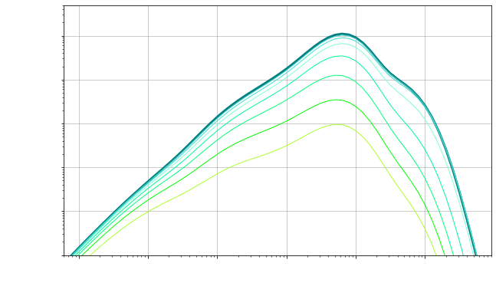
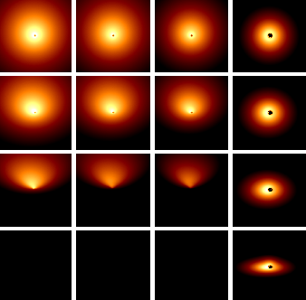
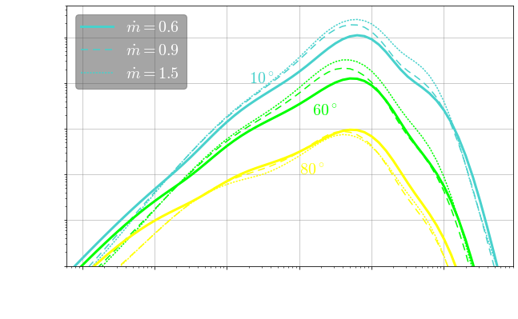


OBSERVATIONAL SIGNATURE
$$\dot{m}=0.6$$
INCLINATION
THIN
DISC
PUFFY DISC
AXIS
INCLINATION
EQUATOR
$$\dot{m}$$
WIELGUS+ 2022

Slide 14

BEAMING
Strong beaming in the direction of axis
$b≈0.25−0.3$ ($1/b={L_{iso}}/L$)
Does not change with $\dot{m}$, much more on inclination
WIELGUS+ 2022

Slide 15
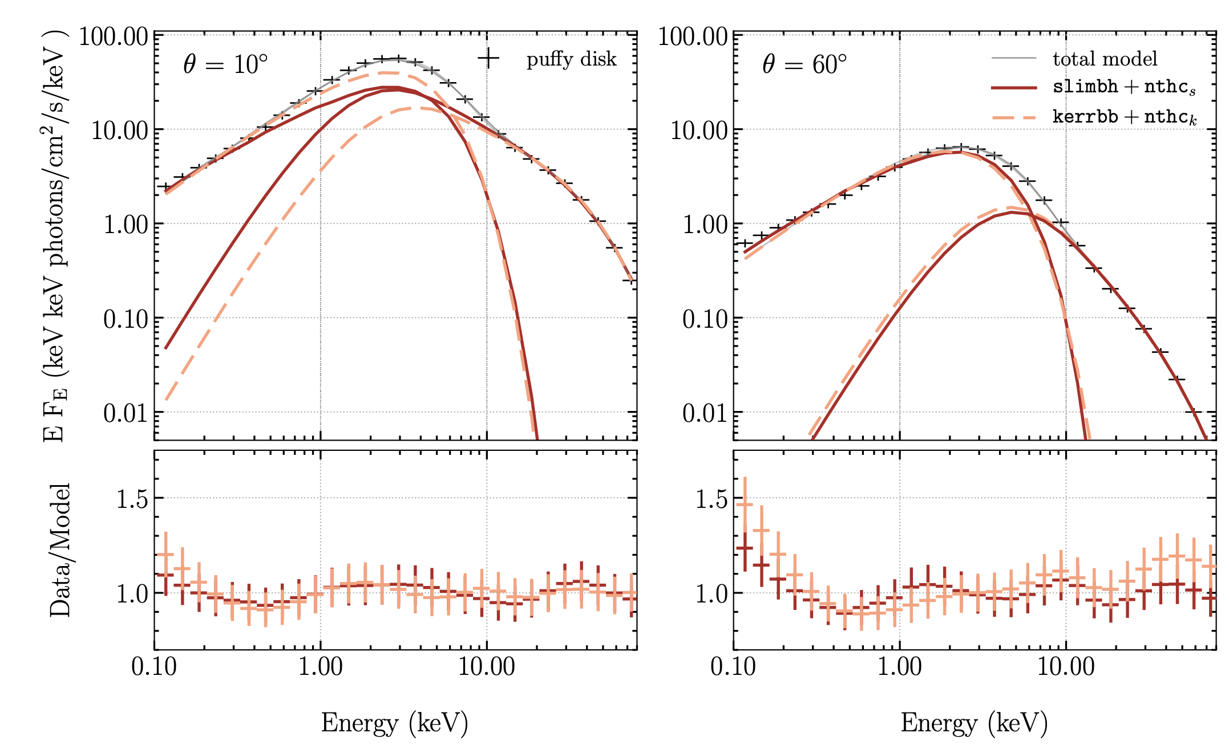
FIT IT!
WIELGUS+ 2022

Slide 16
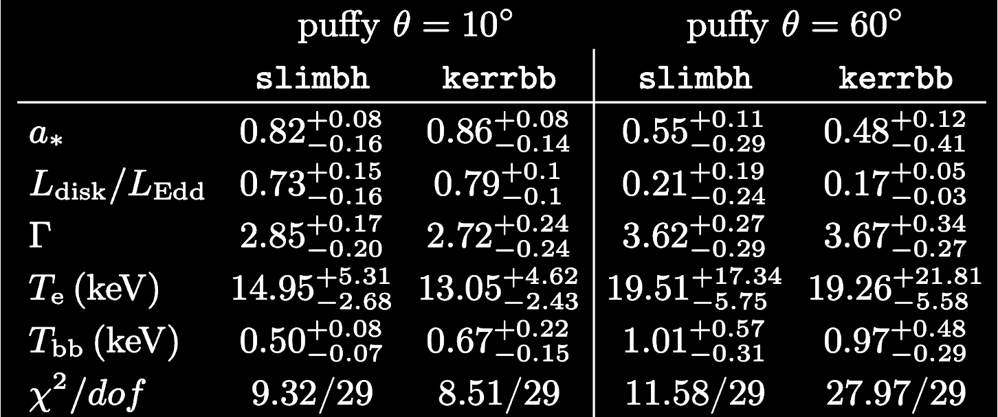
FIT IT!
SLIMBH and KERBB model in XSPEC thermal comptonization model NTHCOMP
Spin overestimated – especially for high inclination – the innermost part of the disc
WIELGUS+ 2022

Slide 17
HARDNESS/LUMINOSITY
Spectra are much harder than analytical model, also more luminous for low inclination
Soften with inclination – inner area is shielded by the thick disc – only funnel wall is visible
WIELGUS+ 2022

Slide 18
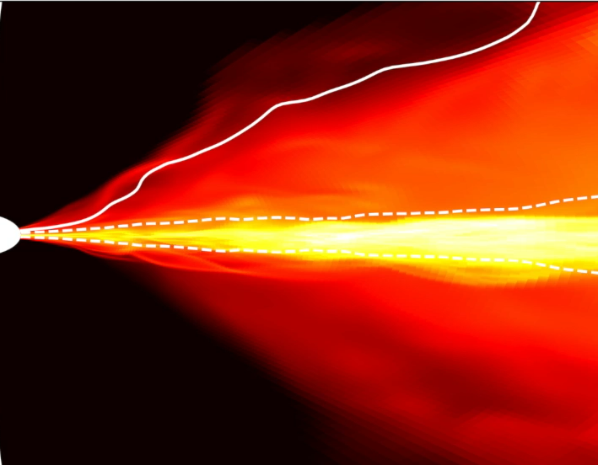
CONCLUSION
Accretion disc model resulting from a numerical simulation
Stabilized by vertical net flux of magnetic field
Geometrically thick, optically thick puffy region
Intermediate state of LMXBs or soft ultra luminous state of ULX?
Warm corona resemblance (Mondal+ 2021)
When fitted with standard model, overestimation spin
THANK YOU

Slide 20
TEMPERATURE RADIAL PROFILE

