Slide 1
Black widow pulsars and the maximum mass for neutron stars
John Miller
(Oxford & SISSA)

Slide 2
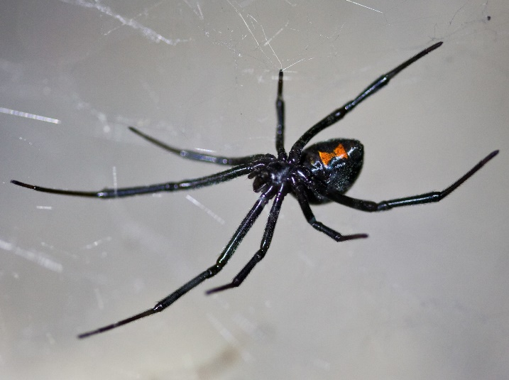
Where does the name come from?
- “Black widow” is the name given to a type of female spider known for killing and eating its partner after mating !
(2-4 cm)
- A “Black widow” pulsar is a pulsar which is destroying its binary companion by irradiation, winds, etc, and gaining matter from it

Slide 3
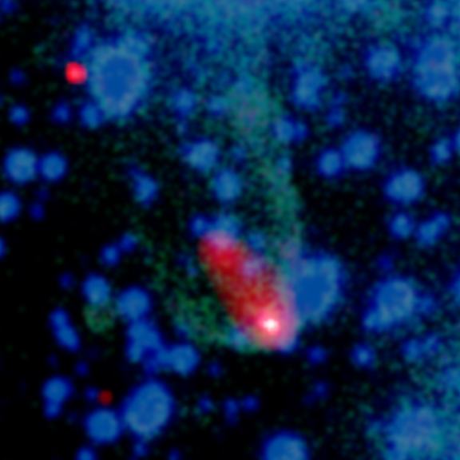
The original one (PSR B1957+20)
– discovered 1988 (Fruchter et al)
- binary millisecond pulsar (1.6 ms, ~ 2 kpc from Earth)
- in eclipsing 9.2 h orbit with a brown dwarf (~ 0.021 M_{ʘ})
- system has high velocity (~ 10⁶ km/h) with respect to the surrounding medium – drives bow shock
blue and green
- optical images
red and white
- x-rays (Chandra)

Slide 4
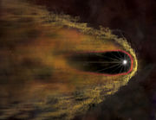
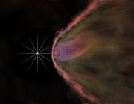
Artists impression of bow shock (L) and effect of pulsar wind on the companion (R) [magnified x 10⁶]
Mass estimates for pulsar of up to 2.4 M_{ʘ} but very controversial and uncertain

Slide 5
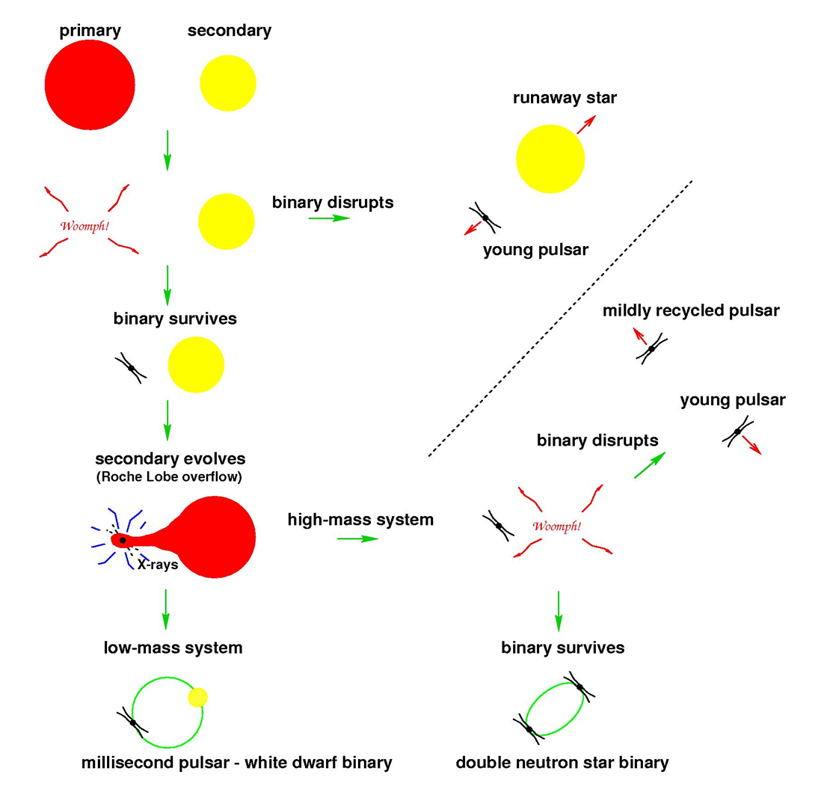
Standard route to millisecond pulsars
- Lorimer (2005)

Slide 6
Five interesting systems:
PSR B1913+16 (Hulse/Taylor 1974) NS + NS
1.441 M + 1.387 M 8 h / 59 ms
PSR J0737-3039 (Burgay et al 2003) NS + NS
1.249 M + 1.338 M 2.45 h / 2.8 s + 23 ms
---------
PSR J1614-2230 (Demorest et al 2010) NS + WD
1.97 M + 0.500 M 8.7 d / 3.15 ms
PSR J0348+0432 (Antoniadis et al 2013) NS + WD
2.03 M + 0.173 M 2.46 h / 39 ms
PSR J0740+6620 (Fonseca et al 2021) NS + WD
2.08 M + 0.253 M 4.77 d / 2.89 ms

Slide 7
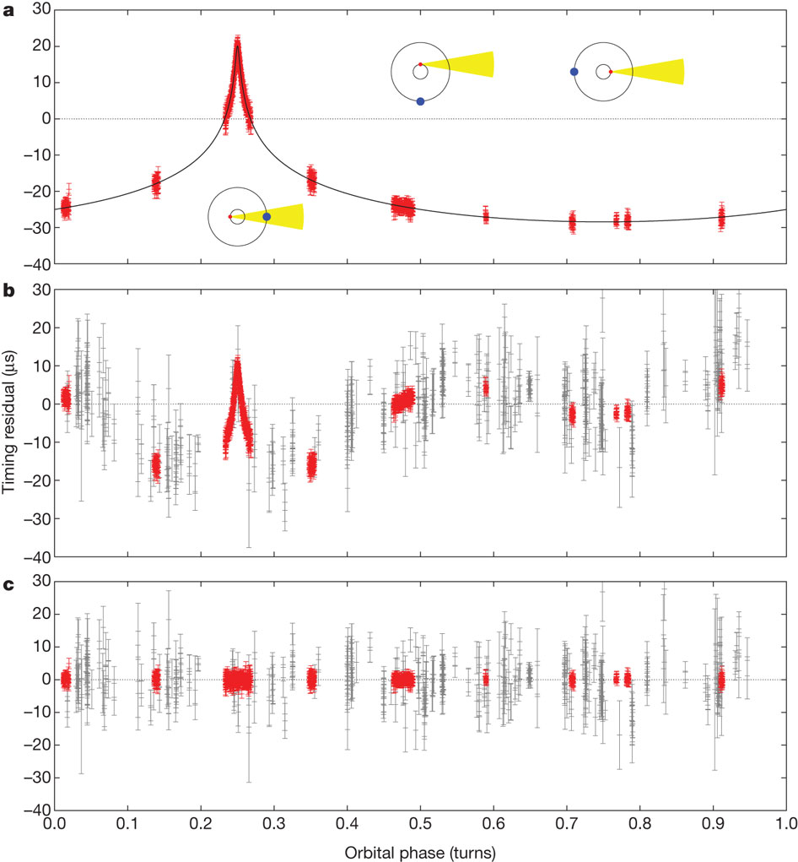
Shapiro delay measurement for PSR J1614-2230

Slide 8
The original black widow pulsar is the prototype for a class of millisecond pulsar + brown dwarf systems where the companion is being ablated
- suggestion that these pulsars may have very high masses
- but these systems can be complicated to model
- possible hot spots (HS), gravity darkening (GD) and wind flows rather than just direct heating (DH) of the companion …
Recent paper by Romani et al (2022b) →

Slide 10
PSR J0952-0607: Basic facts
- Discovered by Bassa et al (2017)
- Spin period: 1.41 ms - fastest known pulsar in the disk of the Milky Way
- but cf PSR J1748−2446 with P =1.396 ms in the globular cluster Terzan 5
- It’s a “black widow” pulsar with a very low-mass companion which is being evaporated due to the pulsar luminosity and/or winds
- Much of the evaporated material may go back onto the neutron star → high mass?

Slide 11
Nieder et al (2019)
- Detected PSR J0952-0607 as a gamma-ray pulsar
- Also obtained additional radio timing and optical photometry allowing initial fits for system properties
- This implied a very low magnetic field B $\sim 6.1×{10}^{7}$ G
- suggesting that there may indeed have been a lot of accretion
- Which makes it very interesting to measure the mass!
- But they didn’t think it could be done because the companion was so faint that it wouldn’t be possible to measure its radial velocities even with a 10m telescope. →

Slide 12
Romani et al (2022b)
responded that:
“This is nearly true, but the exceptional P_{s} and B inspired our intensive campaign of J0952 Keck LRIS imaging”
requiring
“substantial amounts of large telescope time, ideally with superior seeing”
And they did it (observations over 4 years), finding
$M_{ns}=2.35±0.17 M$_{ʘ} $M_{c}=0.032±0. 002 M$_{ʘ} i ~ 60 deg
[ cf Antoniadis $M_{ns}=2.01±0.04 M$_{ʘ}
Fonseca $M_{ns}=2.08±0. 07M$_{ʘ} ]

Slide 13
Sloan ugriz light curves
Frequency bands

Slide 14
Radial velocity curve

Slide 15
The M_{ns} result for PSR J0952-0607 was then plotted together with those for 3 other black widows and one redback, also the 2 highest mass standard pulsars
Fortunately HS, GD and wind complications with the model fitting are not serious for J0952 and the DH model works well (due to low companion mass and large separation)
Finally, a statistical study was made to get a lower limit for the maximum possible mass of neutron stars

Slide 16
Refers to bottom frame
Normalised likelihood

Slide 17
What about J1810+1744 (Romani et al 2022a)?
- the HS+GD+wind corrections are important here
Light curves:
with fits for the best-fit direct heating (DH) model (left) and the best-fit HS+GD+wind model (right)
The values for M_{ns} are $2.13±0.04 M$_{ʘ} (HS+GD+wind)
$3.42±0.09 M$_{ʘ} (DH)

Slide 18
Their final comment in the Abstract:
“Joined with reanalysis of other black widow and redback pulsars, we find that the minimum value for the maximum NS mass is M_{max} > 2.19 M_{ʘ} (2.09 M_{ʘ}) at 1σ (3σ) confidence. This is ∼ 0.15 M_{ʘ} heavier than the lower limit on M_{max} implied by the white dwarf–pulsar binaries measured via radio Shapiro-delay techniques.”

Slide 19
Conclusions:
- These are interesting systems which deserve further study!
- I think that Romani et al made a heroic effort with J0952-0607 but that the error bars on this mass measurement are so large that the result should be seen as very tentative
- Their result M_{max} > 2.19 M_{ʘ} (2.09 M_{ʘ}) at 1σ (3σ) seems to be the main one to take away
- It does seem that the black widows are giving the highest mass neutron stars

